Slide 1
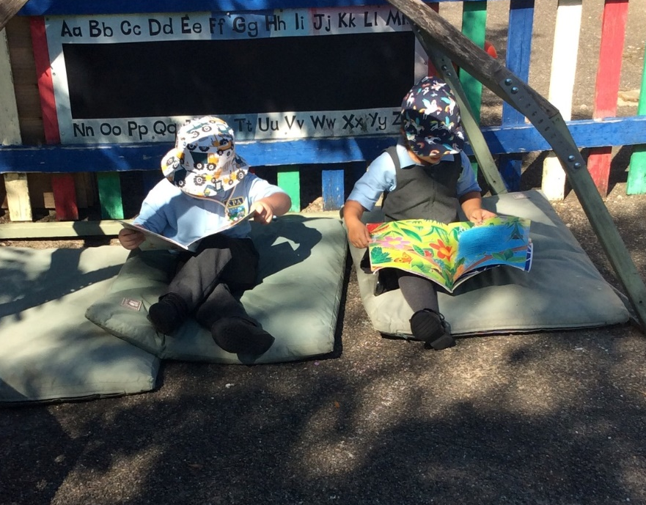
Early Reading and Phonics Workshop
Notes:
Welcome and thank you for coming. You’ve made the first step in supporting your child on their reading journey by being here today. Learning to read takes a strong partnership between home and school- so thank you.

Slide 2
What is Phonics?
‘Phonics refers to a method for teaching speakers of English to read and write their language’
The National Literacy Trust
Notes:
Children are taught to read through phonics. Phonics is a method of teaching the 44 different sounds in the English language and identifying them in words to read them. However phonics is only one strategy the children use when reading. They are also encourage to look at the pictures, listen to the rest of the sentence to work out words they cannot read and think about whether the sentence makes sense in the context.

Slide 3
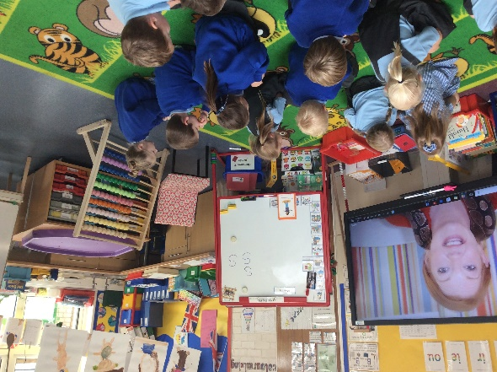
Phonics
30 minute daily focus but referred to throughout the day in a variety of activities.
At KPA, we use Storytime Phonics which follows the Government Letters and Sounds programme.
Recap, Teach, Practise, Apply.
Notes:
At KPA and GS we use Storytime Phonics which follows the Government Letters and Sounds programme. We recap previous learning, teach a new sound, practise using the new sound and then the children have the opportunity to apply their knowledge of the sound in different ways. Chn are taught in small groups according to their needs. Anyone children who are struggling with phonics are identified early and we put booster sessions and extra support in place.
Storytime phonics is designed to help promote a love of reading and to teach phonics in a more meaningful way. The concept helps put the sounds into context through books, something which we have found that the children absolutely love. The magic of the phonics fairy really brings phonics to life and the children engage really well.

Slide 4
Terminology
Children are taught from the beginning to use phonic terminology that may be unfamiliar to you.
A phoneme is the smallest unit of sound in a word.
A grapheme is the letter, or letters, representing a phoneme (e.g. t, ai and igh).
Digraphs have two letters (e.g. sh, ck, th and ll).
A vowel digraph contains at least one vowel (e.g. ai, ee, ar and oy).
Trigraphs have three letters (e.g. igh).
A split digraph (e.g. slide and like).
Notes:
We use the correct phonics terminology in lessons with the children so I thought I would run through some of the words you might encounter in discussions at home that may be unfamiliar to you.
A phoneme is the smallest unit of sound in a word.
A grapheme is the letter, or letters, representing a phoneme (e.g. t, ai and igh).
Digraphs have two letters (e.g. sh, ck, th and ll).
A vowel digraph contains at least one vowel (e.g. ai, ee, ar and oy).
Trigraphs have three letters (e.g. igh).
A split digraph (e.g. slide and like).
The children use these words in phonics lessons and when discussing reading. They will learn how to add sound buttons to these types of sounds. If you are ever unsure please just ask.

Slide 5
Phonics- phase 1
Listening and spoken language skills continue alongside all other phases of learning to read.
Your child has been learning to:
  Have fun with sounds
  Listen carefully
  Develop their vocabulary
  Speak confidently to you, other adults and children
  Tune into sounds
  Listen and remember sounds
  Understand that spoken words are made up of different sounds.
Notes:
GB
Phase one is the first building block to learning to read and really builds on many of the games and activities that you may already do at home with your child such as singing nursery rhymes and listening to environmental sounds. We play lots of listening games such as recognising rhyming, initial sounds, natural sounds etc. We continue this phase alongside all other phases.

Slide 6
Phonics- phase 2 and 3
Phase 2
Set 1: s, a, t, p
Set 2: i, n, m, d
Set 3: g, o, c, k
Set 4: ck, e, u, r
Set 5: h, b, f, ff, l, ll, ss
https://www.youtube.com/watch?v=BqhXUW_v-1s
Phase 3
Set 6: j, v, w, x
Set 7: y, z, zz, qu
Consonant digraphs: ch, sh, th, ng
Vowel digraphs: ai, ee, igh, oa, oo, ar, or, ur, ow, oi, ear, air, ure, er
Notes:
As the children become settled into reception and confident with phase 1 skills we begin to teach phase 2 sounds. We teach the children to recognise single letter sounds as you can see on the screen. We also teach them to segment words into their individual sounds and then blend them together to read the word- this is why it is so important to pronounce each sound correctly.
As the children move through reception they are taught phase 3 sounds. This includes digraphs and trigraphs- 2 or 3 letters making one sound. By phase 3 children are expected to be beginning to read and write simple words in sentences. We always use lowercase letters except for names, people, places and the start of a sentence. We call the uppercase letters by their name (like the alphabet) and lowercase letters make the sounds that the children use in phonics to read the words.

Slide 7
Phonics- Phase 4
In Phase 4-
No new graphemes.
Aim is to consolidate the children's knowledge.
Focus on reading adjacent consonants, such as trap, string and milk.
In phase 3 they learn to read CVC words (mat, sun, van). Now they are taught to read and write CVCC words (jump, gulp, lift).
Tricky Words:
  said
  have
  like
  so
  do
  some
  come
  were
  there
  little
  one
  when
  out
  what
Notes:
After phase 3 we teach phase 4. This often comes at the end of the reception year but is also recapped in year 1. This year we have also recapped phase 2 and phase 3 sounds in year 1 as well. Phase 4 is a short phase which is used for consolidation and some new tricky words are also introduced. All the tricky words for each of the phases can be found in your child’s reading diary. This is the blue book that the children bring home each day.

Slide 8
Phonics- Phase 5
In phase 5 new graphemes are taught:
ay, ou, ie, ea
oy, ir, ue, aw
wh, ph, ew, oe, au, ey
a_e, e_e, i_e, o_e, u_e
Phase 5 teaches more graphemes and phonemes but also teaches alternative pronunciations.
Notes:
The next phase of phonics is phase 5, this is normally taught in year 1. The children learn some new, more challenging sounds but it is often with these sounds their reading really takes off. With practice, speed at recognising and blending graphemes will improve and the children will begin to read more complex words. Word and spelling knowledge will be worked on extensively during this phase. We look at alternative ways of making the same sound. For example all the different ways of making the ai sound such as , a-e, ay, ae, eigh, etc.

Slide 9
Alternative spellings…
ea
ay
ei
ai
a-e
a
eigh
Notes:
There are lots of different spellings for the ai sound so it’s important to explore them and teach the spelling rules around them. This is mainly taught in phase 5 and into phase 6.
Some have their own book/caption and action to help the children distinguish between them, others are just added on or discussed.

Slide 10
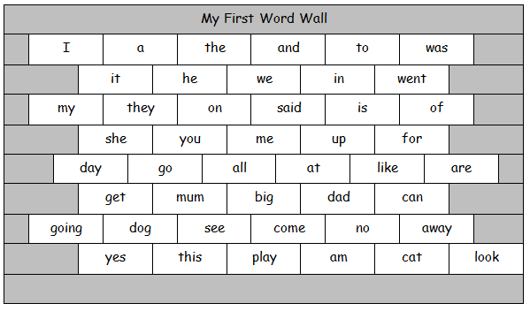
Words Walls
Word walls 1-3 contain high frequency words and some tricky words.
Learning these words by sight will improve reading fluency. You could tackle 3-5 words each week.
Game ideas:
  Word hunt around the house
  Game of pairs
  Chalk them on the patio
  Build them with magnets on the fridge
  Practise spotting them in books you read together.
Notes:
Word walls contain high frequency words and tricky words, this will include words that do not follow the rules of phonics which is why we call them ‘tricky’ words. They can be found in your child’s reading record. The children can earn badges for reading the words on each of the word walls and support the practise of reading these words at home will really help their reading to build fluency and will help to build their confidence.
Some activities you can do to learn them include a word hunt around the house, a game of pairs, chalk them on the patio, build them with magnets on the fridge, spotting them in books you read together.

Slide 11
Book bands/ phonics books
Phonics books
Relate to current sounds your child is learning or one they need to practise.
Decodable words e.g. cvc words
Develops using phonics knowledge to break and blend words
Coloured band book
Relate to the stage your child is on their reading journey
Read with at least 90% accuracy
Develops segmenting and blending skills, understanding of what they have read, expanding vocabulary
Library book
Purely for joy
Access to wide range of books
Develops their imagination
Reading:
Expands vocabulary
Develops imagination
Encourages concentration and focus
Promotes empathy
Provides a chance to access the whole curriculum
Develops expression
Teaches us about the world around us
Notes:
EK
Phonics books, these books relate to the current sounds your child has learnt/learning. These books will contain words that your child can decode. Reading these books helps your child use their phonics knowledge to break down the words and blend them to read.
Coloured band book, these books relate to the stage your child is on their reading journey. Every half term your child will be benchmarked (assessed) on their segmenting and blending skills and understanding of what they have read. These books help develop pleasure for reading, expanding vocabulary and blending skills.
Library book, these books are purely for joy. We want our children to access a wide range of book, develop their imagination and to share their books with you!

Slide 12
Reading diary
A little tired last night so we read this morning. We read to p7. Jane read really confidently and even managed to read the word ‘telescope’. Jane also recognised lots of tricky words!
Read well this evening. Struggled with the word ‘brother’ but sounded it out. We had a chat about all the people in our family.
John whizzed through this book. We chatted about all the new words and what they mean such as circus and carnival. He was able to retell most of the key events in the story in his own words.
We found this book really tricky. We sounded out the words together but really struggled. Can you help?
Notes:
Your child’s read diary is really precious and is a collection of evidence of how their reading is progressing. Please take good care of it!
Here’s are some examples of the kind of thing you might write it their reading diary. Think about what they did really well and what they found a bit tricky. Feel free to ask questions and share successes!
The books the children take home should be mostly easily decodable this means they should be able to read it with around 90-95% accuracy. We tackle some more challenging books at school when reading 1:1 or during guided reading group sessions.

Slide 13
Reading Bands
My child’s friend is on the next colour.
This book is too easy for my child!
When can my child move up?
Bill is on yellow, is my child behind?
My child has read this book already.
Notes:
I really do not want parents to compare the colour band their child is on with other children. Each child is on their own journey. It is not a race! Lots of factors affect when we choose for a child to change colour book band. Most of all we want the children to enjoy the books they read at home- the books that get sent home should be readable with at least 90-95% accuracy- we do the hard work at school in guided reading sessions and when we read 1:1.
Sometimes we ask a child to read a book again or sometimes they choose the same book again. There is nothing wrong with this. It helps to consolidate the sounds and words they know and is a great opportunity for discussion.
You can challenge your child by asking them questions about the text. Can they retell the main events accurately or with details. Can they predict what might happen next if you pause part way through? Can they discuss characters, their feelings and their actions? Can they talk about why they like or dislike a certain book? Can they compare it to other texts? You can do this with any book- bedtimes stories, reading books, books from the library.
My main message here is please do not compare your child with other children. They are on their own learning journey and sharing a love of reading rather than a need to ‘move up’ is much more important.

Slide 14
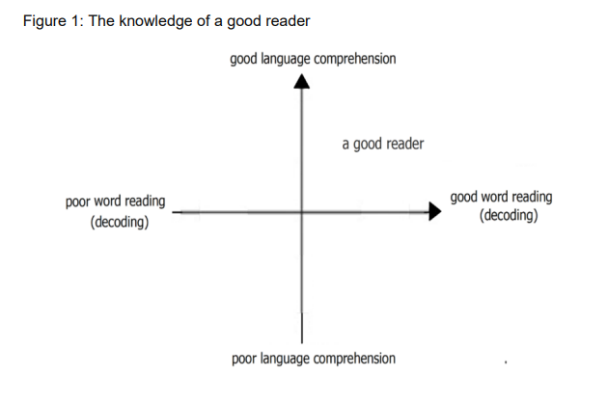
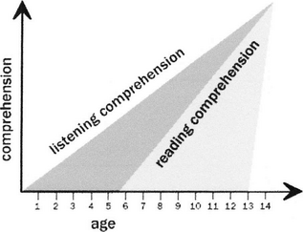
Links between decoding and comprehension
Comprehension: the understanding of the text by connecting ideas within and between sentences.
Decoding: applying phonics knowledge to correctly read written words.
Developing secure decoding skills, and in turn fluency and comprehension, opens a world of opportunities.
Notes:
GB
Decoding is a key skill to reading comprehension. Word reading and language comprehension require different sorts of teaching. When children start learning to read, the number of words they can decode accurately is too limited to broaden their vocabulary. Their understanding of language should therefore be developed through their listening and speaking, while they are taught to decode through phonics. This skill is developed through the phonics phases. However, when they can read most words ‘at a glance’ and can decode unfamiliar words easily, they are free to think about the meaning of what they read. They can then begin to develop their understanding of language through their reading. (p17)
In contrast to spoken language, written language is a cultural invention. Most children do not develop the ability to read without direct teaching. For children who begin school with a poor understanding of language, being able to decode words is essential for equality, because their understanding of language, their vocabulary and their knowledge of the world will expand rapidly when they can read for themselves. Children need both good language comprehension and good word reading to become good readers.
Graph 2: Decades of research, not to mention personal experiences, confirm that listening comprehension outpaces reading comprehension from early childhood through at least middle school. Based on their review of research, Stricht and James (1984) analyzed the gap between listening and reading comprehension by age of learner (see Figure 1). What is obvious from this figure is the fact that access to complex ideas, for many years of the learner's life, requires oral rather than written input.
Simply stated, children can listen to and talk about much more complex ideas than they can read (and probably write) about. In addition to the research, anyone who has ever read a bedtime story to a preschooler knows that listening comprehension is more sophisticated than reading comprehension. The proof comes from nights when you're tired and you skip a page while reading a bedtime story. That 3-, 4-, or 5-year-old's eyes pop open. You are accused of skipping some of the story, and the punishment is that now you must start over. Yes, in fact, the child is listening, understanding, and comparing the text with his or her expectations.
What is less obvious from personal experience is the persistence of this gap. According to Stricht and James (1984), the gap extends well into middle school. This gap has implications for high-quality instruction across the learner's elementary and middle school experience, and oral language development should not be considered solely the role and responsibility of early childhood educators.

Slide 15

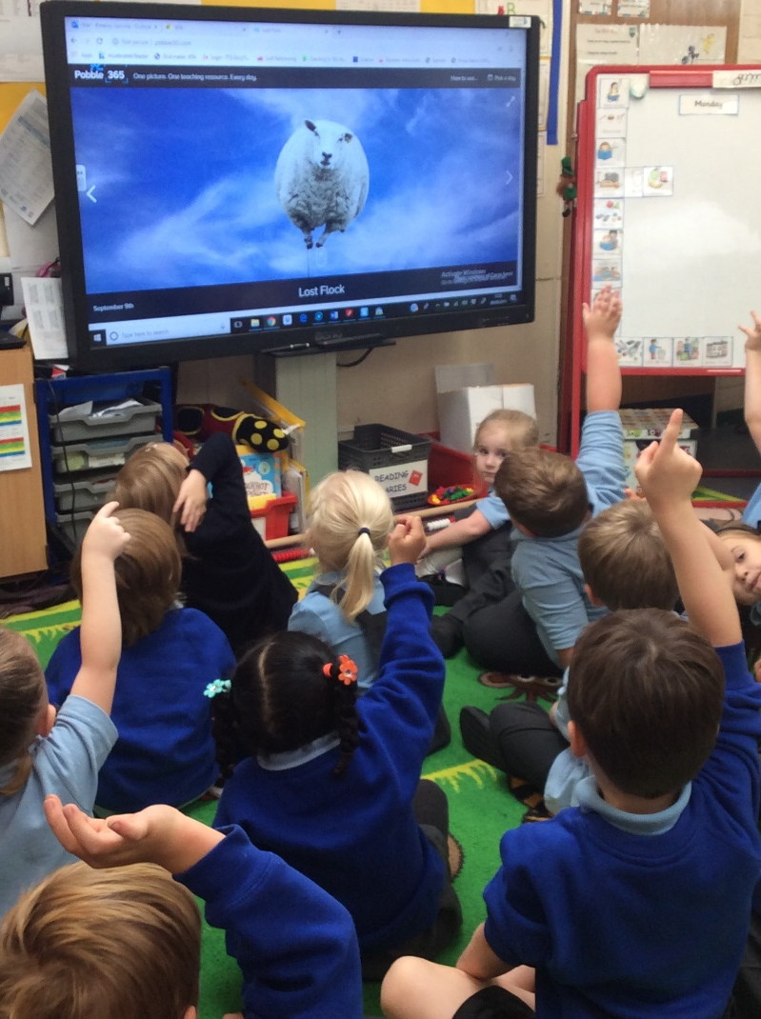
Phonics packs
Notes:
Your child will receive a phonics pack with all the sounds they have learnt so far. It is useful for you to practise these at home to help consolidate learning. At school we play games such as SPLAT!, pairs and snap. These are games you can also play at home.
Please look after your child’s phonics pack and keep it safe in their bag so that it comes to school each day. It takes a lot of time to produce these resources so having to replace them is a shame.

Slide 16
The Importance of Book Talk
Book talk refers to the discussion you might have about a book.
Look at the front cover, the title, the pictures. Discuss what you think the book might be about.
Who are the character?
What might happen? How do you know?
Retell the story in your own words.
It’s vital to develop children’s listening and speaking skills alongside reading
Notes:
GB
Book talk is vital for children to gain an understanding of what they have read, to improve their comprehension skills and inferential skills. Book talk gives the children a chance to use some of the words in the book in advance of reading the book.
We really encourage you to try lots of book talk at home before you ask your child to start reading the words- look at the front cover, the pictures, discuss what they think the story is going to be about.
Oral language development facilitates print literacy.

Slide 17
Reading at school
Reading at Home
Sharing books for pleasure.
Bedtime Stories.
1:1 reading of school reading book.
Sharing newspapers, magazines and non-fiction texts.
1:1 reading
Guided Reading
Shared Reading
Independent Reading
Readers are made on the knees of their parents.
Notes:
At KPA we provide opportunities for the children to read 1:1 with an adult almost every day. This is most likely to be with the class teacher or teaching assistant but there may be times when they read to other adults in school.
We also do guided reading every week where the children take part in a group discussion about a book. We share books as a whole class and the children also have opportunities for independent reading within the classroom. They enjoy choosing their own library books, which they often cannot read yet themselves- this is a great opportunity for discussions and to broaden their vocabulary. Discussing the meaning of next words is a fantastic opportunity to move their reading skills on!
At home you can share books for pleasure- this is probably the most important thing you can do! Enjoy bedtime stories, but also books at any time of day. Share recipe books, newspapers, magazines, instruction manuals- anything with text in it is a great things to share with your child as they explore reading for different purposes!
The children in reception may currently have a book with no words in. This is part of the process. We encourage you to spend time discussing the title, pictures and events in the story. When the children are ready they will receive a book with words in that matches their phonics ability. Again, just a reminder it is not a race but parental input at home has a huge effect on reading attainment so supporting your child by reading with them regularly is really important.

Slide 18
Reading at home
Encourage your child to hold the book and turn the pages themselves.
Talk about the front cover. Can they find the title? Who is the author? What do they think the book is going to be about?
Encourage your child to use their phonics, knowledge of tricky word and the pictures to read the words. Discuss the pictures together.
After reading, discuss what the book was about and what their favourite part was.
Notes:
Discuss how to read with a child 1:1.
Encourage your child to hold the book and turn the pages themselves.
Talk about the front cover. Can they find the title? Who is the author? What do they think the book is going to be about?
Encourage your child to use their phonics, knowledge of tricky word and the pictures to read the words. Discuss the pictures together.
After reading, discuss what the book was about and what their favourite part was.
Remember, they should be able to read the book they take home quite easily. If they get stuck, count to 3 slowly and then tell them the word.

Slide 19
Top Tips
Practise little and often.
Practise phonics flash cards and games.
Discuss the world and children’s experiences to gain new vocabulary.
Sharing books with your child often. Look at the pictures and talk about the book. Share bedtime stories/ magazines/ recipes/ all texts!
Encouraging your child to form their letters correctly.
Model correct speech and correct your child’s speech if they say something incorrectly.
Play reading and writing games.
Come and chat if you are worried or have questions!
Notes:
Practise little and often.
Practise phonics flash cards and games.
Discuss the world and children’s experiences to gain new vocabulary.
Sharing books with your child often. Look at the pictures and talk about the book. Share bedtime stories/ magazines/ recipes/ all texts!
Encouraging your child to form their letters correctly.
Model correct speech and correct your child’s speech if they say something incorrectly.
Play reading and writing games.
Come and chat if you are worried or have questions!

Slide 20
What can I do if my child is stuck?
Don’t let them struggle for too long- count to three and then help them by:
  Encouraging your child to look at the pictures.
  Ask what sound the word starts with?
  Re-read the sentence up to the point your child is stuck.
  Write the word down and ask your child to add sound buttons.
  Give the child the word.
  Write any words your child struggles with and needs to learn in their reading diary.
Notes:
Don’t let them struggle for too long- count to three and then help them by:
Encouraging your child to look at the pictures. Please don’t cover up the pictures!
Ask what sound the word starts with?
Re-read the sentence up to the point your child is stuck.
Write the word down and ask your child to add sound buttons.
Give the child the word.
Write any words your child struggles with and needs to learn in their reading diary.

Slide 21
Sound buttons
We use sound buttons as a visual aid to support segmenting and blending.
cat
tap
church
ship
Notes:
Model this on a whiteboard!!
Tricky words and some of the words on the word walls cannot be segmented and blended- this is why the children learn them by sight.

Slide 22

Year 1 Phonics Screening Check
The Phonics Screening Check takes place at the end of year 1.
The phonics screening check assesses children’s ability to decode words.
The children will read 40 words. Some of these words will be alien or nonsense words.
Notes:
The phonics screening check takes place at the end of year 1. The children read 40 words, some of which are nonsense words. We practise nonsense words through each phase of phonics so it becomes normal. The screening assesses the children’s ability to decode words. It purely assess their phonics knowledge and their ability to decode words using phonics.
This is something the children in year 1 are already familiar with and is nothing to worry about.

Slide 23
Useful Resources
Phonics Play-
www.phonicsplay.co.uk
Letters and Sounds- http://www.letters-and-sounds.com/
Mr Thorne Does Phonics/ Geraldine the Giraffe Learns… (Youtube)
Espresso
Notes:
Some useful websites to practise phonics at home in a fun way!

Slide 24
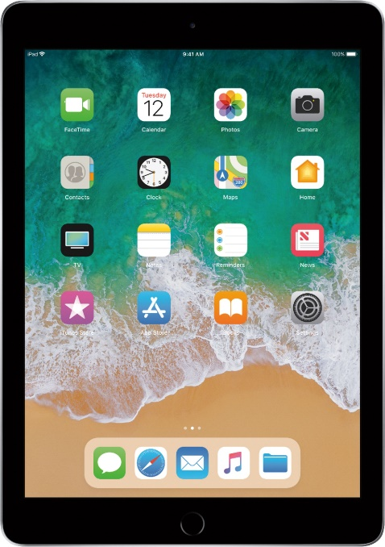
Useful apps
Teach Your Monster to Read app
Mr Thorne Does Phonics: Letters & Sounds
Alphablocks (free) – excellent for initial sounds and blending
Notes:
If you have any more please share them with other parents!
The children have access to apps and programs in the classroom during busy learning time too such as the Teach Your Monster to read app.

Slide 25
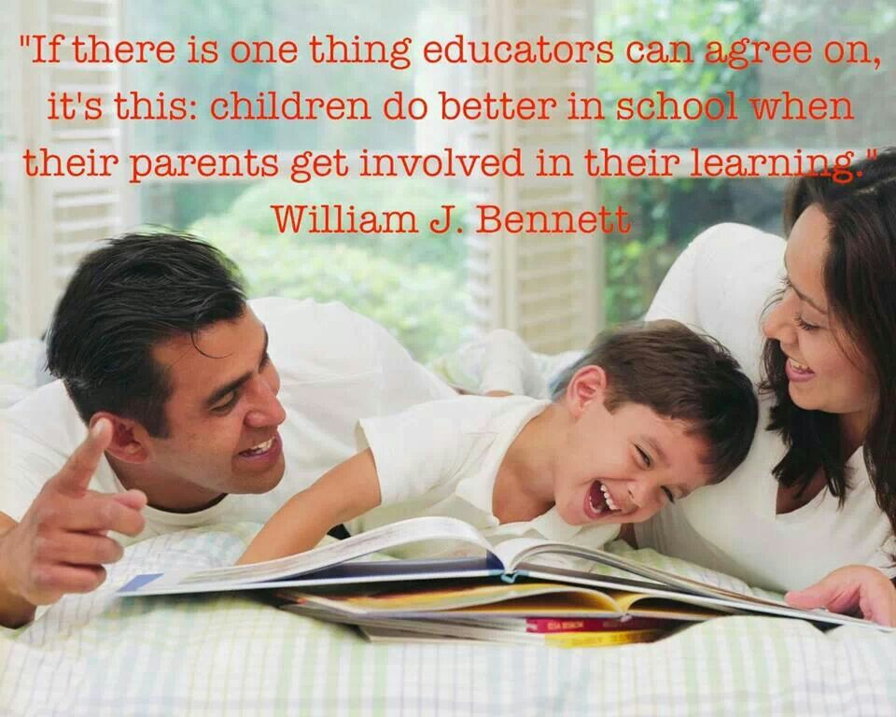
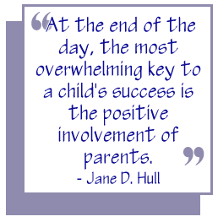
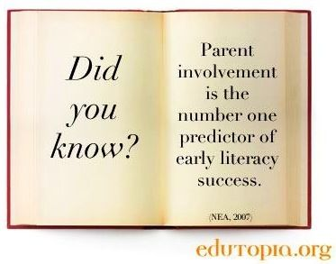
Notes:
As you are all here I’m sure you will agree with the quotes on this slide. The impact of parental support and engagement is huge. We see it everyday. Education doesn’t just happen at school and I hope that together we can form a partnership which will support and guide your child to become a successful reader. Parental input at home is paramount to a child’s success at school. Please support your child by completing activities at home and asking if you need help. We are here to help you and your child.

