Slide 1
Understanding the world around us and our place within it
The Secret Sky Garden
By Linda Sarah and Fiona Lumbers

Slide 2
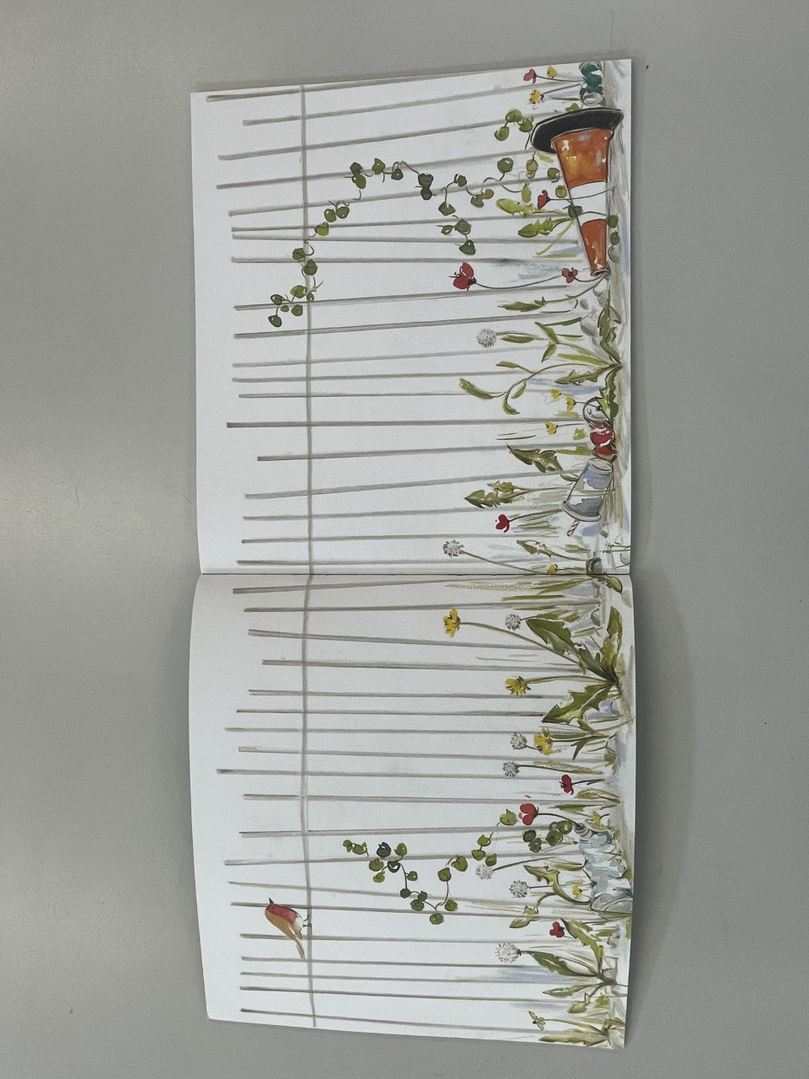
What can you see?
Notes:
Before showing the children the front cover, show them the front endpaper. Allow them time to look at this and respond to what they can see.
Have a large copy on flipchart and annotate with children’s ideas and observations.

Slide 3
Now lets think about:
Where is this place?
What is it like? How do you know?
Would you like to be there? Why or why not?
Have you ever been somewhere like this? Where was it? What was it like?
How might it feel to be here?
Notes:
Write the answers down to these in a different colour pen on flipchart

Slide 4
Lets look closer…
Do you know what bird this is?
Why might it be there?
What do you think the robin might be thinking about this place?
Notes:
Now encourage children to look at the robin.
Have this as a discussion

Slide 5
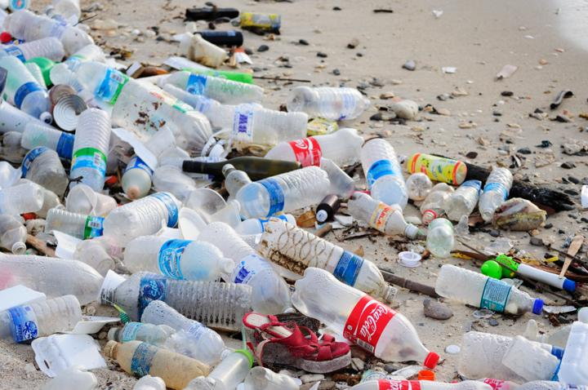
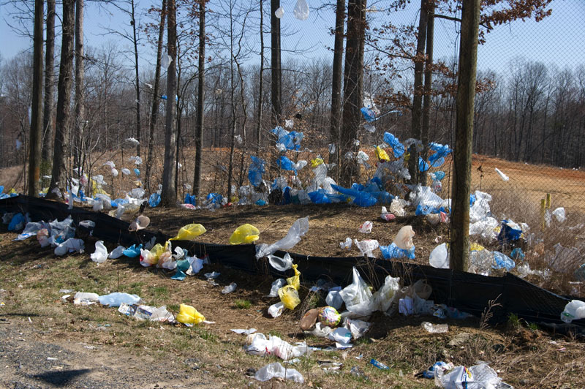
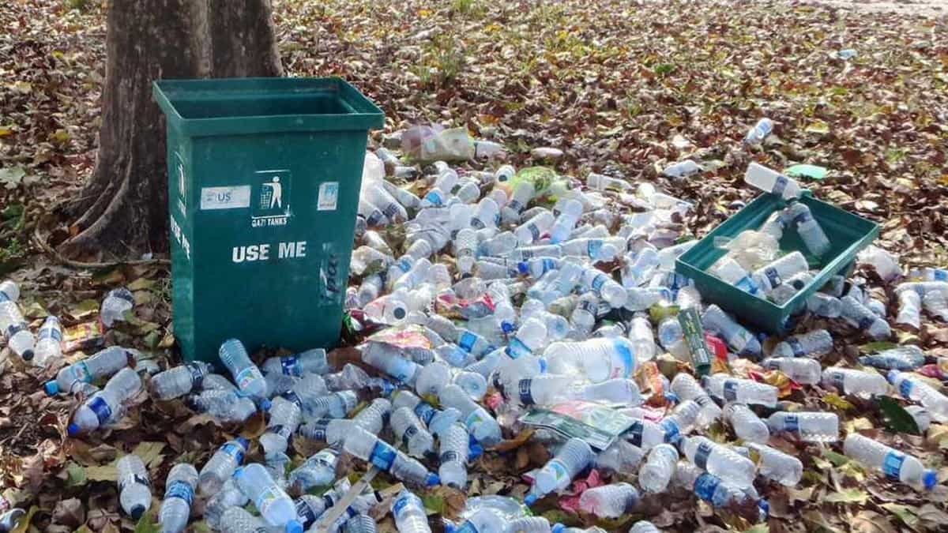
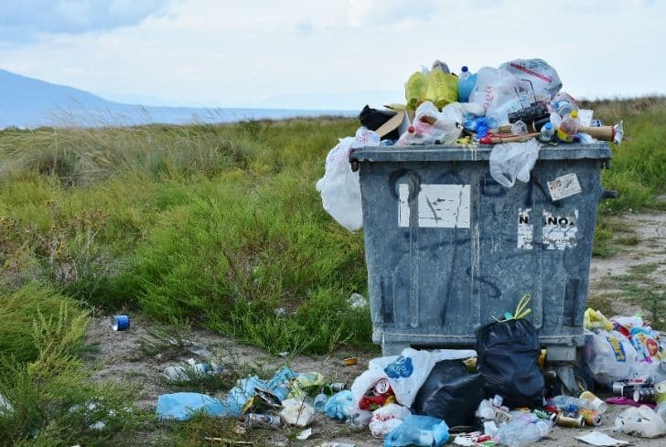
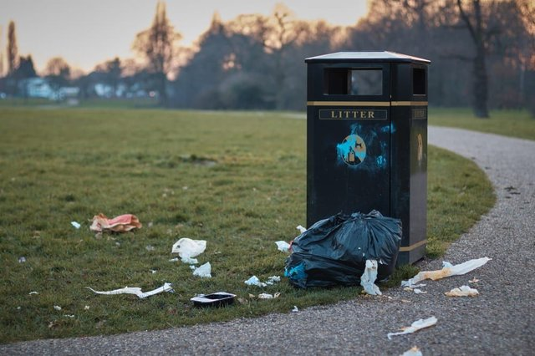
We are now going to think about littering in the real world.
Notes:
We are now going to try and link this to real life contexts.
Either on a walk in the local area, around the school grounds or by showing a variety of videos and images of littering.

Slide 6
Looking at the litter, think about:
What kind of litter is it? Is it food packets, crisp packets or larger fly tipping or dumping?
How do you think this happened? Why do you think people litter?
What should happen to rubbish like this?
Who do you think is responsible for this litter now?
Notes:
Have children make notes on their brainstorm image, then scribe as a class

Slide 7
Lets discuss
Have we seen anywhere where littering is a concern in our local area?
Why is littering a problem?
How could we encourage people not to litter?
How does it make our local area look or how does it make this place feel?
What harm might it do to the local wildlife?
Notes:
Scribe on flipchart

Slide 8
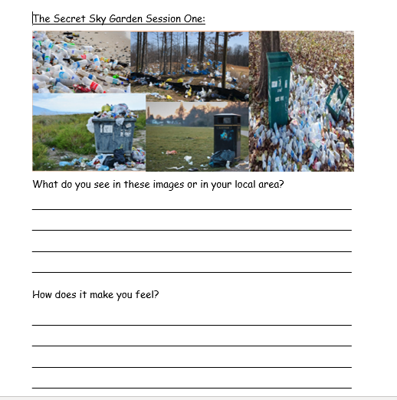
Task
Notes:
Allow children some time to look through the photos and write their thoughts on their sheets to describe what they saw and how it makes them feel.
Y2 EXS and Y3 WTS sheet with word bank on
Y2 GDS and Y3 has the extra question, what would you do to stop people littering

