Slide 1
Engaging with the environment
The Secret Sky Garden

Slide 2
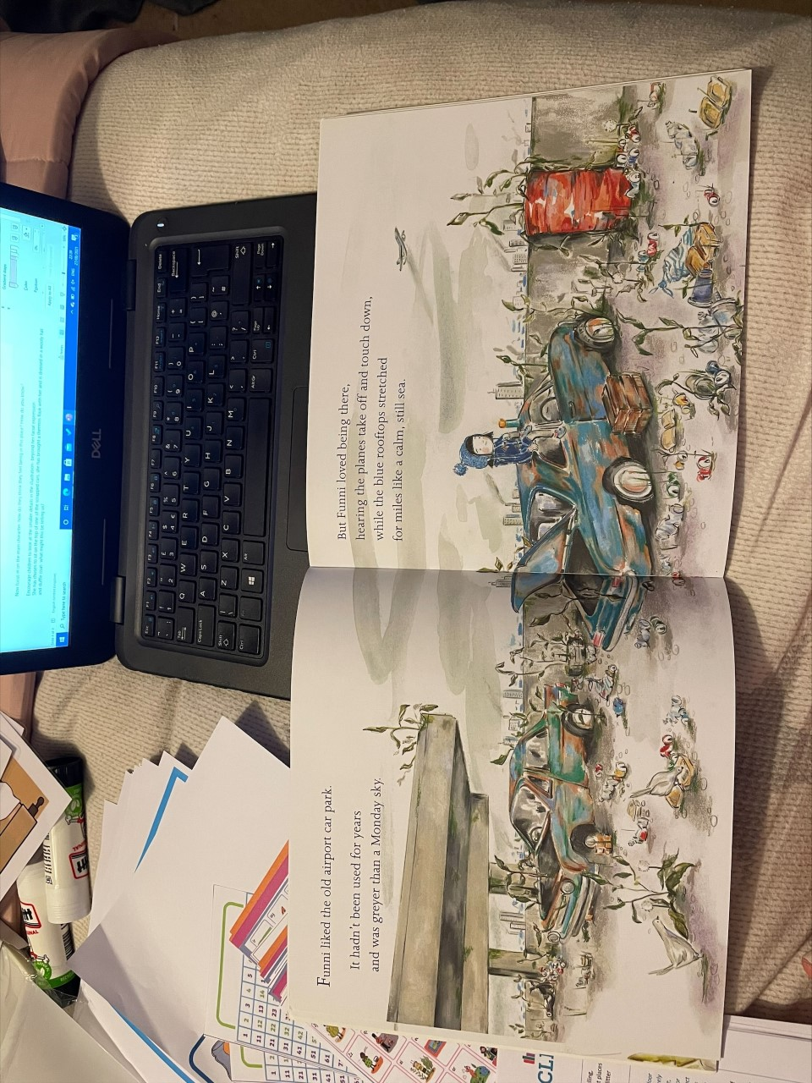
Notes:
Sharing this image to the children, give the children the opportunity to study this image in depth, record their ideas around the image on flipchart

Slide 3
Let’s discuss
How does this illustration make you feel? Why?
How would you describe this place to someone else?
What do you think it is like to be there?
What can you see?
What might you hear?
What might it smell like?
How would it feel to be in this place?
Notes:
Note their ideas on the flipchart in different colours

Slide 4
How do you think they feel being in this place?
Let’s look at the smaller details, what can we spot?
How do you know?
Notes:
Now focus in on the main character, how do they think they feel being in this place? How do you know?
Encourage children to look at the smaller details in the illustration- beyond her facial expression
She has chosen to sit on the top of one of the scrapped cars, she has brought a thermos flask with her and is dressed in a wooly hat and duffle coat- what might this be telling us?

Slide 5
Let’s think about predictions
What do you think might happen in this character's story?
Why do you think that?
Notes:
Make notes of this on flipchart

Slide 6
Let’s read
How do the words you just heard make you feel?
Did it make you feel differently about this place?
Why did it make you feel different?
Notes:
Now read the words on this page to the children, talk about how the words they heard made them feel? Did it make them feel differently about this place? Why?

Slide 7
Notes:
With a partner, give them the sheet and have them highlight or mark the words and phrases they like or that tells them how this character feels about this place.

Slide 8
Let’s go outside
We are going to go outside, and take in our surroundings.
Focus on what you can hear, see and smell around them, what they can touch and how this place makes them feel.
Make sketches of things that catch your eye or yourself in the place.
Year 3s- make notes of your thoughts, feelings, or ideas.
Notes:
Year 2s to verbally share their ideas as they are drawing and an adult to scribe these on paper
When coming back in- allow children to add paint/water colour or any other choice of media.
Year 2s to write words or phrases on speech bubbles to go alongside their image
Year 3s to write sentences to go alongside their image

Slide 9
How did it feel to be outdoors?
What sort of things did you see and hear?
How did this place make you feel?
How did the place you visited compare to Funni’s car park?

