Slide 1
Recognising and expressing feelings through a focus on characters
The Secret Sky Garden

Slide 2
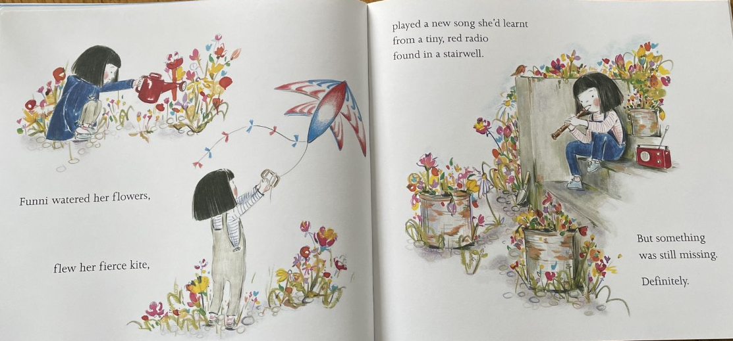
What more do we learn about the character of Funni on this page? How would we describe her here?
Has her character developed or changed since the start of the story? How?
Notes:
Read the book from the beginning up until the line ‘but something was missing definitely.

Slide 3
Notes:
Re-read this spread, does this spread remind them of anything we have seen previously?
e.g. ‘She came there most Saturdays’ ‘But something was missing. Definitely’

Slide 4
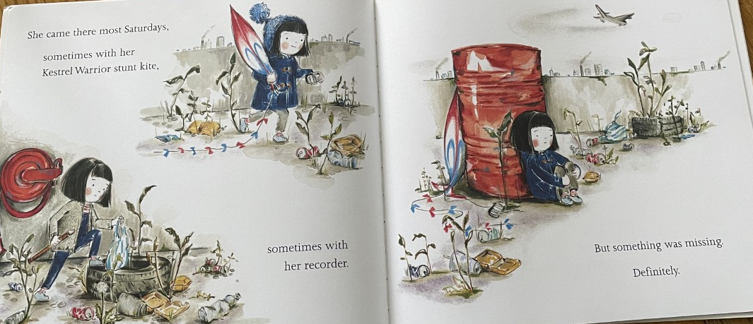
In groups, you will have a copy of the two illustrations to talk about. Think about how the pictures and words are similar or different. looking at how the text and illustrations compare.
Write on your pictures anything that you see, think or any ideas that you have.
Then, we will come back together and discuss the changes and similarities in Funni’s life since the garden has grown.

Slide 5
Groups
Group 1:
Finley
Sam
Noah
Charlie AW
Alice
Group 2:
Olly
Aaliyah
Robert
Jack
Jasmine
Group 3:
Alesha
Landon
Esmee
Max
Niamh
Ivy
Group 4:
Charlie W
Paige
Skyla-Rose
Albert
Honour

Slide 6
What do you think may still be missing for Funni?
Notes:
Reread the spread, reflect on the last sentence.

Slide 7
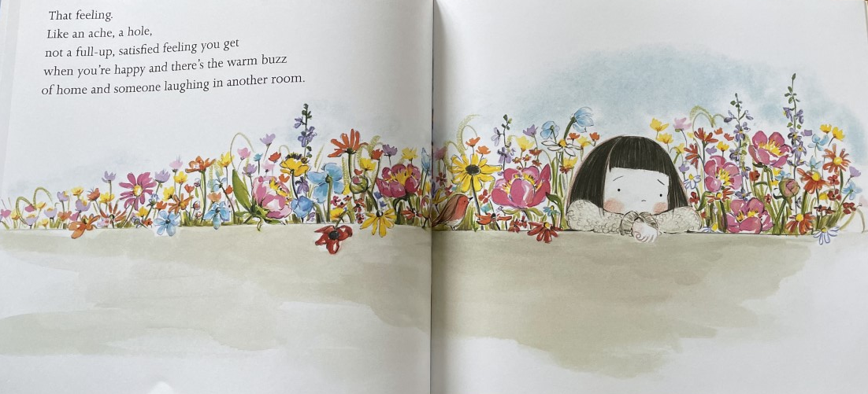
Does this give you any ideas what is missing for Funni?
Let’s write down our ideas, on flipchart as a class- What might give her the ‘full up satisfied feeling’?

Slide 8
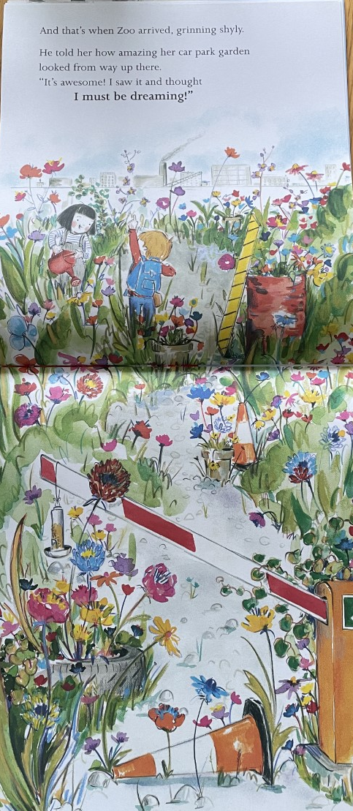
Look at the illustrations
What do you see? What do you notice?
Annotate with thoughts, feelings or questions.
Then read the page out loud. Did this page surprise them or is it what they thought would happen?
How do you think the children feel about meeting each other?

Slide 9
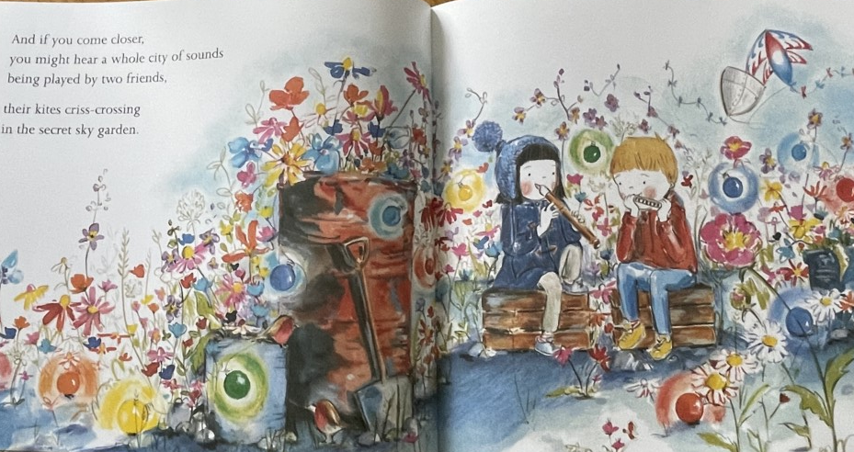
Notes:
Read on until the last page however don’t show the end paper
Reflect on this part of the story together
What do you really think was missing for Funni?
Do you think she still feels an ‘ache’ or ‘hole’?
How do you think Zoo has helped take this away?
What was it that brought the pair together?
Why might shared green spaces like this be important for a community?
What other benefits might a garden like this bring?

Slide 10
What do you really think was missing for Funni?
Do you think she still feels an ‘ache’ or ‘hole’?
How do you think Zoo has helped take this away?
What was it that brought the pair together?
Why might shared green spaces like this be important for a community?
What other benefits might a garden like this bring?

Slide 11
Let’s think
Why is it important to have trees, flowers, parks and gardens in local communities?
How do these things support both the people and wildlife in the community?

