Slide 1
Warm up
Add the missing punctuation to these sentences.
jane went to see the doctor
the cow eats grass
are you coming to my party

Slide 2

LO: to use the correct punctuation in a sentence.
Must: sequence words to form sentences.
Should: use capital letters, full stops and exclamation marks to punctuate sentences correctly.
Could: write my own correctly punctuated sentences about whales.

Slide 3
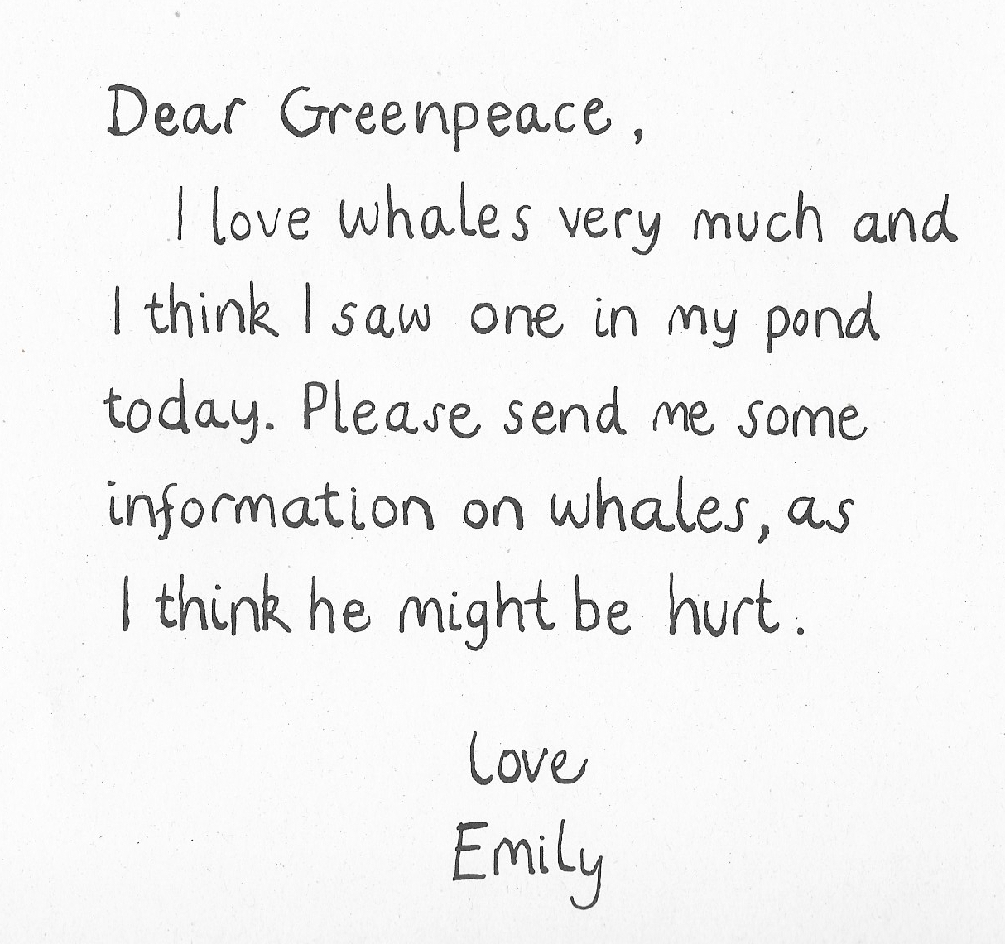

Slide 4

What facts do you know about whales? Let’s write some facts together.

Slide 5
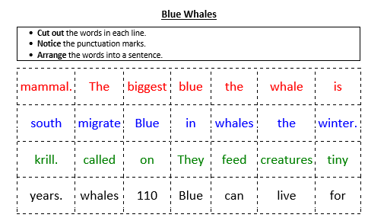
Your task- Reception:

Slide 6
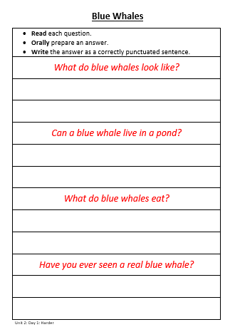
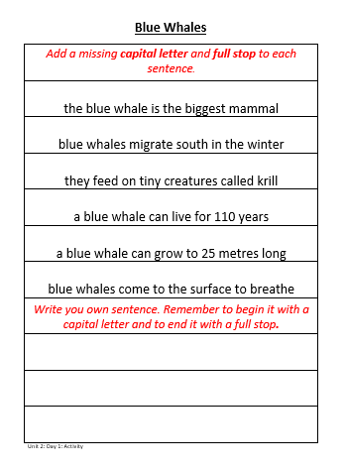
Your task- Year 1:

Slide 7

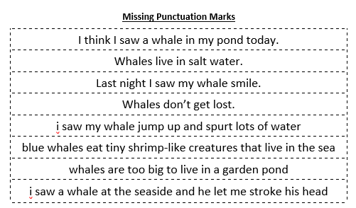
Extension/ Plenary:
Sort the sentences into those that are correctly punctuated and those that are not correctly punctuated.

