Slide 1
Warm up
Choose a conjunction to join the two sentences together.
Sam is really excited. It is his birthday tomorrow.

Slide 2

LO: to punctuate a sentence using capital letters, full stops, exclamation marks and question marks.
Must: identify missing punctuation.
Should: edit and improve sentences with missing punctuation.
Could: write own sentences using full stops, question marks and exclamation marks.

Slide 3
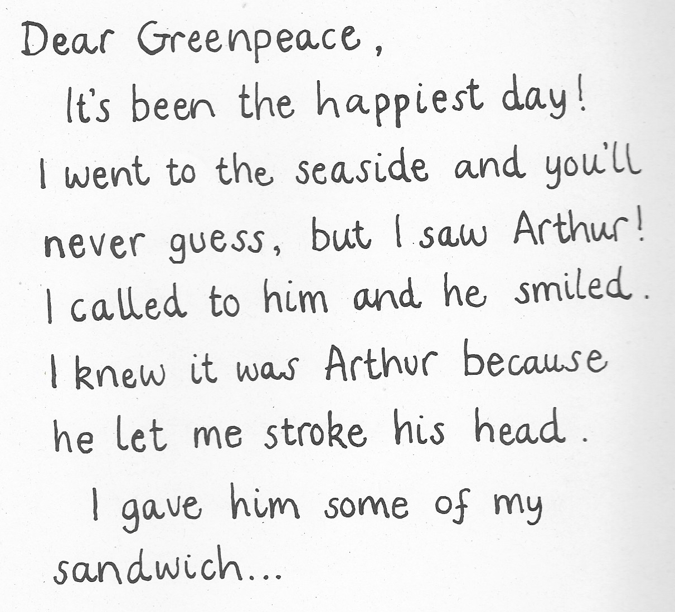
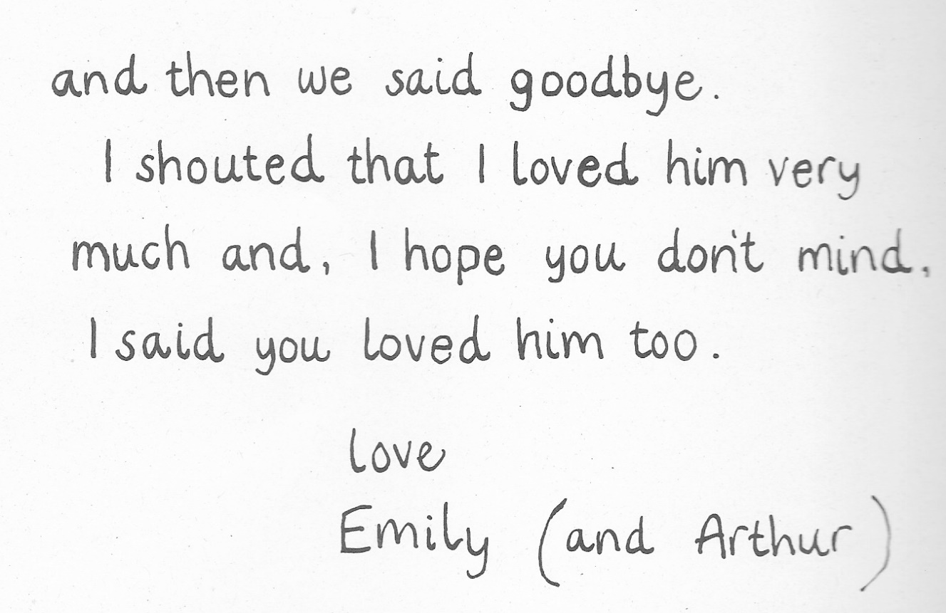

Slide 4

What punctuation would you choose?
.
Mum, there is a whale in the pond
?
!
ANSWER

Slide 5
What punctuation would you choose?
.
What can I feed a whale
?
!
ANSWER

Slide 6
What punctuation would you choose?
.
Blue whales are very big
?
!
ANSWER

Slide 7
What punctuation would you choose?
.
How amazing
?
!
ANSWER

Slide 8
What punctuation would you choose?
.
Where do whales live
?
!
ANSWER

Slide 9
What punctuation would you choose?
.
I shall call him Arthur
?
!
ANSWER

Slide 10
Your task- Reception/ year 1 something easier:
Write your own fact about whales. Can you remember to use a capital letter and a full stop?
Draw a picture and label it to accompany your fact.

Slide 11
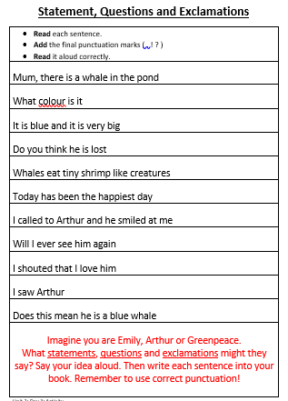
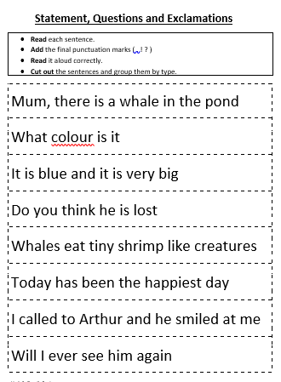
Your task- Year 1:

Slide 12
Plenary
Let’s mark some answers together.

