Slide 1
Exciting Writing

Slide 2
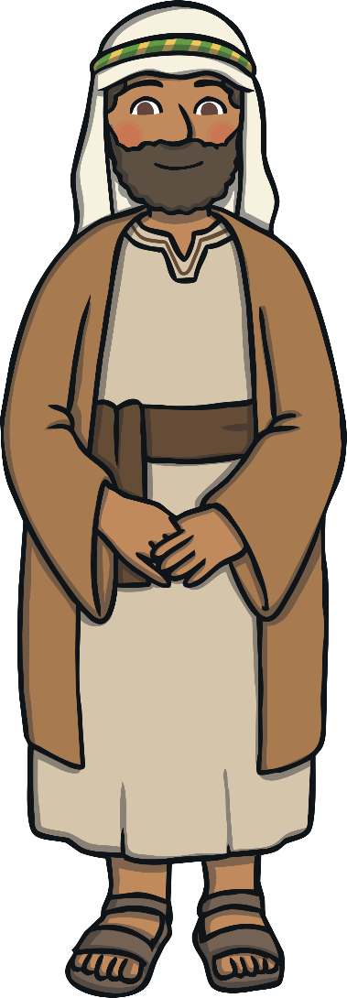
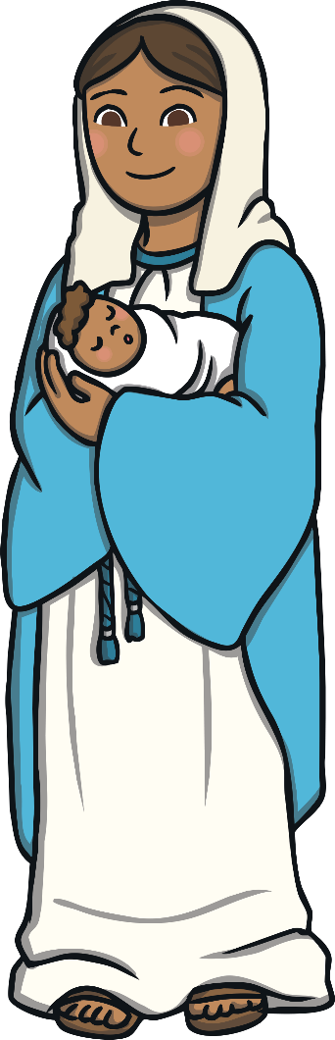
What is Advent?
Advent is the start of the Christian year.
It is a time for Christians to prepare for the celebration of the birth of Jesus.
It is also a time for Christians to look forward
to a time when Jesus will come again.
The word ‘Advent’ comes from a very old word ‘Adventus’ which means the arrival of something
or someone important.

Slide 3
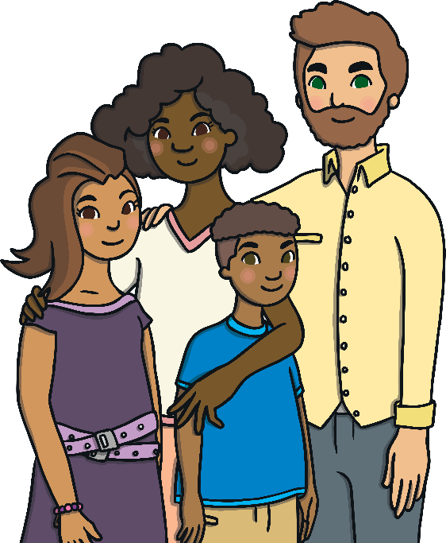
When is Advent?
Advent is the four weeks before Christmas.
It starts on the nearest Sunday to November 30th.
Advent lasts until midnight on Christmas Eve.
Advent is a time for Christians to enjoy time
with their families and friends.
It began in Germany over 250 years ago.

Slide 4
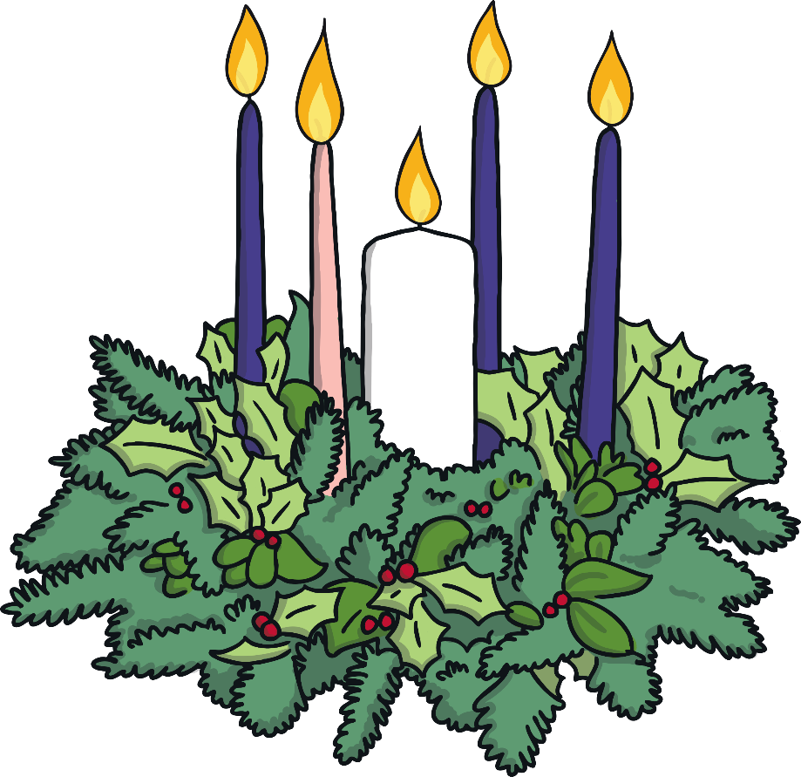
How is Advent Celebrated?
Churches display an Advent crown or Advent wreath during Advent.
There are four candles standing in the circle. In the centre there is a fifth candle.
During advent, in
some churches there
are no flowers
The Advent wreath is a circle of evergreen branches.

Slide 5
How is Advent Celebrated?
The circle of evergreen branches is a reminder that God does not change.
The candles remind Christians of the light of God.
A new candle is lit each Sunday during Advent until all four candles are burning. Each candle has a different meaning:
Hope
Peace
Joy
Love
The final candle is lit on Christmas day to celebrate the birth of Jesus.

Slide 6
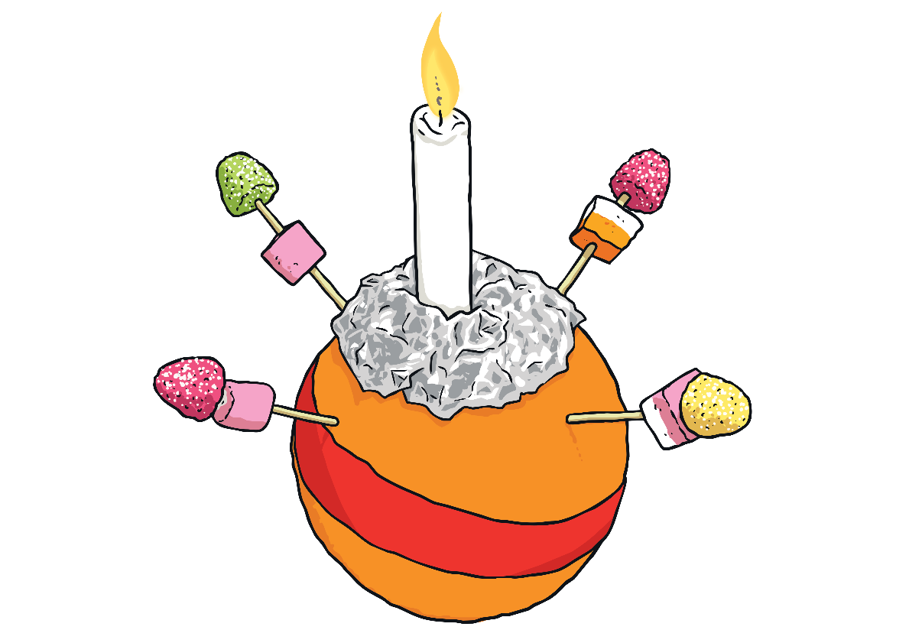
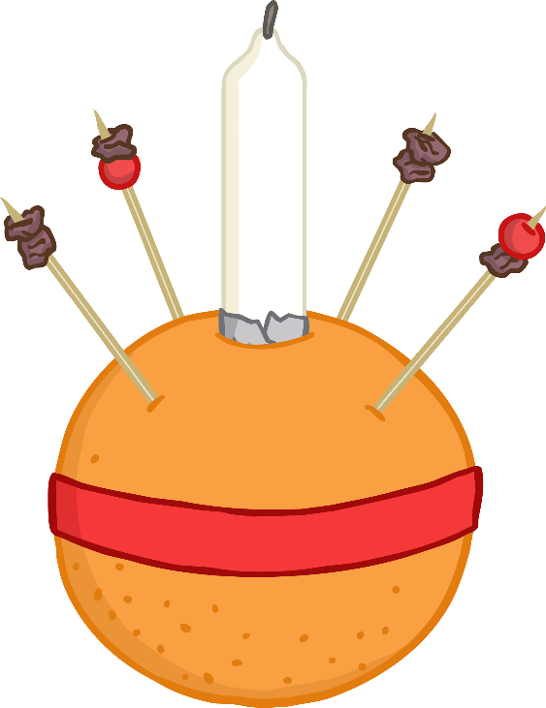
Christingles
Children often have fun making Christingles during Advent.
The cocktail sticks represent the four seasons.
The candle reminds Christians of Jesus, light of the world.
The orange represents the world.
Christingle means ‘Christ’s Light’.
The red ribbon is a reminder that Jesus died.
The sweets or dried fruit represent all of God’s creations.

Slide 7
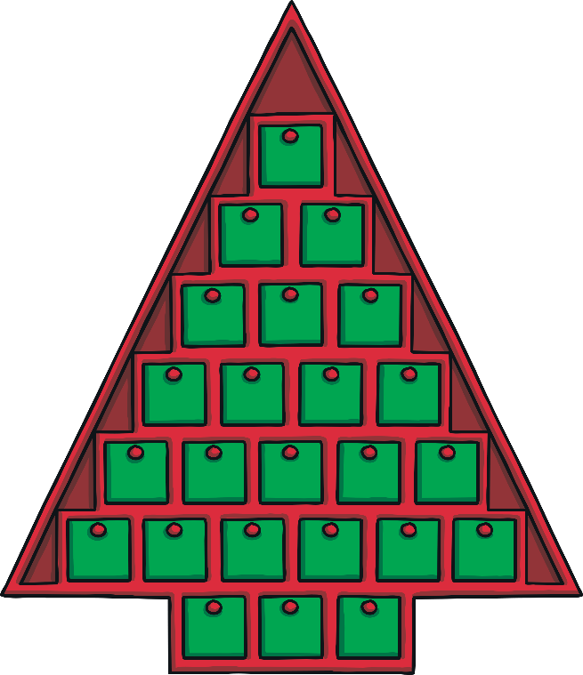
Advent Calendars
Advent calendars start on the 1st of December and countdown to Christmas Eve.
Each day a door is opened and shows a Christmas picture.
Some Advent calendars have a chocolate
treat hidden behind each door!

Slide 8
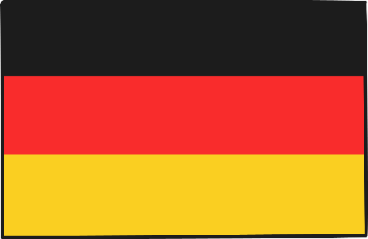
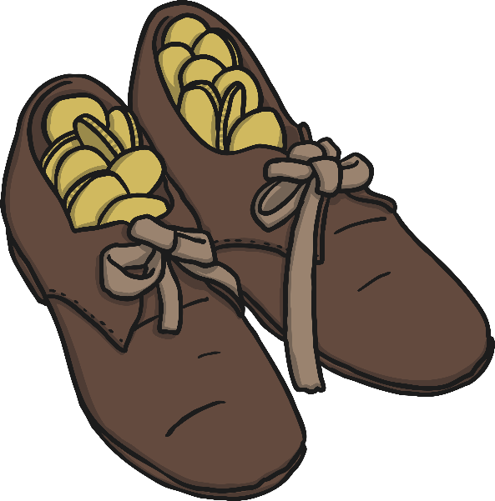
Advent Around the World
Germany
In Germany, at Advent you need to check your shoes before putting them on.
    On the 6th December, Saint Nikolaus comes and puts sweets in children's shoes during the night.

Slide 9
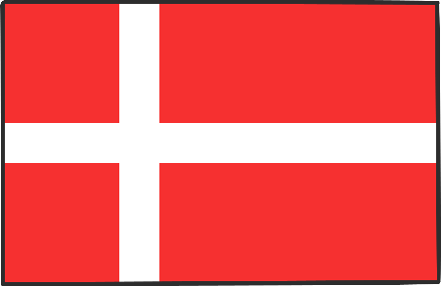
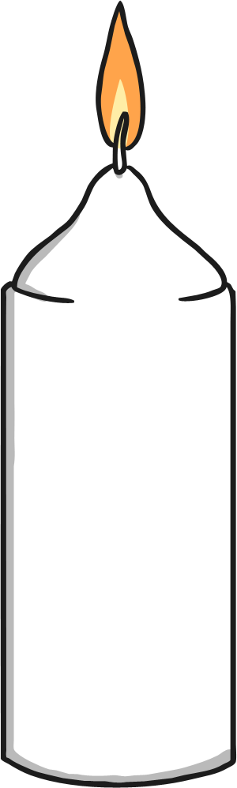
Advent Around the World
Denmark
In Denmark, families burn calendar candles.
  The candle is burnt a little each night until it is finished on Christmas Eve.

Slide 10
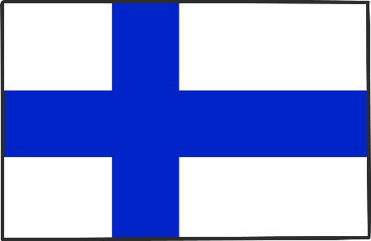
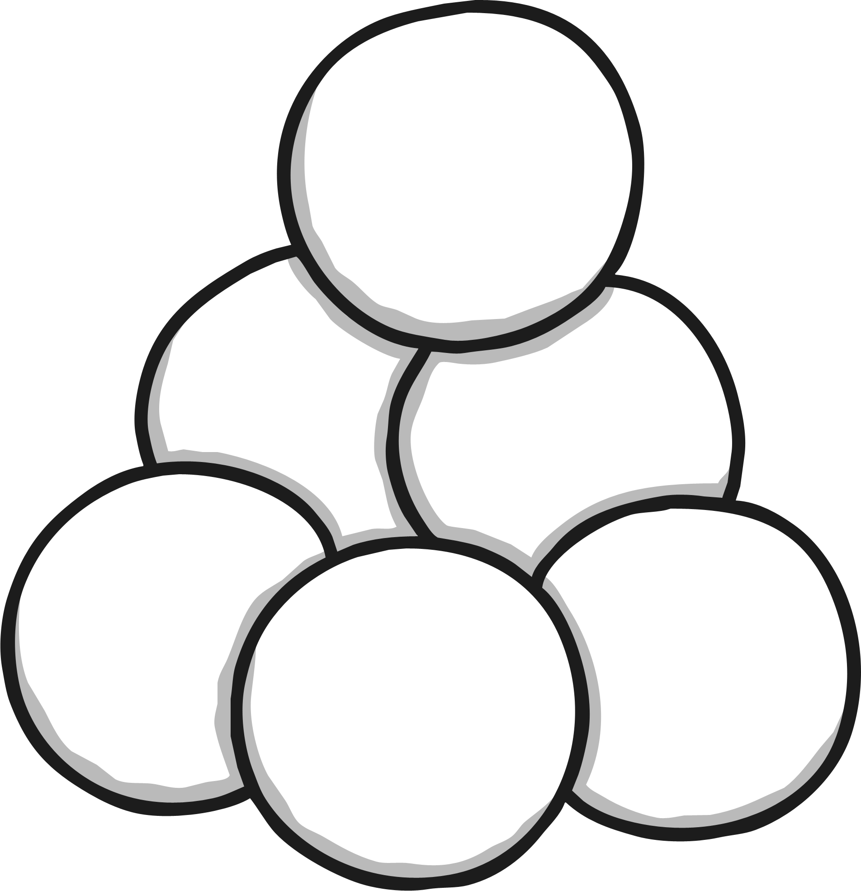
Advent Around the World
Finland
  In Finland, families have ice or snow lanterns burning in their gardens.

Slide 11
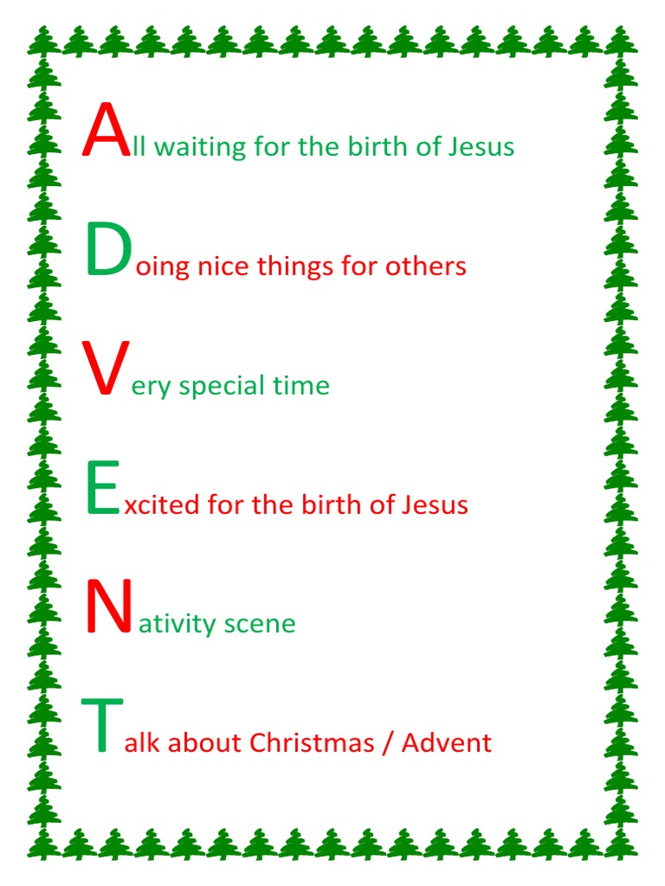
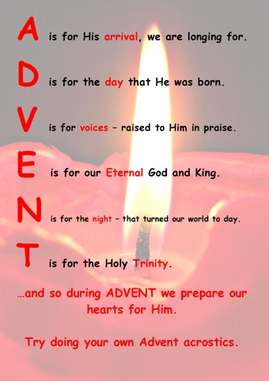

Slide 12
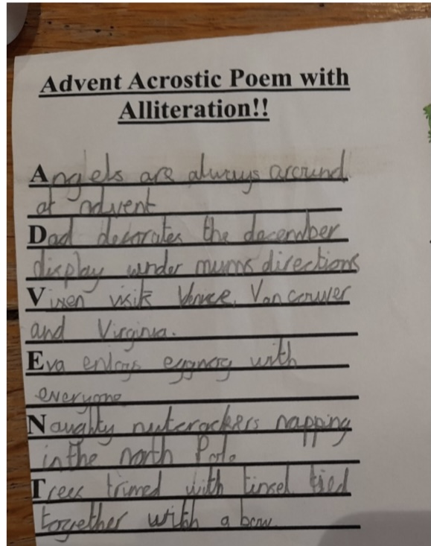
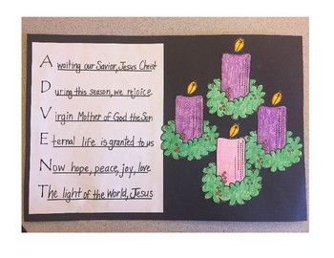

Slide 13
Can you think of words for advent?
Let’s record some key words associated with advent and Christmas on sugar paper.
Eg angels, December, Virgin Mary, eating, candles, Christmas, tree, decorations,

Slide 14
Task:
Write your own advent acrostic poem. Use the words we have gathered and the word mat to help you.
Challenge: can you use alliteration?

