Slide 1
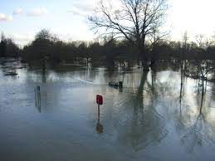

Slide 2
Spag Focus.
To use a range of sentence structures.
Start- The girl held her brother’s hand.
Add adjectives to improve these noun phrases.
The girl held her brother’s hand.
Then add a relative clause.
The ___________ girl, who __________________ , held her brother’s hand.
Then add a subordinate clause to explain the reason why.
The ___________ girl, who __________________ , held her brother’s hand, _____________________________________________________.

Slide 3
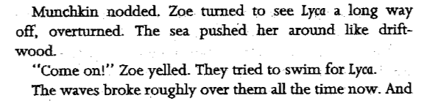
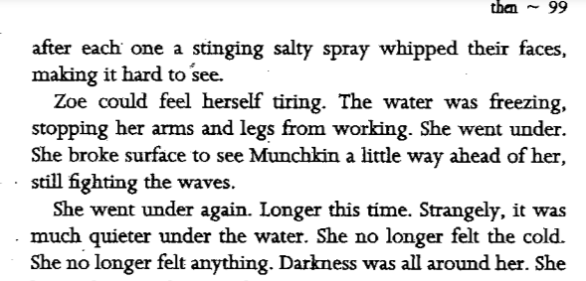
Re-read this extract from chapter 13.
With Your partner, go through these pages and highlight any descriptive language you see.
Can you identify the writing techniques used?

Slide 4
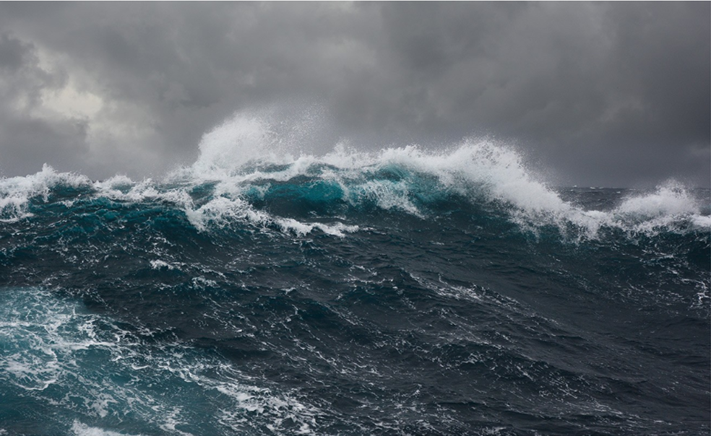
Using a piece of sugar paper, Come up with more descriptive words, phrases and sentences to describe the rough seas.

Slide 5
Your task is to write a list poem to describe the rough seas.
Experiment with swapping around the word order of your sentences to try different effects.
Your sentences should still be
grammatically correct.
Challenge- Use personification, simile and metaphor to catch your reader’s imagination.

Slide 6
Plenary
Let’s hear some of you perform your poetry.
As you are listening, try to spot any uses of personification, similes and metaphor.

