Slide 1


Slide 2
Spag Focus.
L.O: To write a play script.
Self- Assessment | Success Criteria | Teacher Assessment
 | Must: I can write a scene based on a text.
 | Should: I can use what the characters say to produce tension and fear.
 | Could: I can include most of the features expected of this text type including scene and stage directions.
 | Even better if… I can use the manner in which the characters speak to infer a level of formality.
Edit and re-write these sentences in standard English.
You don’t know nothing about Eels Island! Yelled Spat. We should of done you in if you dont got no brains Dooby aint gonna watch you forever
Can you suggest a time when it might be more effective to not write using standard English?

Slide 3
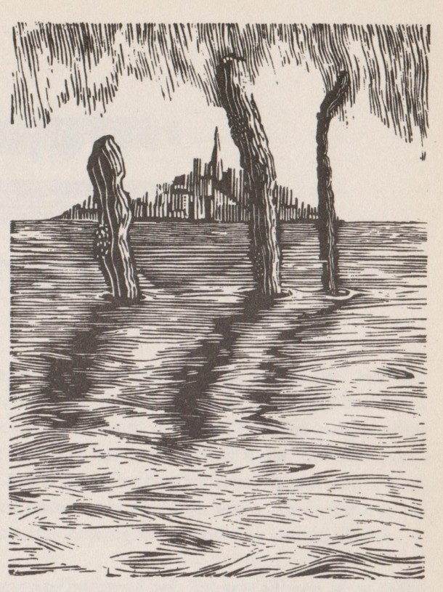
Let’s recap- what happened last in our story of Floodland?
What do we know about the characters on Eels Island?
What do you predict will happen next?

Slide 4

With your talk partner, come up with as many features of a play script as you can in one minute.
What is the purpose of a play script?
What information will the actors and director need in order to perform your work effectively?

Slide 5
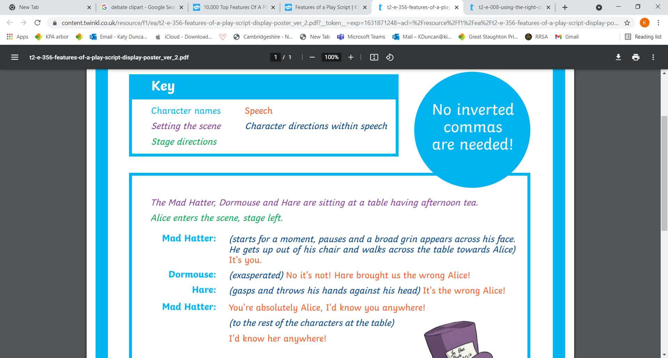
First, refresh your memory of your scene from your plan.
Then we will write the beginning of a scene together to get you started.
Task: To write a scene in which Dooby, Spat and Munchkin find Zoe’s boat and hide it away.
Challenge yourself to show something about each of the characters through their words and actions.

Slide 6

Plenary
I will choose a few volunteers to perform their completed play script for the class. The rest of you will watch closely and try to suggest what the stage directions might have been from their actions.
Read Chapters 4 and 5 before next session

