Slide 1
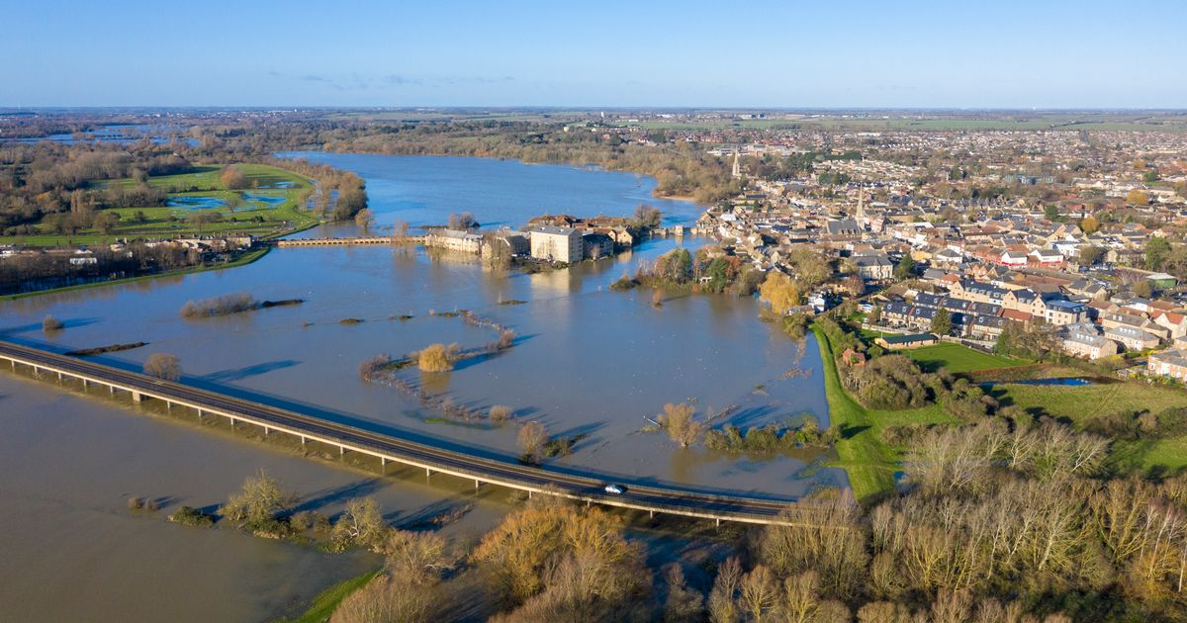

Slide 2
Spag Focus
L.O. To give an opinion based on a text.
Self- Assessment | Success Criteria | Teacher Assessment
 | Must: I can give an opinion as to what Zoe should do.
 | Should: I can give reasons for my opinion.
 | Could: I can give a counter opinion with reasons.
 | Even better if… I can use my opinions to advise the main character.
Conjunctions join ideas together to form complex sentences.
Zoe smiled at Molly and Sarah, ____________ they were being horrible.
Spat stopped talking ______________ Dooby glared at him.
Zoe was parched with thirst __________________ her water bottle was empty.

Slide 3

Read up until the beginning of Chapter 7,
‘She didn’t even know where she was.’
What has happened to Zoe?
What are Zoe’s choices now?
What do you think she should do and why?

Slide 4
Task 1- Use your post it notes on your table to give your opinion and your reason for thinking so. Try to give a reason why Zoe should trust Dooby, and a reason why she should not.
These will go up on our working wall.
Task 2- Write a couple of paragraphs in your book, explaining your opinions on what Zoe should do and give reasons to back them up.
Challenge- present arguments for and against trusting Dooby, before giving your opinion in your conclusion.

Slide 5
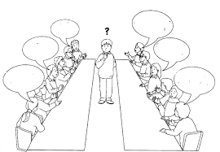
Plenary. Conscience Alley.
One member of the class will be chosen to take on the role of Zoe.
The rest of the class will be split into two teams. One side will give reasons why Zoe should work with Dooby, and the other will give reasons she should not trust him.
At the end Zoe will decide what she will do based on how convincing you were.

