Slide 1
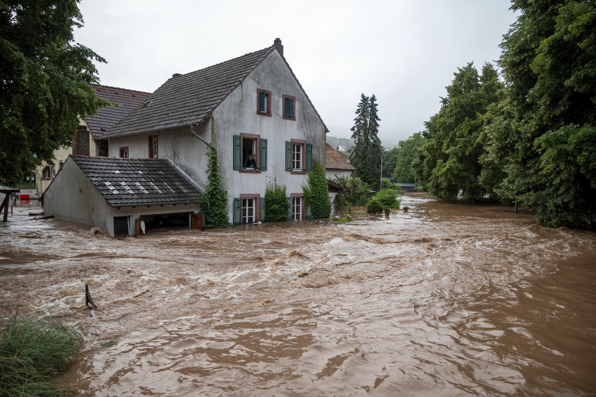

Slide 2
SPAG Focus.
L.O. To write a letter to advise Zoe.
Self- Assessment | Success Criteria | Teacher Assessment
 | Must: I can write a letter giving my opinion.
 | Should: I can clearly explain what Zoe should do.
 | Could: I can use persuasive language to get Zoe to agree with me.
 | Even better if… I can use the appropriate conjunctions to help me to structure and write a cohesive argument.
Modal verbs. These are words we can add to a main verb in order to show how possible or probable this thing is to happen.
Complete these sentences with a Modal Verb.
If it is sunny, __________ we have lessons outside?
My long hair is annoying, I _____________ cut it.
_____________ I please go to the toilet?
All pupils _______________ wear correct school uniform.
Modal Verbs
Could Should Must
May Would Can Might
Shall Ought to Will

Slide 3
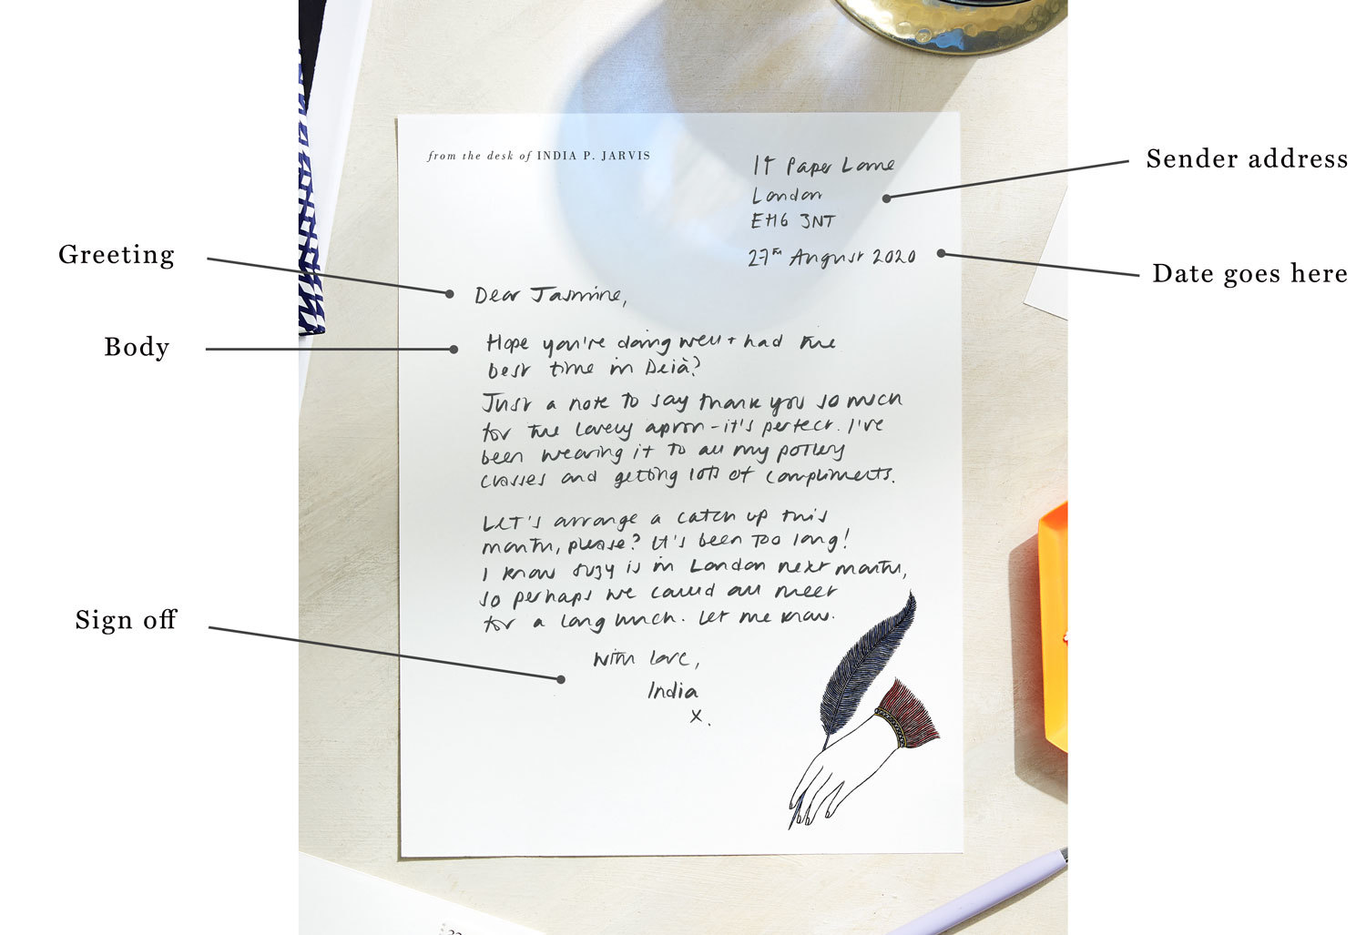
What did we learn in our last lesson?
Check your book and the working wall for more ideas.
Your task this lesson is to write a letter to Zoe to advise her on what to do next.
What do we know about Zoe’s personality?
Do you think she will want to trust us?

Slide 4

Writing to give advice is tricky, because you need to persuade someone you are on their side, and also clearly explain what you think they should do.
Steps to success.
Show sympathy to Zoe so she knows you are on her side.
Use modal verbs to explain what she should do.
Clearly state your opinion, and give evidence to back up your ideas.
Write directly to Zoe, use persuasive phrases in your writing.

