Slide 1
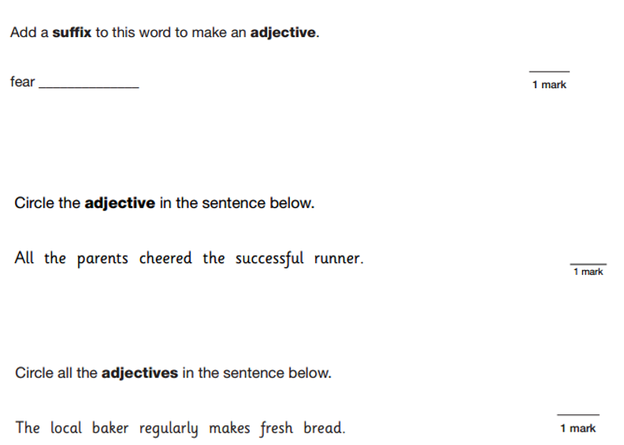
L.O: To complete a narrative based on FArTHER. 27.01.22
P | Success Criteria | T
 | Must: I can use paragraphs to mark changes in time, setting or event.
 | Should: I can combine action and description.
 | Could: I can continue to expand on my descriptions.
 | Even better if… I can bring my story to a satisfying conclusion.

Slide 2
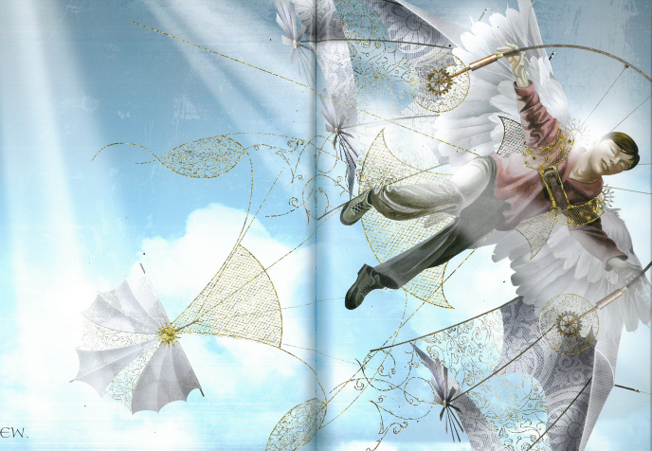
Task: To write the resolution and ending of your narrative, in which the son fixes his father’s wings and finally flies.
You should include plenty of descriptive detail and take your time.
Don’t rush to the end.
Remember your self-assessment criteria from last lesson!
How could you improve your writing from last time?

Slide 3
Self-Assessment
Use a green highlighter to draw a box around the paragraph you are most proud of.
What is it you like about this work?
Use a yellow highlighter to draw box around the paragraph which needs most work (in your opinion).
What have you noticed that you could improve next time?

