Slide 1
L.O: To make persuasive arguments for and against evacuation 01.02.22
Must I can gather information about children’s experiences of evacuation.
Should I can make arguments for and against evacuation.
Could I can use evidence to support my opinion.
Even better if- I can use persuasive language in my argument.
Causal Conjunctions are used to introduce a reason or explanation for a given action.
Tommy could hardly keep his eyes open _______ he stayed up past his bedtime.
Casualties inWW1 were very high ___________ both sides used modern weapons.
Clare was confident in her 9 times table ______ she often used TT Rockstars.

Slide 2
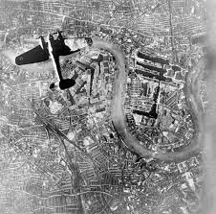
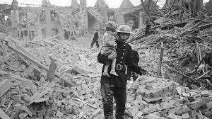
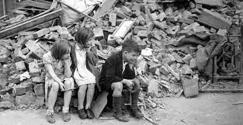
Key question for this lesson: Should children be evacuated from urban areas?
At the beginning of WW2, many children in the cities were sent away from their families to live in the countryside.
https://www.bbc.co.uk/teach/class-clips-video/history-ks2-living-through-the-air-raids/zjnyrj6
https://www.bbc.co.uk/teach/school-radio/history-ks2-world-war-2-clips-ww2-evacuation-index/zvs3scw
Discuss with your partner- why was it considered safer for children in rural areas?

Slide 3
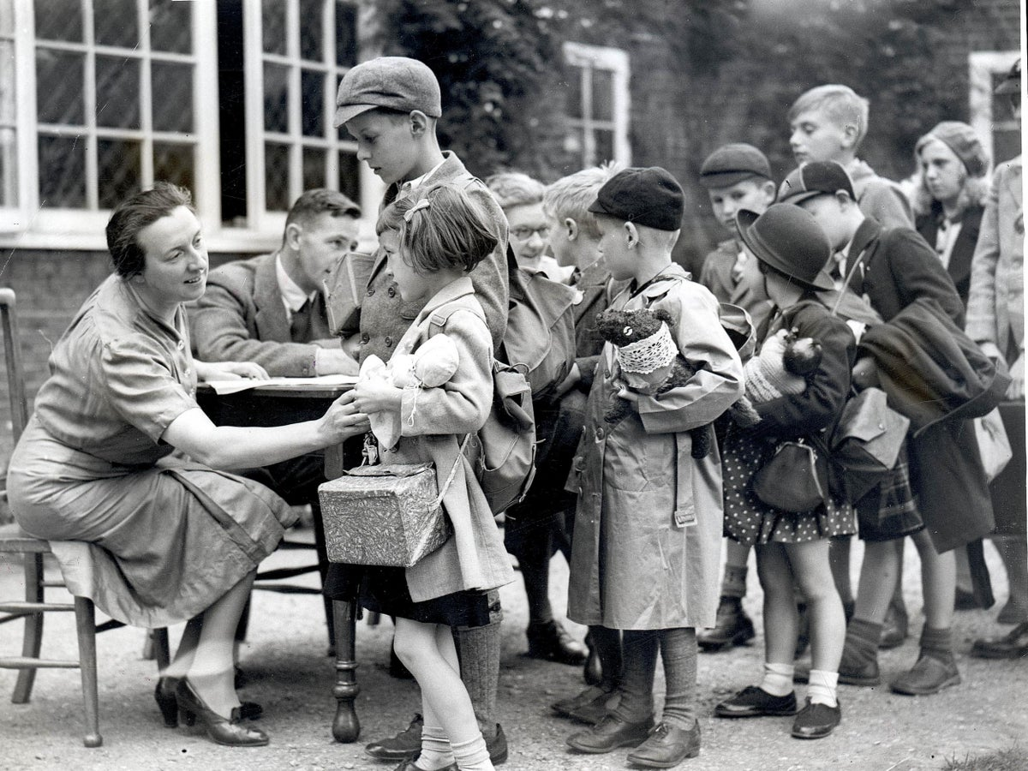
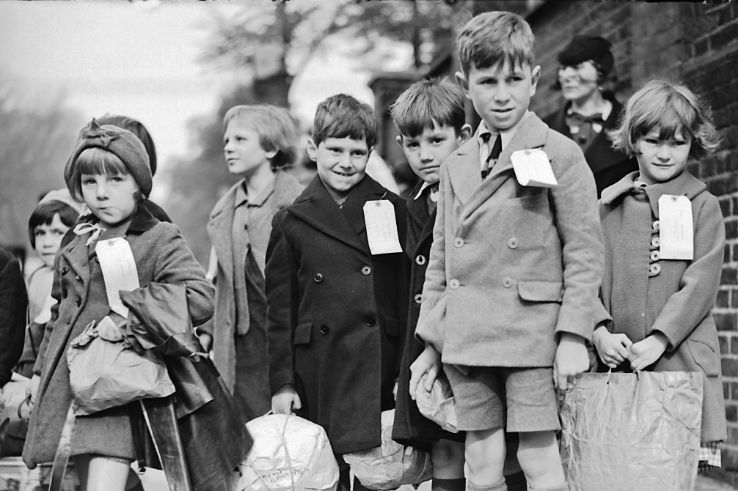
Spend some time learning about evacuation.
In this lesson, you will be asked to come up with persuasive arguments for and against evacuation.
You will be asked to back up your ideas with evidence from your research.
E.g. Children should not be evacuated from urban areas, as many children were distressed by leaving their families at a young age.

Slide 4

Writing a persuasive argument.
Make sure you back up your point with evidence, using a causal conjunction.
Use a strong voice, and ‘agreeing’ adverbs; obviously, clearly, without doubt.
Rhetorical questions- ‘Would you want your family to be killed by a bomb?’

Slide 5

Plenary: Class debate.
Present your arguments in a respectful debate to answer the question- should children be evacuated to the countryside?

