Slide 1
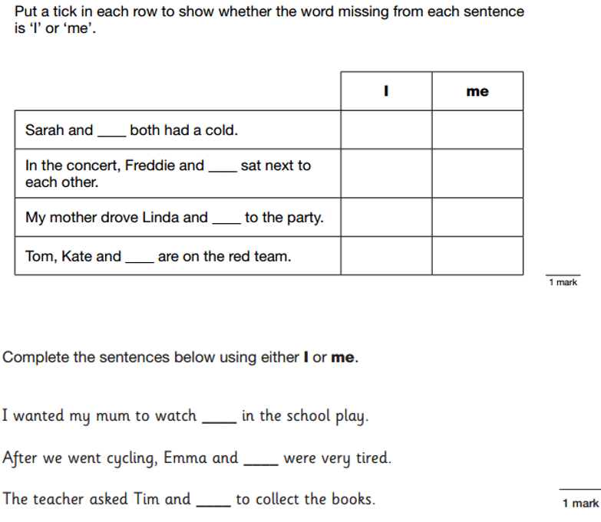
LO: To explore the feelings of characters in the text through drama.
Must- I can create a freeze frame of a scene.
Should- Use drama to portray a character.
Could- I can imagine how my character would feel in role.
Even better if- I can explain my character’s thoughts and feelings.

Slide 2
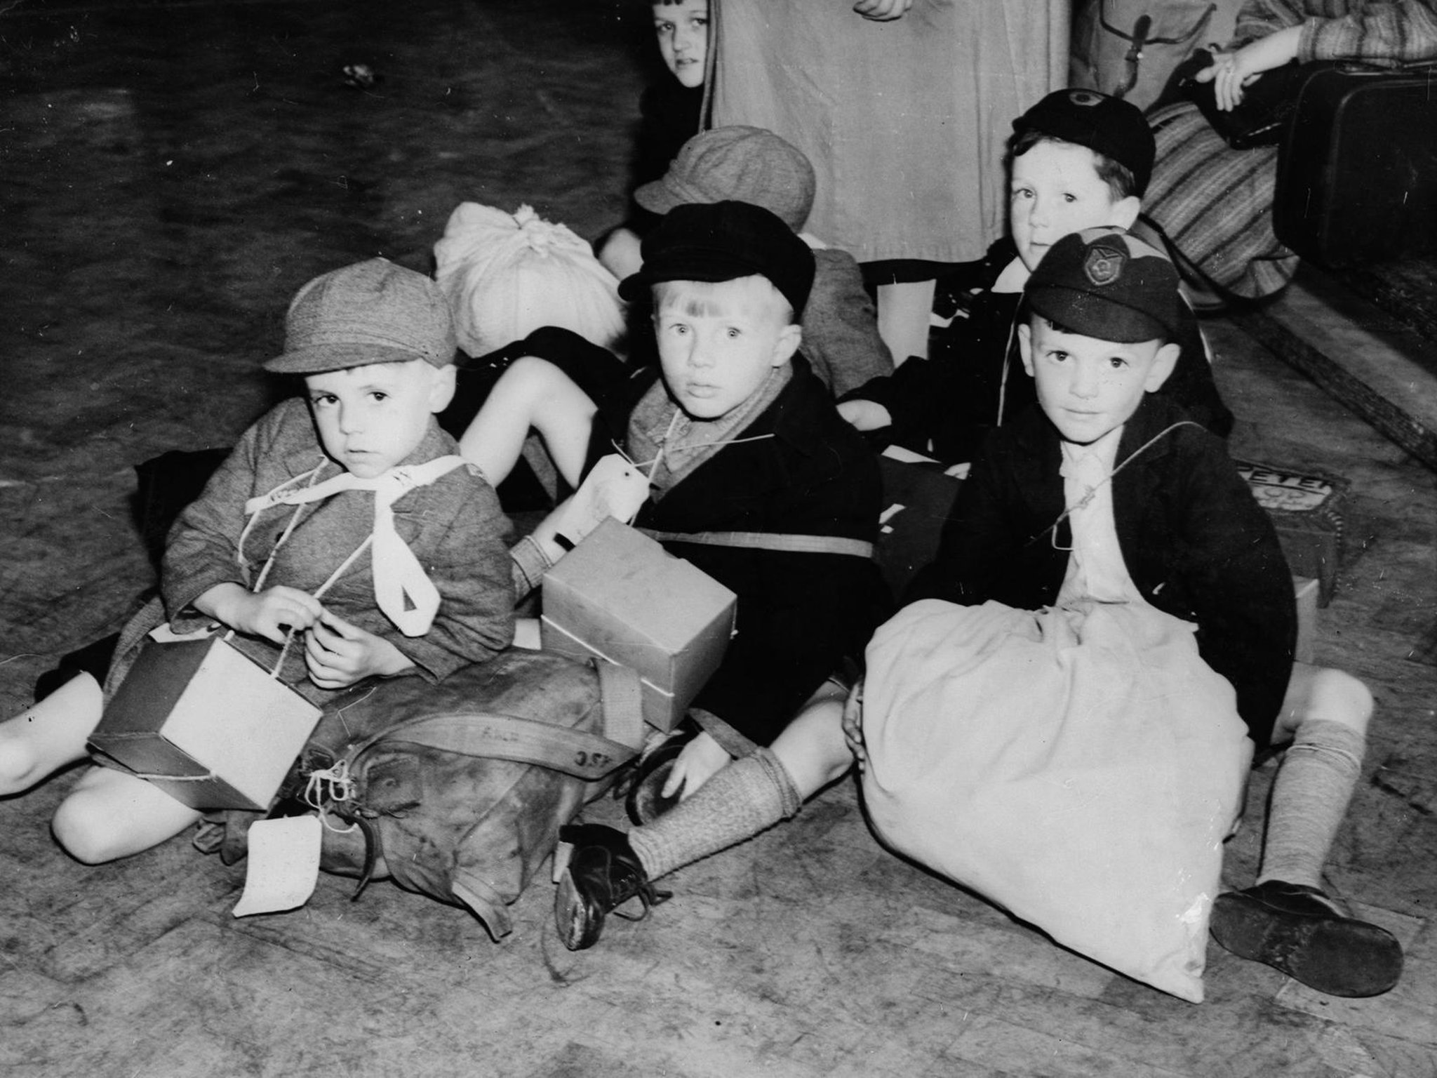

Slide 3
Read up to the end of chapter 1 of Goodnight Mr Tom.
Task: In small groups, create a freeze frame of a group of evacuees arriving at their new home. You can take on different roles, such as the evacuees, billeting officer, or householder.
Consider:
What emotions are you feeling?
What are you thinking about?
Do you have any hopes or worries?
How could you communicate this through your posture and facial expression?

Slide 4
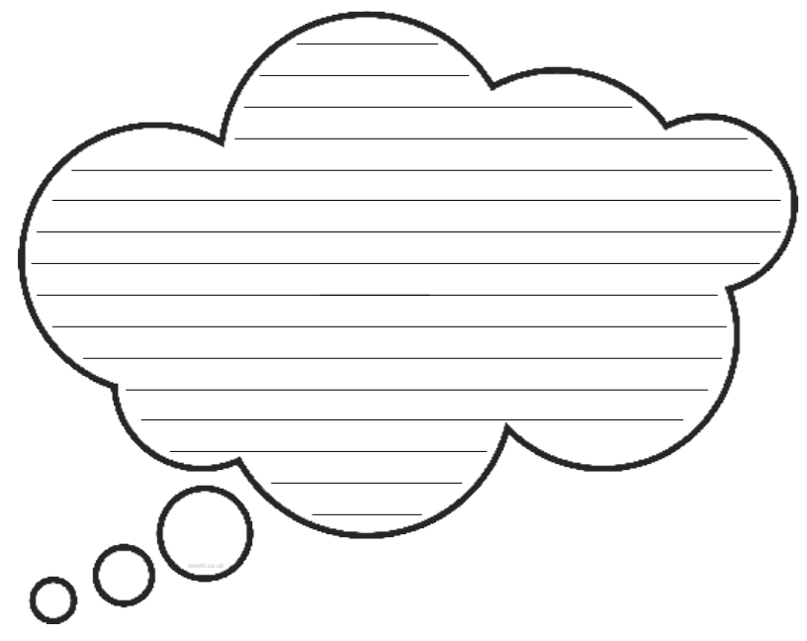
Plenary- Write a few sentences to explain what was going through your character’s mind.

