Slide 1
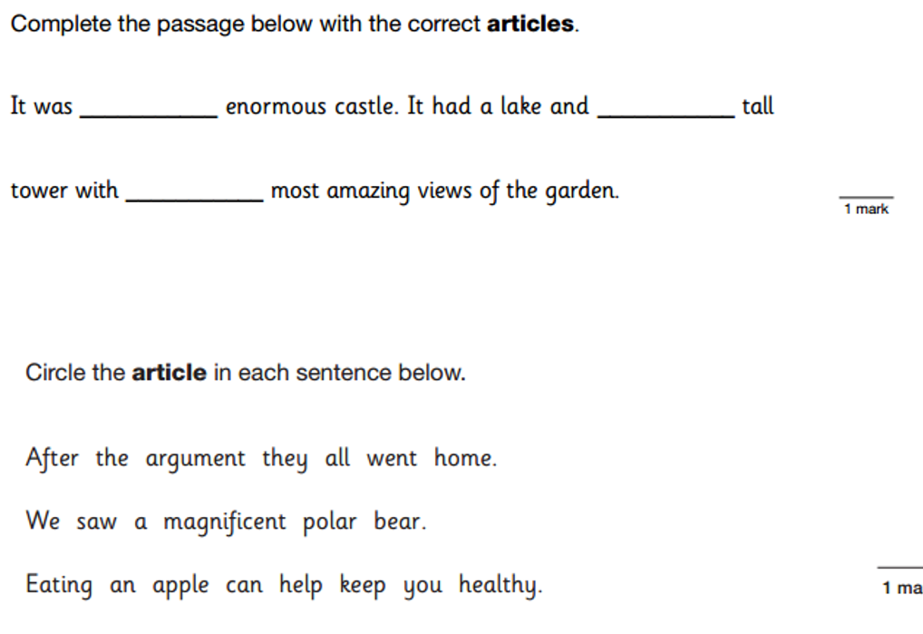
LO: To create poetry through shared writing.
Must: compose interesting, descriptive sentences.
Should: experiment with different line order.
Could: Work together to create a cohesive whole.
Even better if: perform our poem confidently

Slide 2

In this lesson we will be reading and writing some poetry inspired by the experience of evacuation.
We will be reading Evacuation by Roger Stevens, Mollie by Brian Moses and Another war by Brian Moses.
Listen carefully to each poem, then tell me…
Was there anything you liked about this poem?
Was there anything that you particularly disliked?
Was there anything that puzzled you?
Were there any patterns, or any connections that you noticed?

Slide 3
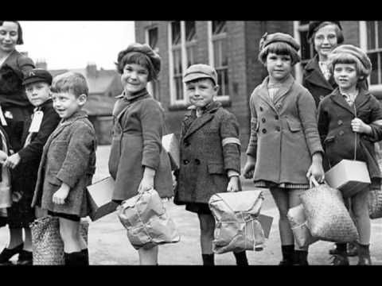
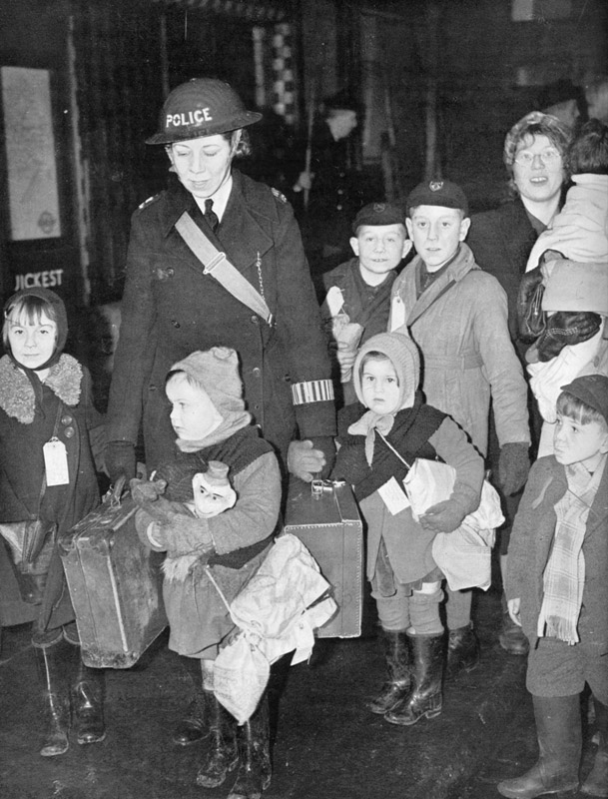
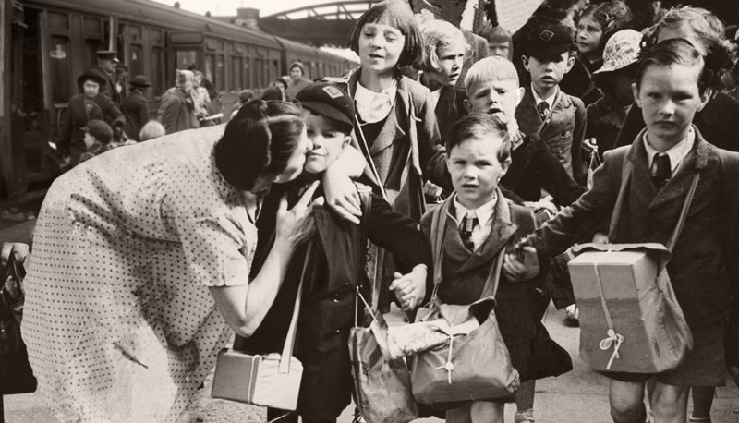
Look at these images of children being evacuated. What different emotions and thoughts might they be experiencing?
https://www.bbc.co.uk/teach/class-clips-video/history-ks2-an-evacuees-adventure/zk7hy9q

Slide 4
Task- In mixed year groups, write some sentences to describe the evacuees experience on long strips of card.
Focus on originality and describe the evacuees feelings through powerful vocabulary.
You will then work as a team to put your sentences together into a group poem. Try ordering them in different combinations- which one is the most effective? Why do you think so?
When your team has finished composing your poem, you can begin to rehearse the poem ready for performance!

