Slide 1
LO: I can make inferences about the characters.
Must: use role on the wall to describe Tom and William.
Could: describe the characters’ appearance.
Should: include information inferred about their personality.
Even better if: I can use P.E.E. to support my inferences.
Did you know your choice of verbs can give your reader lots of information?
Read these two examples.
What picture do you have in your mind? Why?
A. Tom walked along the lane. Willie walked after him.
B. Tom strode along the lane. Willie scurried after him.
Re-write these sentences using more interesting verbs.
Tom gave Willie a plate of food. Willie ate the food.

Slide 2
Before we go any further, let’s recap what we know about the two main characters.
What we know.
What we think.
Can you use P.E.E. (Point, Evidence, Explain) to back up your opinions?

Slide 3
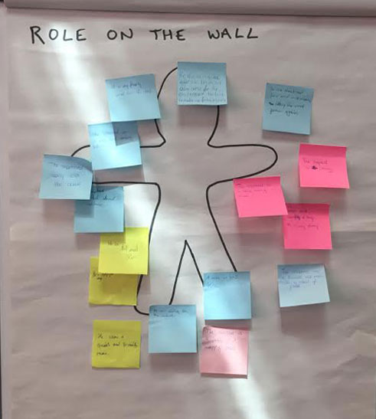
Role on the wall.
We will be using post-its to record our thoughts and opinions about William and Mr. Tom. You can describe both their outward appearance and their personality.
You can challenge yourself by:
Using a thesaurus to choose more ambitious vocabulary.
Using P.E.E to extend your answers.
Tom is lonely and grumpy.
Tom is isolated and cantankerous.
Tom is isolated and cantankerous due to the pain of losing his beloved wife Rachel. I believe this because the text said he had not been into the art shop since Rachel passed away.

Slide 4
Prediction: How do you think Willie and Tom might change during the story?
Your task now is to write a short character description about either Willie or Tom.

