Slide 1
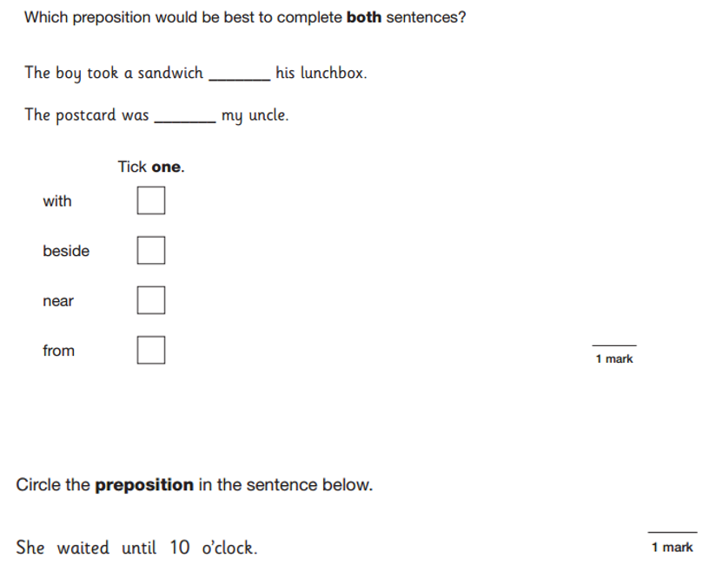
LO: To write a diary entry in role.
Must: Use the correct features of a diary entry.
Should: Write from the perspective of a character.
Could: Use powerful description to set the scene.
Even better if: I can use historical details in my writing.

Slide 2
In this part of the story war is declared against Germany.
Listen to the radio announcement from 1939. Imagine you are one of the characters sitting in the church. What do you imagine each person would be feeling?
How would a young man feel? What about an older man who may have fought in the first world war? Would a woman feel differently? What about a child like Zach whose parents are in London?

Slide 3
Task: To write a diary entry in role as either Willie or Mr. Tom.
What are the key features of a diary entry?
https://www.bbc.co.uk/bitesize/articles/z4qtqfr
Make sure to include:
Writing from your character’s perspective, using first person (I, me).
Detailed description of the setting- paint a picture for your reader.
An explanation of how your character is feeling.
Challenge- use historical vocabulary, e.g. Wireless, gas mask, blackout.

