Slide 1
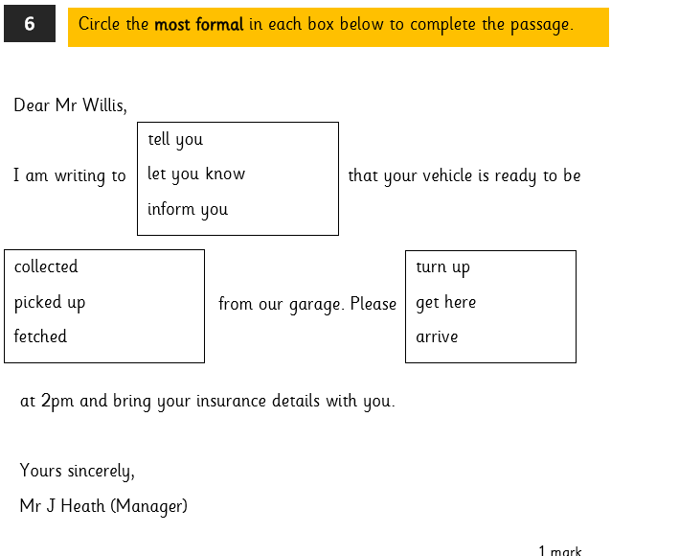
LO: To write in role as a character. 22.02.22
Must- mind map some key events of the story so far.
Could- write in role as a character.
Should- use language to influence another character.
Even better if- consider use of formality to reflect the character’s relationship

Slide 2
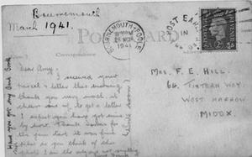
Before we go any further with the lesson, recap the story of Goodnight Mr Tom so far in pairs.
In this lesson, we will be writing postcards in role as some of the characters. What do you know about writing post cards?
Your first task this lesson is to write a postcard home to his mum in role as William.
How might William feel about this?
What would he want to write about?
Is there anything he would want to keep secret?

Slide 3
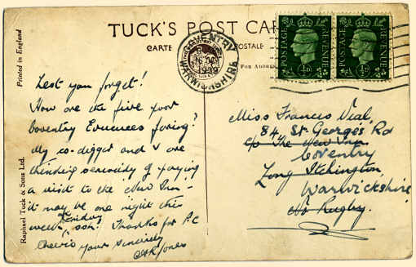
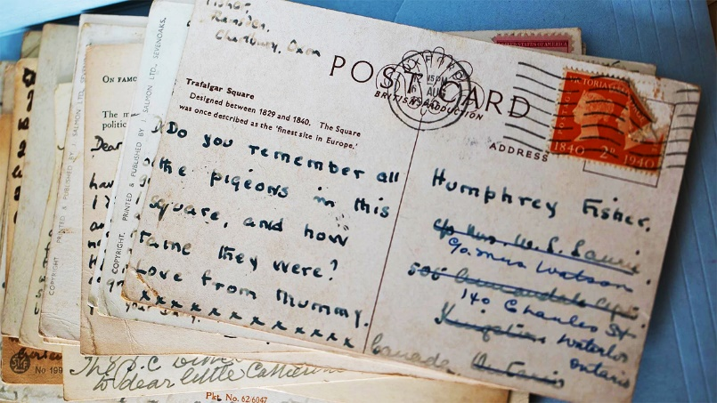
Now, swap over your work with a different student. Your new task is to write a response to this postcard, in role as William’s mother.
Before you begin, talk to your partner about these three questions-
What do we know from the text about William’s mother?
How do you think she would respond to William’s postcard?
What sort of relationship do they have?

Slide 4
Plenary. Consider the character of Zach, who we first see writing a postcard to his parents. (p46-47).
How might a postcard written by Zach be different to the two postcards we have written so far?

