Slide 1
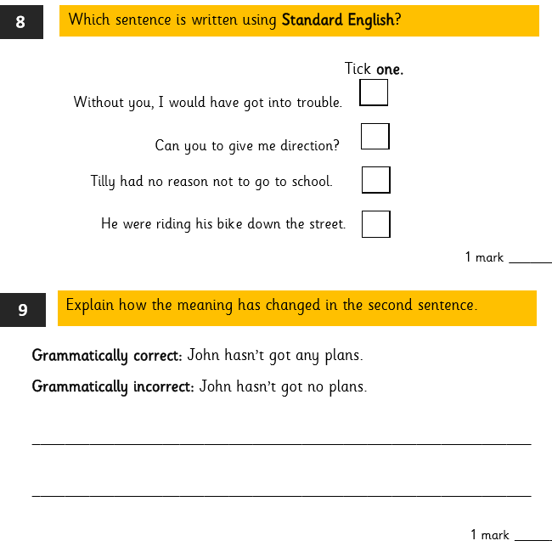
LO: To write instructions for an air raid shelter.
Must: follow my plan to structure my work.
Should: use the features of instructional writing.
Could: use clear, detailed writing.
Even better if: I can begin to use persuasive techniques to influence the reader.

Slide 2
In this lesson, you will be writing your instructions based on the plan you made last lesson.
Before you begin, let’s recap the features of this text type.
Introduction to explain purpose and interest reader.
Organisational devices such as sub-headings.
Use of imperative (bossy) verbs.
Second person and present tense.
Steps in chronological order.
Technical language and clear descriptions.
Tips and extra advice.
A conclusion aimed at reader.

Slide 3
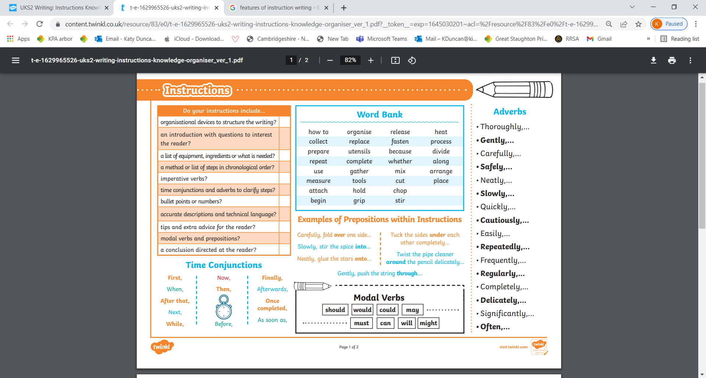
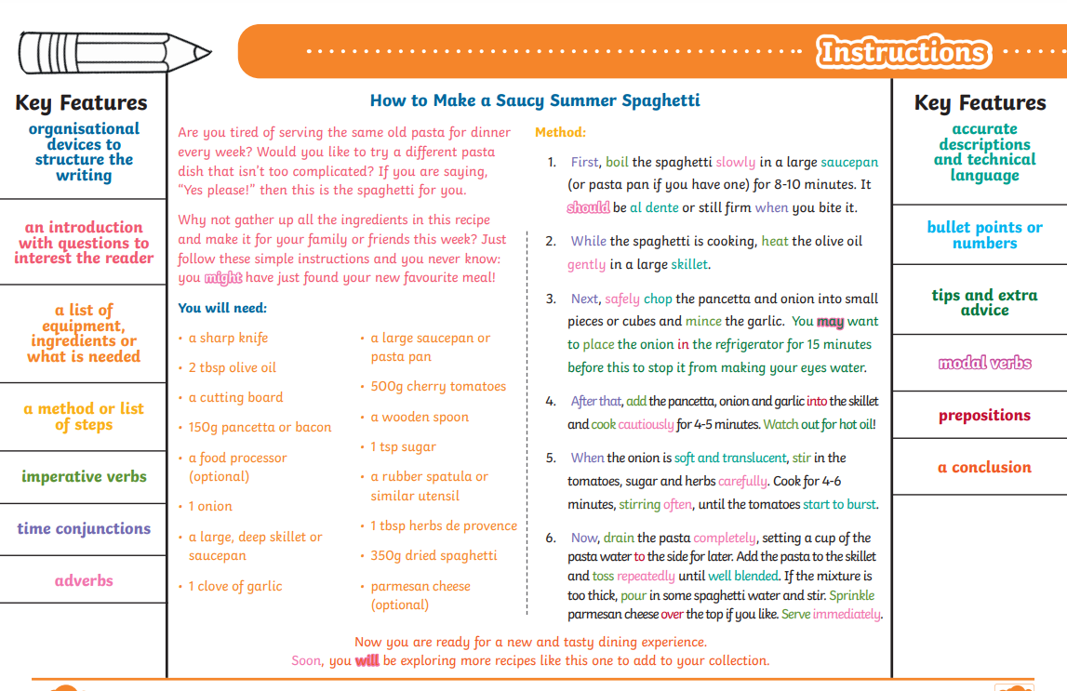
Challenge- Can you include features of persuasive writing in your introduction and conclusion to motivate the user to take action right away?

Slide 4
Plenary- Self-assess your writing using the success criteria checklist.
Then, explain one thing you think is effective about your work.
Finally, explain one thing you could improve next time.
(You may not choose spelling, punctuation of handwriting).

