Slide 1
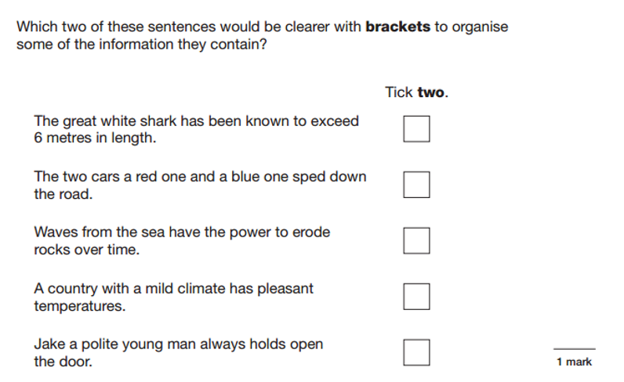
L.O: To plan a story based on FArTHER. 25.01.22
P | Success Criteria
 | Must: I can plan a story where paragraphs are used to mark changes in time, setting or event.
 | Should: I can expand on descriptions and themes.
 | Could: I can use the setting to indicate atmosphere and change.
 | Even better if… I can plan appropriate style and vocabulary.

Slide 2
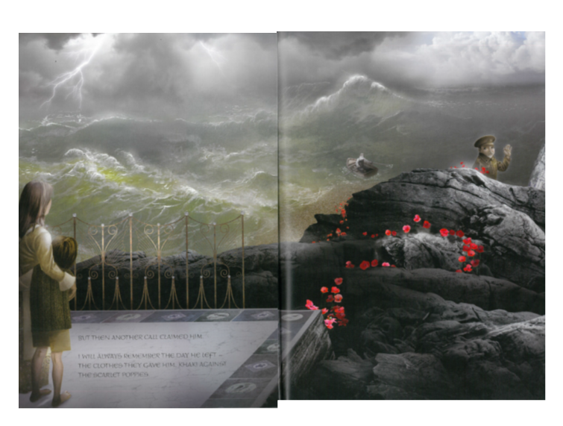
Today we will be reading the story of FArTHER to the end. With your partner, recap everything that happened so far in the story. Do you have any predictions of what might happen next?
In then next two lessons, we will be writing our own version of FArTHER. We will be telling the story from either the mother or the son’s perspective.

Slide 3
Suggested story structure.
Introduction- introduce the story of the family living together in the house.
Build up- the father receives his ‘call up’ papers and leaves for the war.
Climax- the family receive a telegram to inform them of his death.
Resolution- the son decides to continue his father’s dream of flying.
Ending- the son manages to succeed in getting the wings to work and flies.

Slide 4
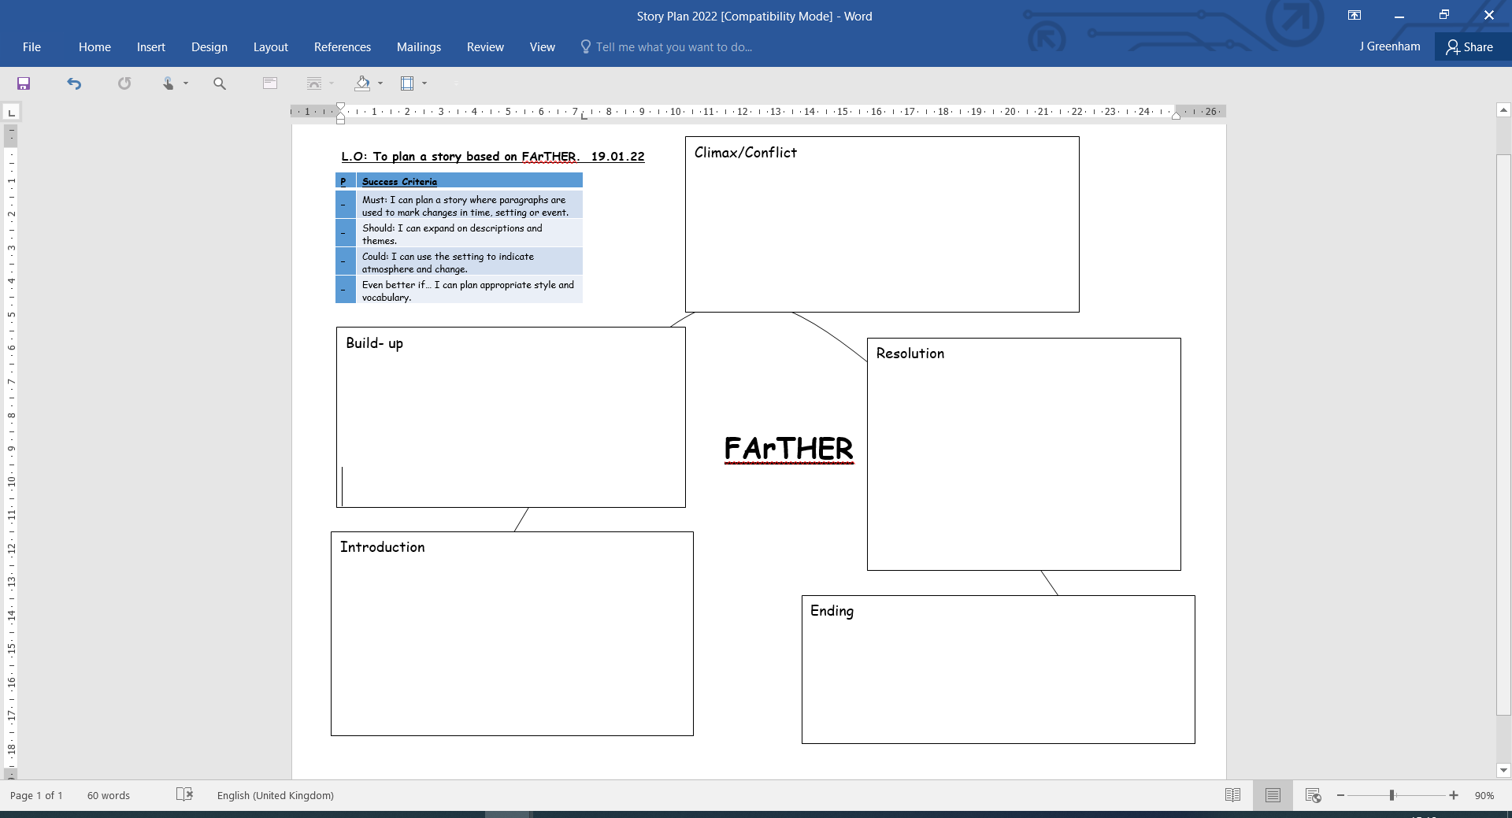

Slide 5
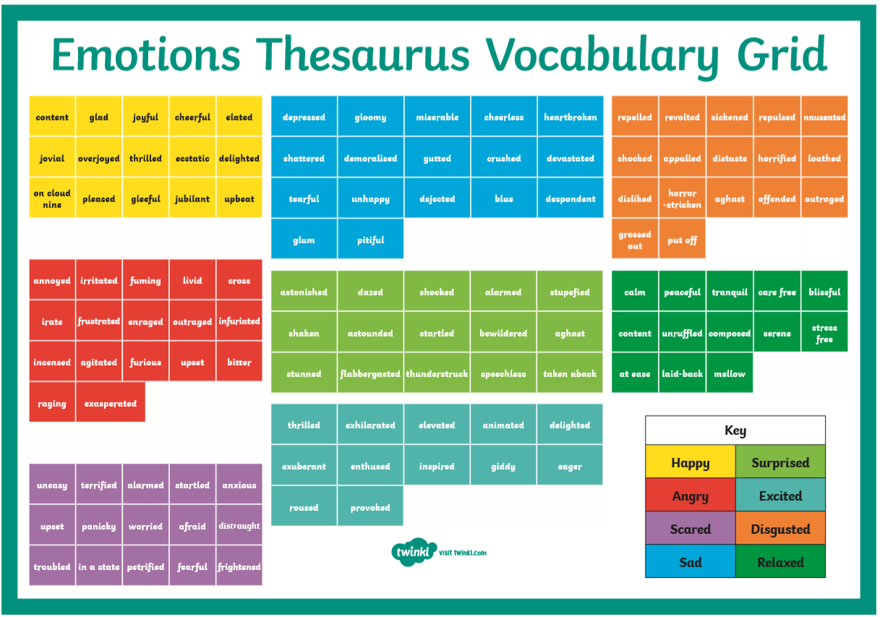
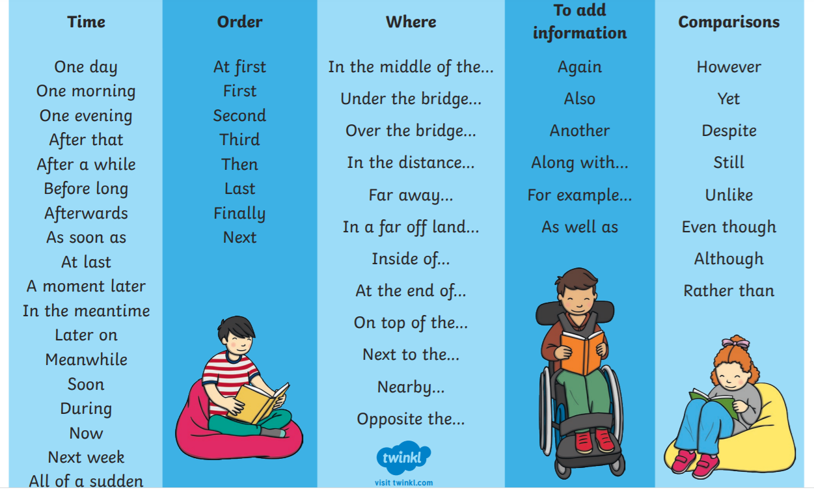
This lesson is your opportunity to come up with lots of brilliant ideas to help you later.
Improve your work by adding things like powerful adjectives and verbs, figurative language such as similes, and sentence starters to your plan. This will make your work much easier when you begin to write.

