Slide 1
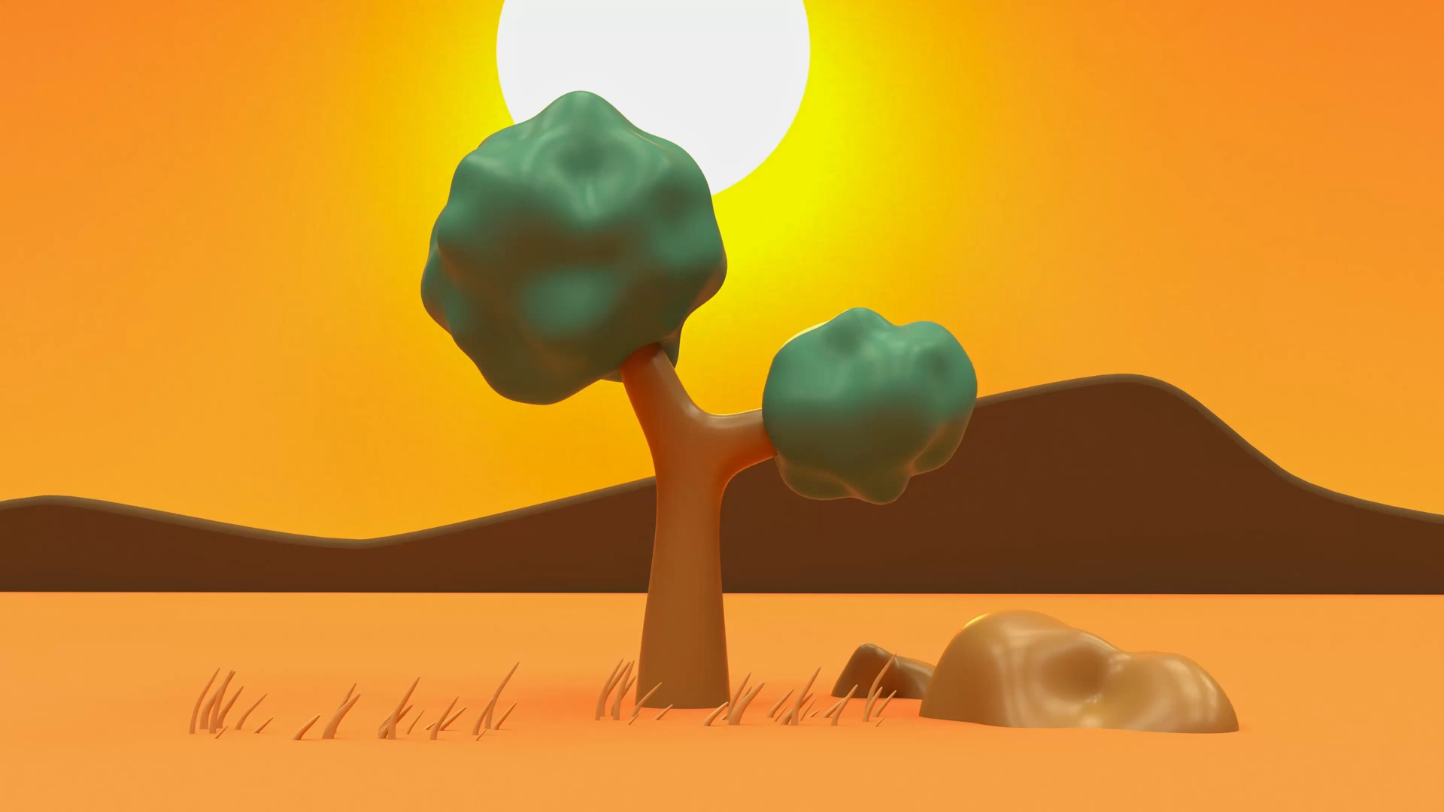
Aesop’s Fables
Lesson 3

Slide 2
YR2 LO: To answer comprehension questions about The Town Mouse and the Country Mouse.
I can answer literal questions about the text.
I can answer inference questions about the text.
I can summarise the story and it’s moral.

Slide 3
YR3 LO: To answer comprehension questions about The North Wind and The Sun.
I can answer literal and inference questions about a text.
I can summarise the story and it’s moral.
I can link this story to the key features of a fable.

Slide 4
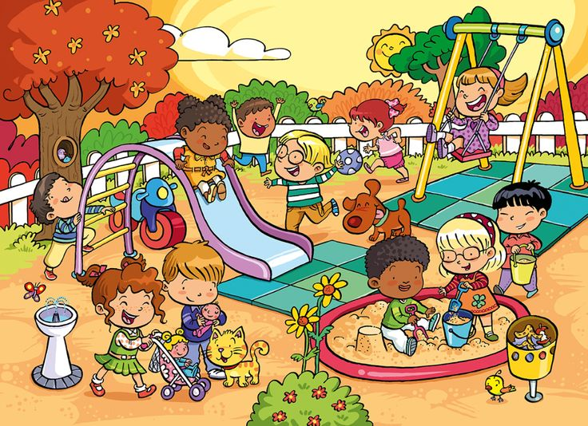
Retrieval questions:
What equipment can you see in the playground?
What is the weather like?
Are the children well behaved? How can you tell?

Slide 5
Inference questions:
How are the children feeling?
Why are the birds hiding in the tree?
Why do you think the boy at the bottom of the slide has his tongue poking out?

Slide 6
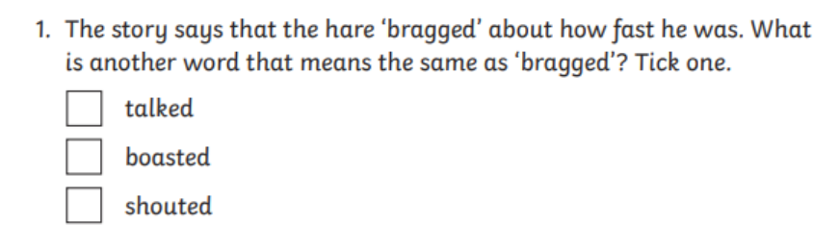
How do you read?
When we are answering reading comprehension questions, it is important to read the text first carefully. Then read the questions.
If you are 100% sure of an answer, then try to answer. If you are not sure, find the piece of the text that the question is referring to. Read that part again, then try to answer the question.
For example, in The Tortoise and The Hare, I might know already what bragged means.
Notes:
Ask how chn normally work during tests. Do most chn read the whole text first?

Slide 7
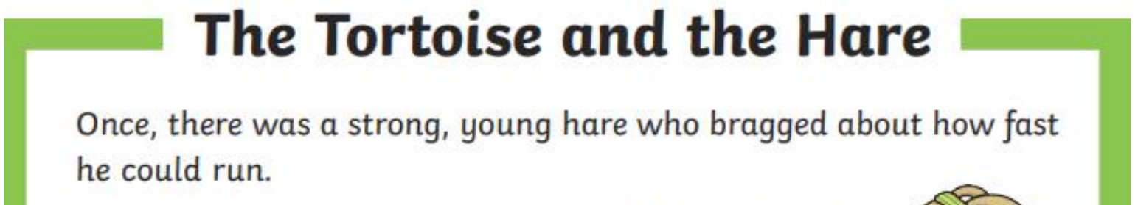
But I might need to read the sentence with bragged in it to make sure…

Slide 8
Your task:
YR2 – You are going to read the fable ‘The Town Mouse and The Country Mouse.’ Summarise what happens in the story in your own words and see if you can explain the moral of the story. The answer the comprehension questions.
YR3 - You are going to read the fable ‘The North Wind and The Sun.’ Summarise what happens in the story in your own words and see if you can explain the moral of the story. The answer the comprehension questions.

