Slide 1
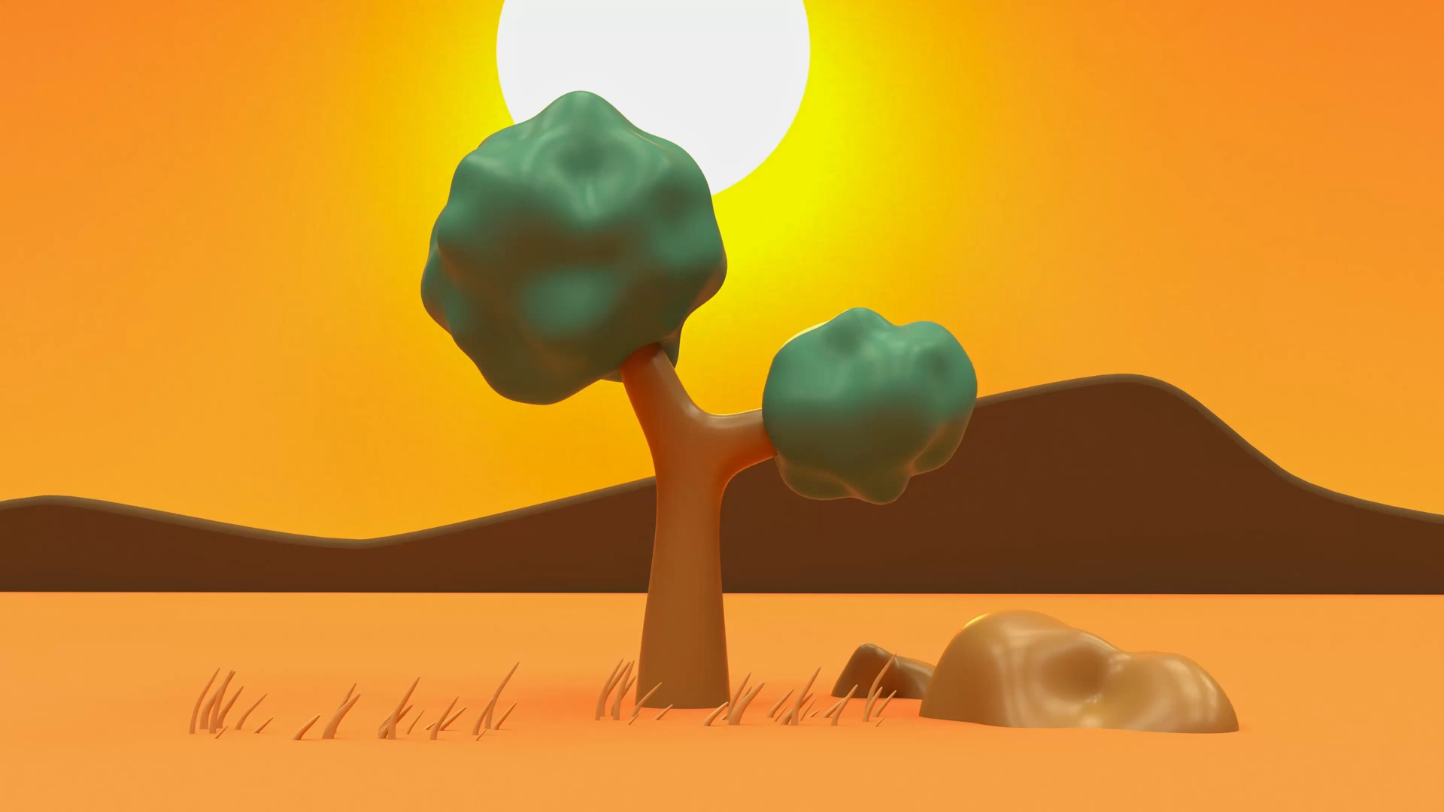
Aesop’s Fables
Lesson 5

Slide 2
LO: To create my main characters for my fable.
I can describe my characters’ personalities.
I can create phrases to show their personality.
I can consider an appropriate place where my story might happen.

Slide 3
How many emotions can you think of?
Notes:
Starter: With a partner - Write ideas down on IWB. Explain to chn if a character has one or two of these emotions all the time, we can say it is their personality (it is what they are like)

Slide 4
Can you match each personality to the opposite?
Confident
Kind
Bossy
Clever
Generous
Patient
Brave
Scared
Silly
Greedy
Shy
Rude
Understanding
In a rush

Slide 5
Can you match each personality to it’s opposite?
Confident
Kind
Bossy
Clever
Generous
Patient
Brave
Scared
Silly
Greedy
Shy
Rude
Understanding
In a rush
Notes:
Explain to chn that in order to teach a moral, we need to create two opposite characters. One ‘good’ and one ‘bad.’

Slide 6
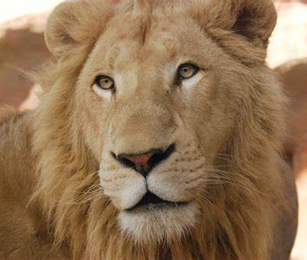
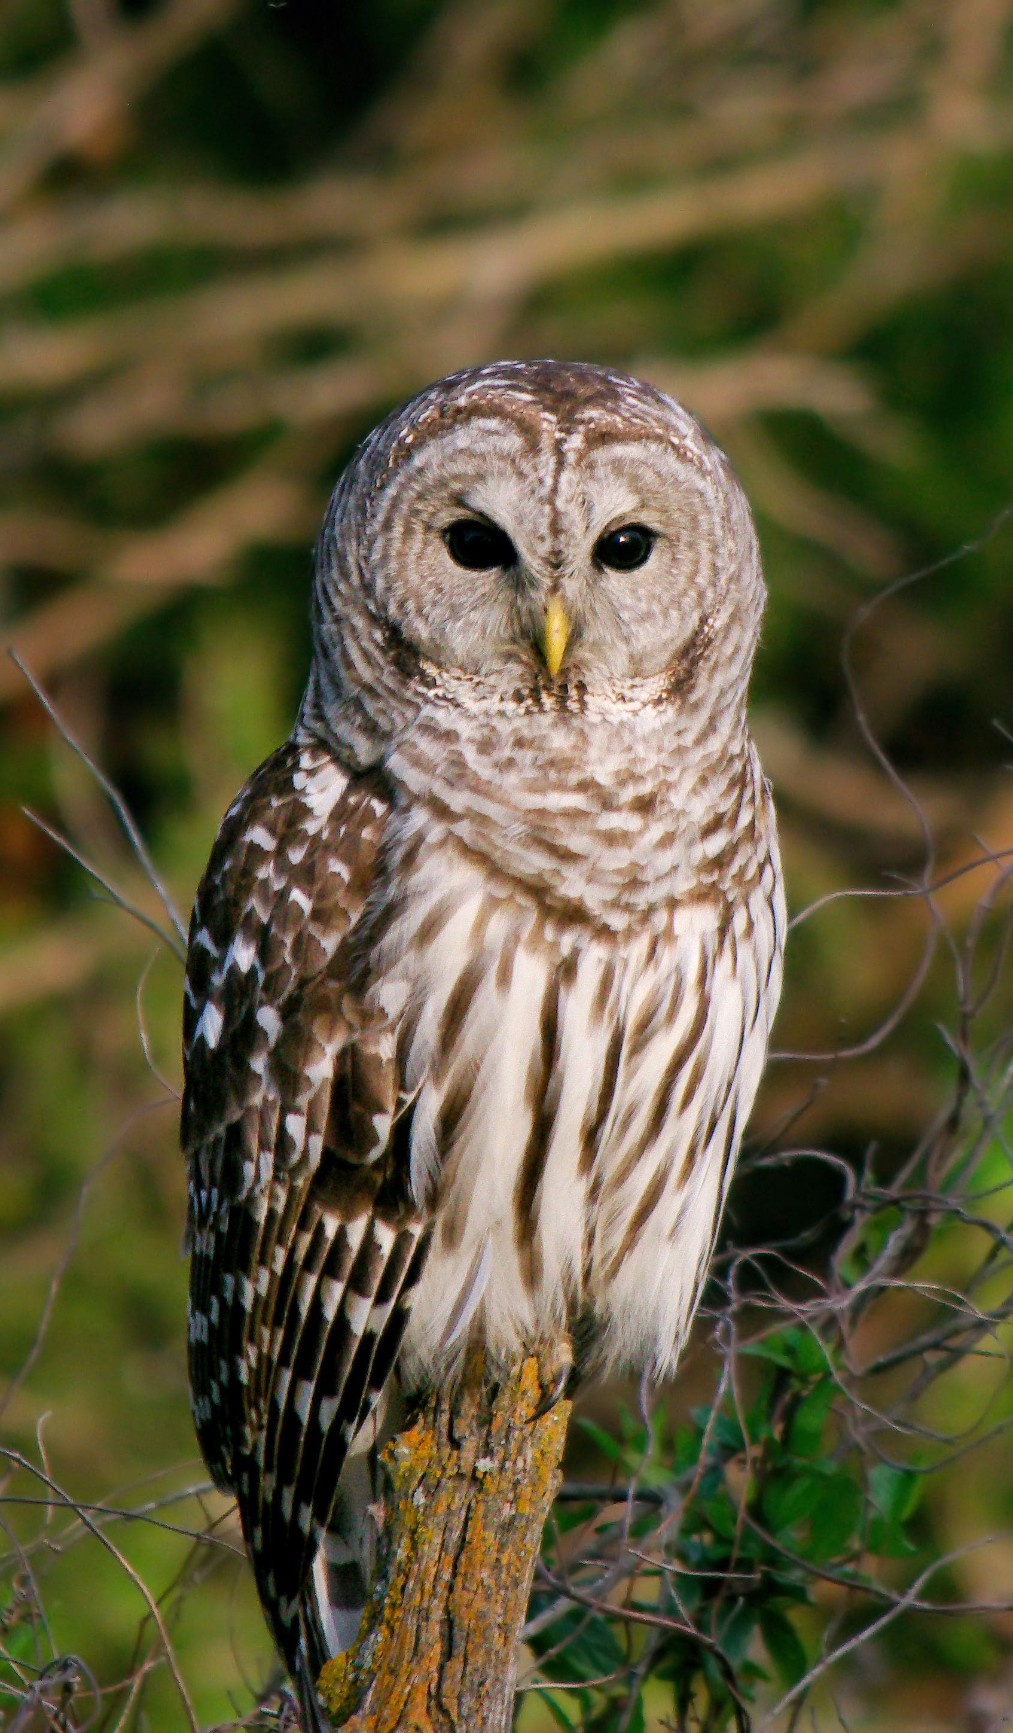
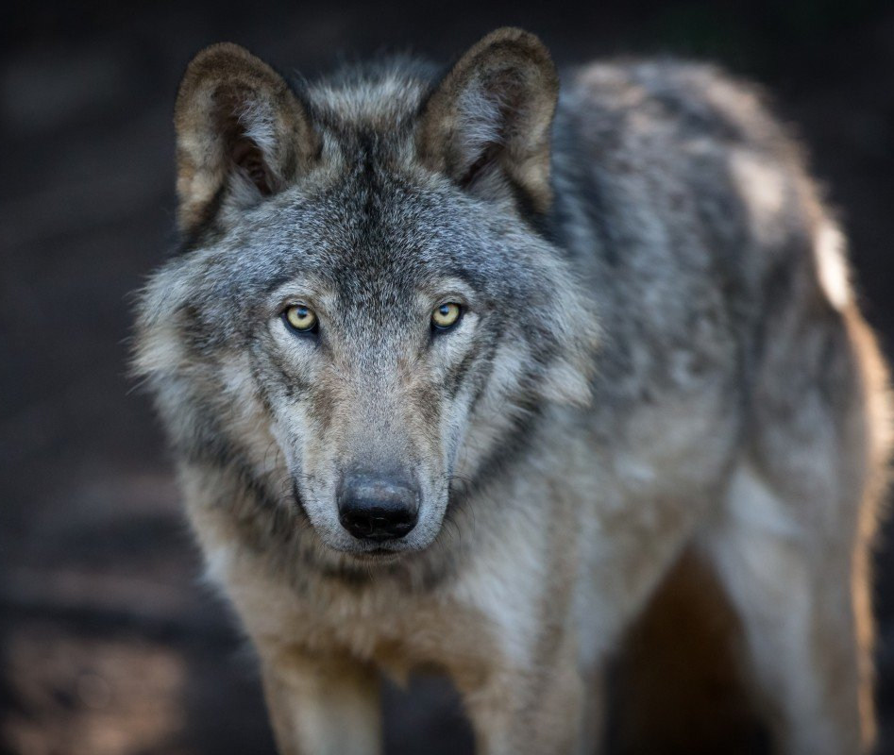
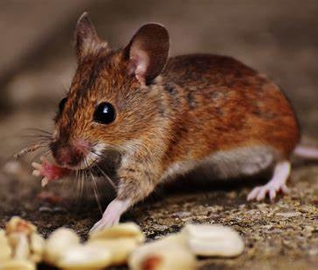
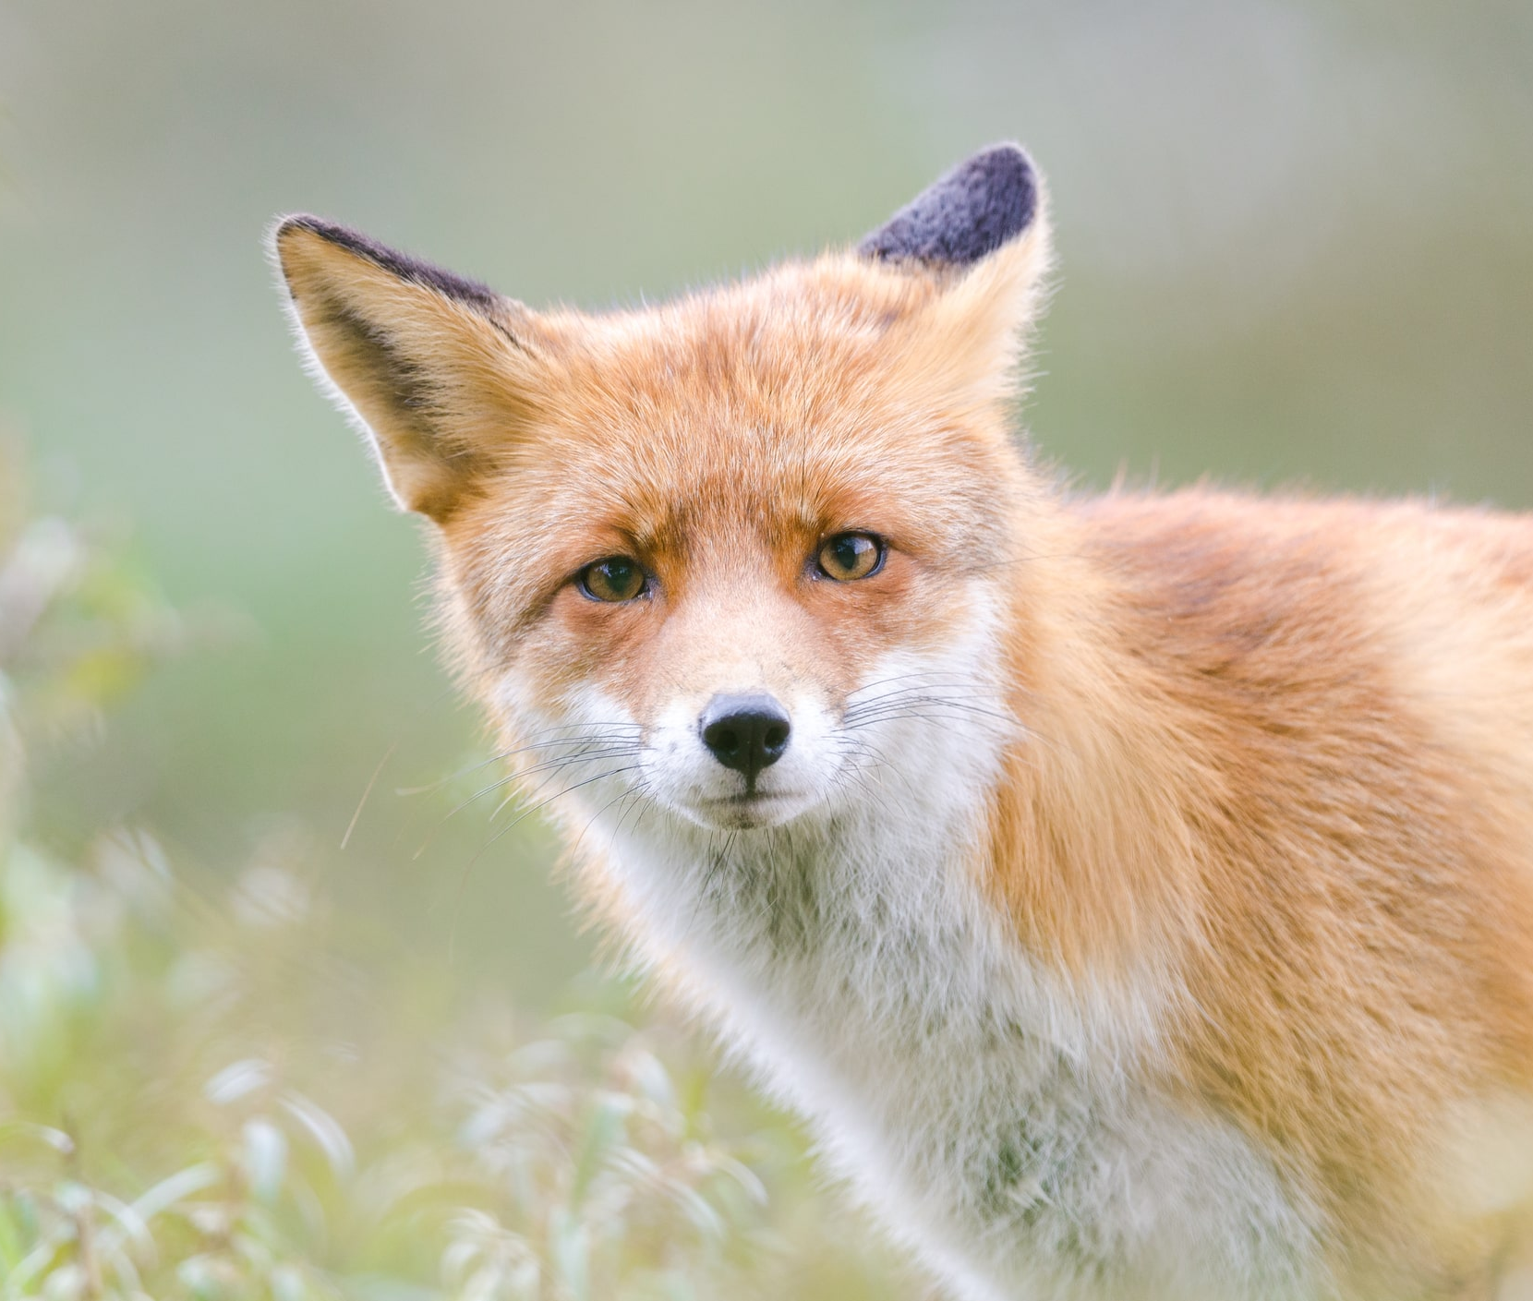
Notes:
How could we describe these animals? E.g. fox is clever and sly, the owl is intelligent and calm. Can chn think of their own animals and how they might describe them?

Slide 7
Your task:
Using your template, you are going to plan your moral and characters for your fable.
Some children have been given a moral and others can choose from the list given.
Think about two opposite animals that you might use. You need to think of animals that would be in the same setting e.g. a fox and an owl might both live in the woods. Use your template to draw your animals, describe what they look like and their personality.
You need to choose a setting for your story to happen in. Remember it needs to be realistic (a real place.)
Can you think of any sentences that tell us more about your character. For example, if your character is shy, you could say that they were shaking when they spoke.

Slide 8
Morals
Animals
Be kind to each other.
Don’t lie.
Don’t cheat.
Never give up.
Kindness is never wasted.
Fox
Wasp
Caterpillar
Butterfly
Wolf
Sheep
Ant
Bird
Notes:
If chn are struggling to choose their own moral and animals from list, suggest the moral of don’t give up and have a caterpillar and a butterfly.

Slide 9
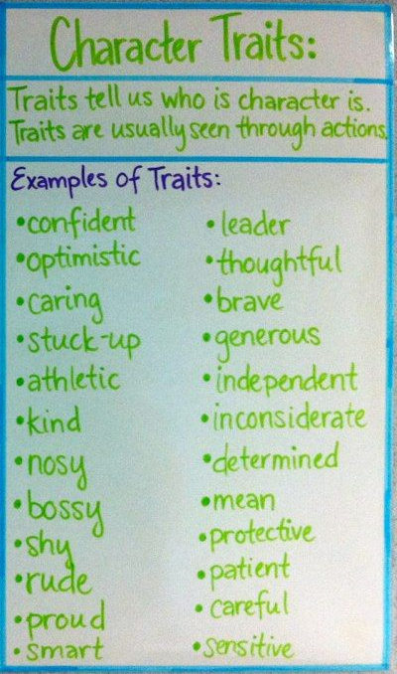
Plenary
Let’s share some of our characters!

