Slide 1

Aesop’s Fables
Lesson 6

Slide 2
LO: To plan the plot of my fable.
I know how a story is structured.
I can plan the key events of my fable using a story hill.
I can include a moral in the end of my story.

Slide 3
Inverted Commas
The most important rule in punctuating direct speech is that all words spoken must be enclosed by inverted commas.
In British English, a single inverted comma may be used:
‘Get off my bridge.’
However a double inverted comma may also be used:
“Get off my bridge.”
Whichever style you choose, use it consistently across a text.

Slide 4

Punctuation Inside Inverted Commas
All commas, full stops, question marks and exclamation marks must also be enclosed by inverted commas.
For example:
‘That grass looks delicious,’ said the smallest Billy Goat Gruff.
‘Hey, goat!’ shouted the troll. ‘You are not allowed to cross my bridge.’
‘How can we get to the other side?’ asked the Biggest Goat Gruff.
NOT: ‘Get off my bridge ’ ! shouted the troll.

Slide 5

Commas
Commas are another important tool to help the reader separate direct speech from the rest of the text.
Where direct speech precedes a verb, and does not end in a question mark or exclamation mark, a comma must be used.
For example:
‘We need to get to the other side,’ moaned the goats.
‘Those goats are always disturbing my sleep,’ muttered the troll.

Slide 6

Commas
Where the direct speech before a verb ends in a question mark or exclamation mark however, this punctuation replaces the comma.
For example:
‘Who goes there ?’ shouted the troll.
NOT:
‘Who goes there ?,’ shouted the troll.

Slide 7
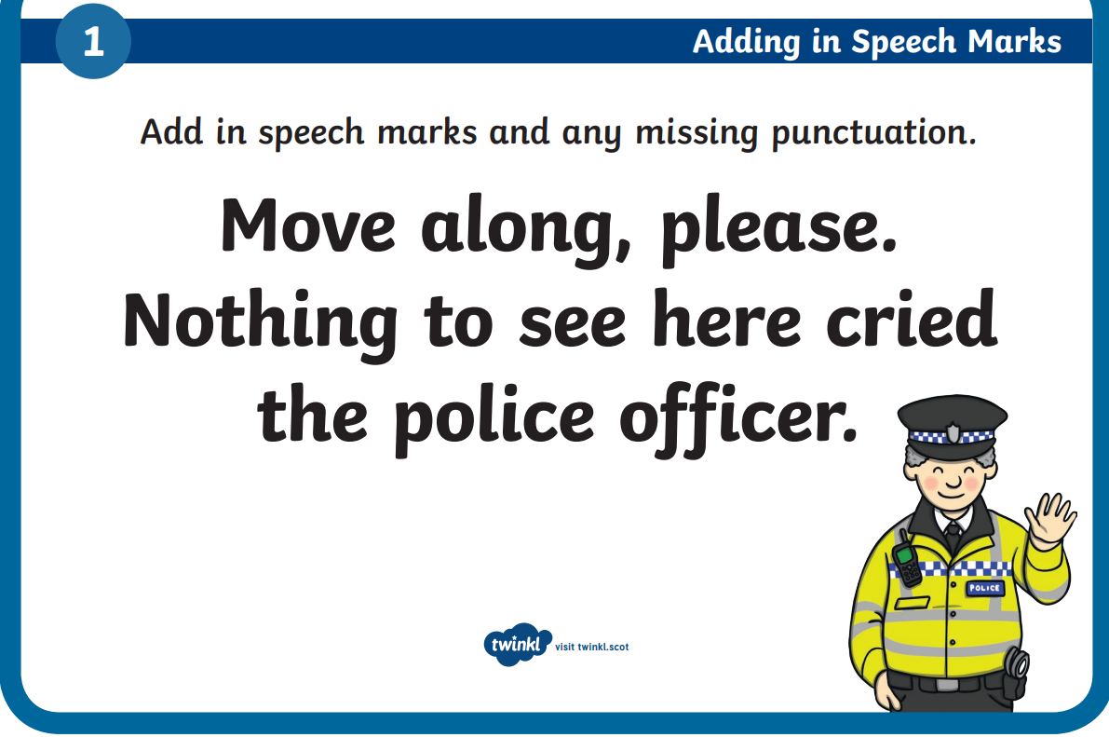

Slide 8
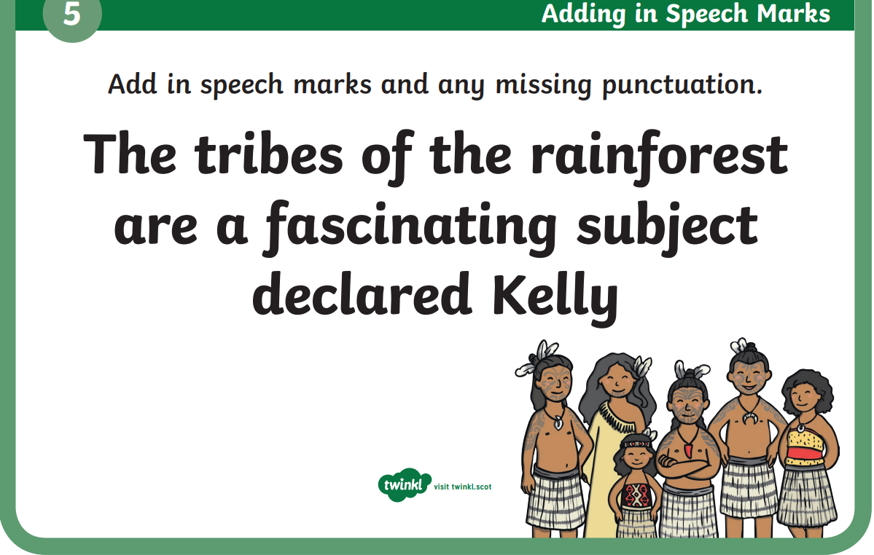

Slide 9
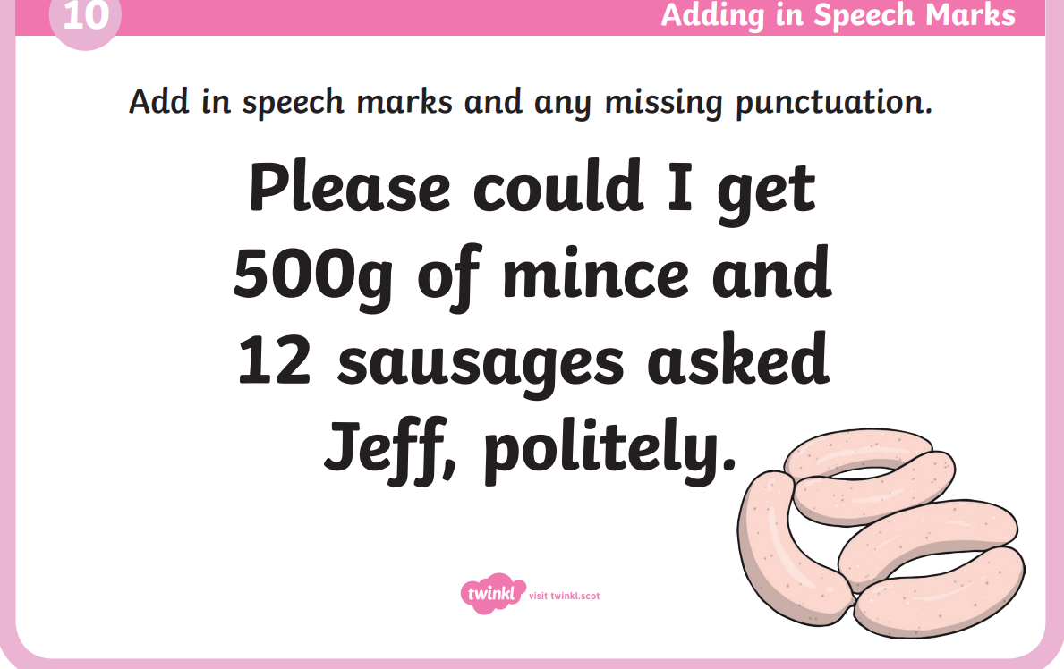

Slide 10
Partner talk:
Tell your talk partner what the moral of your story is and which animals you have picked for your fable. Can your partner help you think of a problem that will help prove your moral.

Slide 11
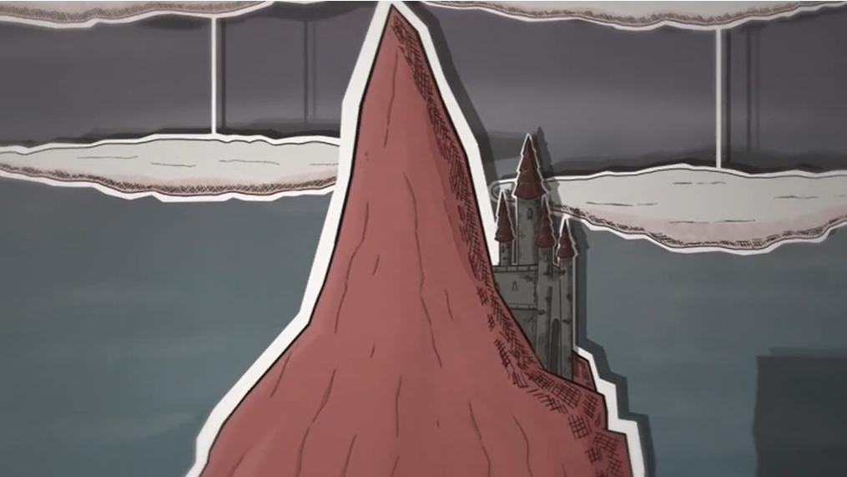
How to plan a story - BBC Bitesize
Notes:
How to plan a story - BBC Bitesize

Slide 12
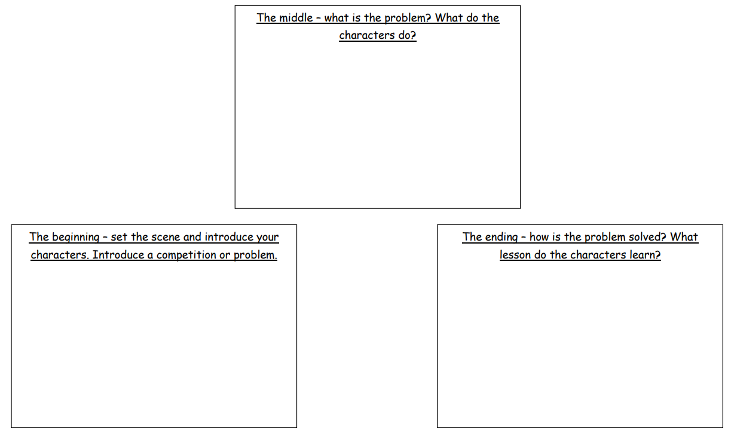
Notes:
See if chn can help to fill in the boxes using the story of the boy who cried wolf.

Slide 13
Your task:
Story hill one: This story hill has a beginning, middle and end to help you plan your story. Use the boxes to plan the plot of your story in bullet points.
Story hill two: This story hill has four boxes for planning. A beginning to introduce your characters and the setting, a build-up to explain the problem or competition, a climax and resolution to solve the problem or have a consequence, and an ending to explore the moral.
Notes:
Remind chn that the problem needs to be solved in order to learn a lesson. Unlike a normal story, we don’t have a happy ever after. One character has to face consequences or lose to teach the reader a lesson.
Remind chn of examples e.g. the boy who cried wolf has the sheep eaten. The grasshopper doesn’t have food in the winter and starves, the sun wins the competition.

