Slide 1
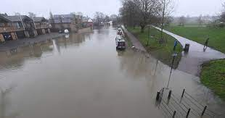
Floodland

Slide 2
Causal conjunctions-
Monday 13th September 2021 L.O. To predict what might happen from details stated and implied. L.O. To provide reasoned justifications for my opinion. L.O. To use appropriate conjunctions (joining words) to join simple sentences.
Self- Assessment | Success Criteria | Teacher Assessment
 | Must… I can predict what might happen in the text based on details stated and/or implied.
 | Should… I can draw inferences from a text.
 | Could… I can identify and use appropriate conjunctions to join sentences.
 | Even better if… I can give reasoned justification for my viewpoint based on evidence in the text.
Grammar Focus
Who can explain what a causal conjunction is?
Write some examples of causal conjunctions on your mini WB.
How are they used- what is their purpose?

Slide 3
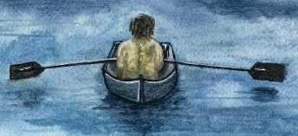
Grammar Focus
therefore even though
accordingly
as a result
due to
so
because
now that
consequently
since
These words are used to explain
WHY a thing happened.
They show a CAUSE and effect.
Finish these sentences with a causal conjunction.
Billy could not play ______________ he had not completed his homework.
Mina practised the piano every day; _________________ she advanced to the next piano grade.
Causal Conjunctions
hence

Slide 4

What do you think the book might be about?
Working with a partner - decide together and come up with a
statement. Be prepared to justify your reasoning using a causal
conjunction!
“I think the book is about ______________
because_______________”.

Slide 5
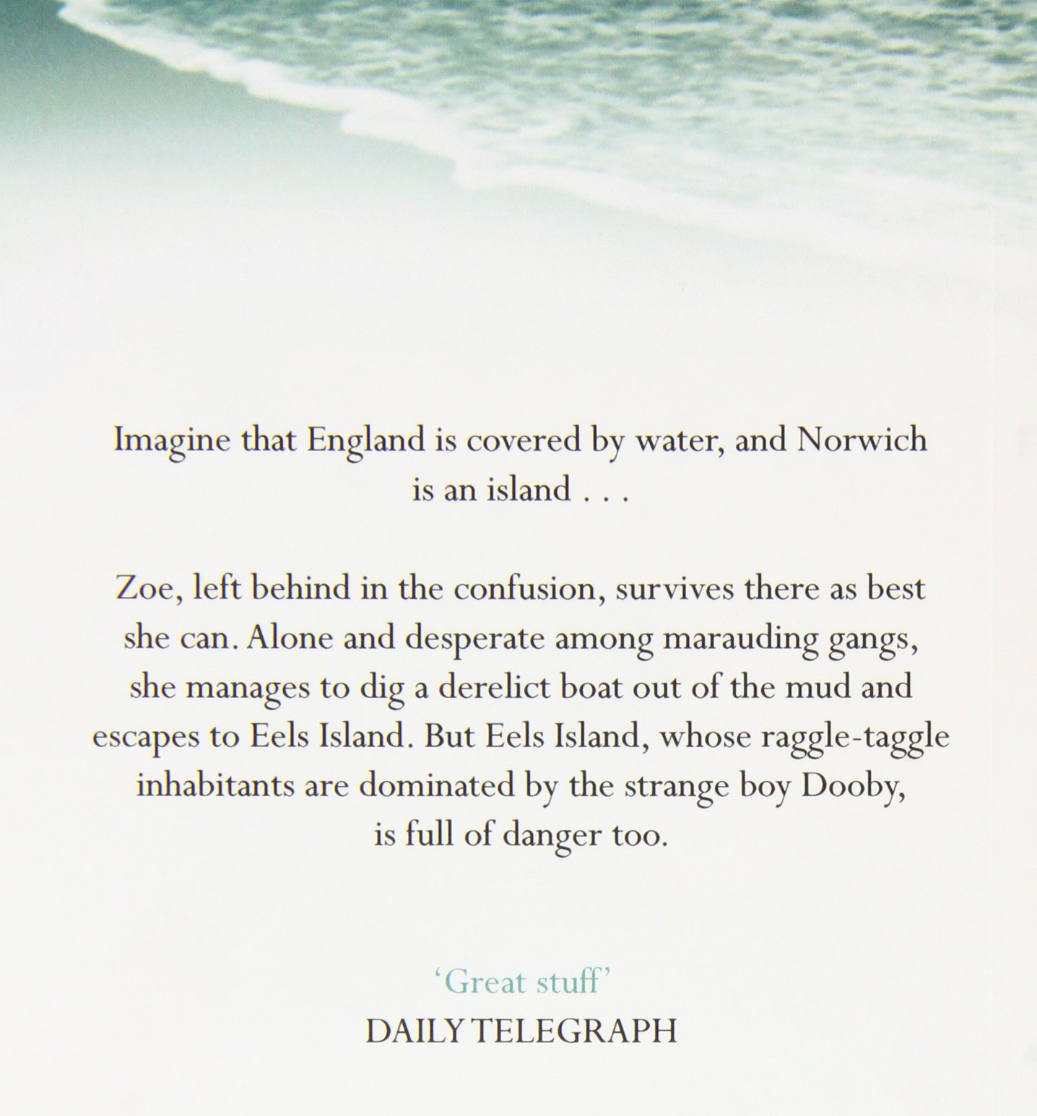
Read through the blurb, then tell me...
What have you learned?
Write another statement saying what you think the book is about.
Use a different causal connective to justify your reasoning.

Slide 6
Zoe ran. Harder than she had ever run in her life. Her feet pounded through the deserted streets of derelict buildings. Somewhere, not far behind, she could hear the gang coming after her. It felt as if her heart would burst, but she didn't slow down. She'd been planning to leave the island for a long time, but had been putting it off. It was a big decision to set out to sea in a tiny rowing boat. Now she had no choice.

Slide 7
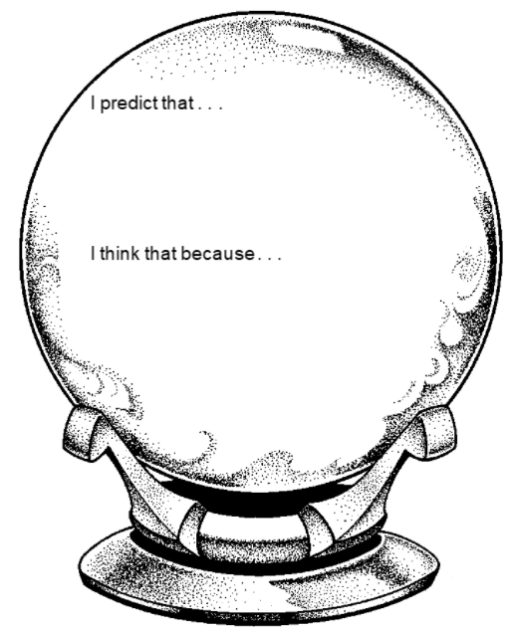
Use your crystal ball to peer into the future and predict what will happen in the story.
Make sure to:
Use causal conjunctions to explain your reasons why you think so.
Give evidence from the blurb and the text to back up your ideas.

Slide 8
Book Talk
Explain what you liked and disliked so far about this text.
Use causal conjunctions to explain why!
Who do you think the intended audience of the book is?
What is the purpose of the book?

