Slide 1

Floodland

Slide 2
Tuesday 14th September, 2021 L.O: To be able to use a range of sentence structures in a character description
Self- Assessment | Success Criteria | Teacher Assessment
 | Must: I can identify and use expanded noun phrases.
 | Should: I can identify and use coordinating conjunctions to join sentences.
 | Could: I can identify and use subordinate conjunctions and clauses.
 | Even better if… I can use a range of different sentence structures to describe a character.
Grammar Focus- Noun Phrases
You have one minute to define a noun phrase with your partner.
What is a noun? Give an example.
Define 'noun phrase' Give an example.
What is an expanded noun phrase? Define and give examples.

Slide 3

An expanded noun phrase provides extra information about the noun- E.g.
Dog- Noun
The dog- Noun Phrase
The happy brown dog in the park- Expanded noun phrase.
Now come up with expanded noun phrases about an
ice cream and a lake.

Slide 4
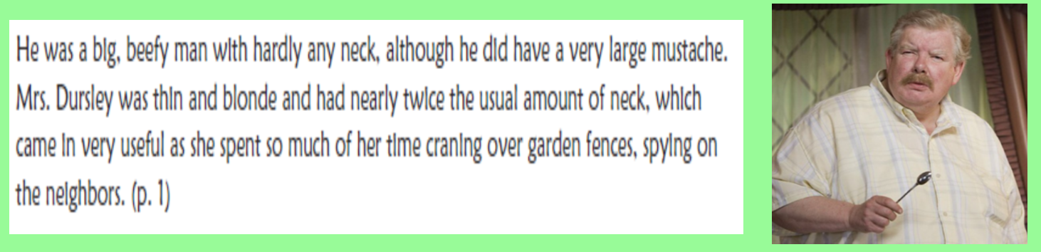
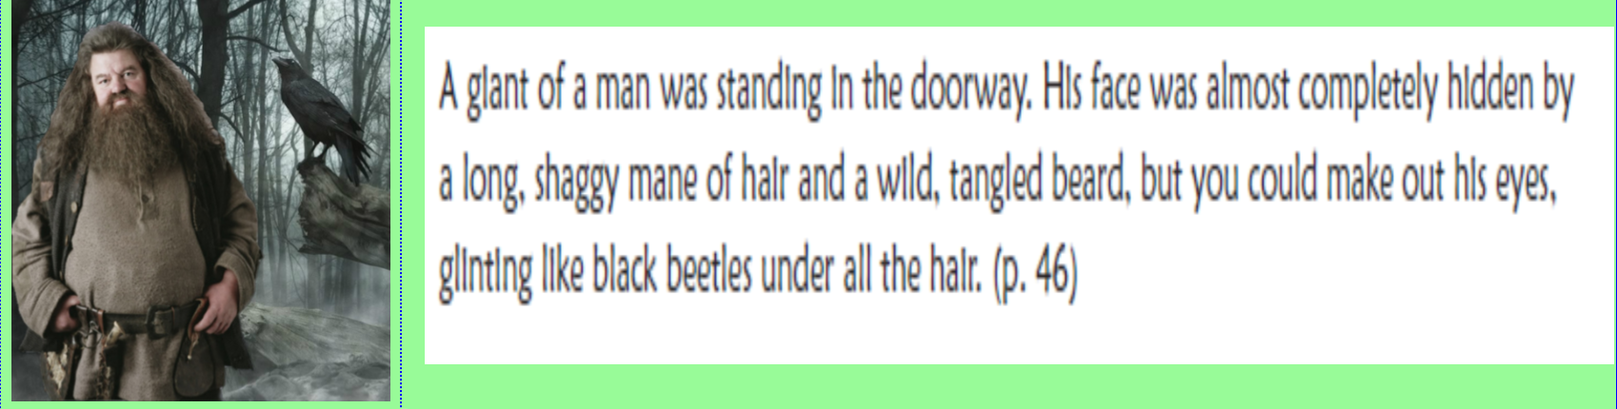
What type of sentences can you identify?
What type of conjunction has the author used?

Slide 5
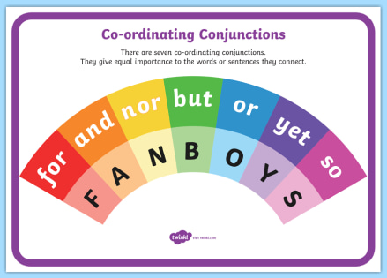
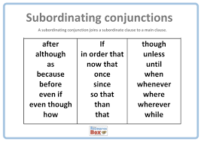
The boy sat down. Simple
The boy sat down and ate his lunch. Compound
The boy sat down and ate his lunch because he was hungry. Complex
Because he was hungry, the boy sat down and ate his lunch. Complex

Slide 6

Book Talk
ZOE
Role on the wall
Re- read the beginning of chapter one, up until ‘without even looking where she was going’.
Using post it notes, we will be describing the character of Zoe on our working wall.
Ideas about Zoe’s personality or feelings will go on the inside of the outline.
Ideas about Zoe’s outward appearance, or other information go outside.

Slide 7
Your task is to write an interesting character description of Zoe.
Here is one- Zoe is a small girl. Zoe has brown hair and lives in Norwich. She is dirty and has no parents.
What do you think?

Slide 8
Must: I can identify and use expanded noun phrases.
Should: I can identify and use coordinating conjunctions to join sentences.
Could: I can identify and use subordinate conjunctions and clauses.
Even better if… I can use a range of different sentence structures to describe a character.

Slide 9
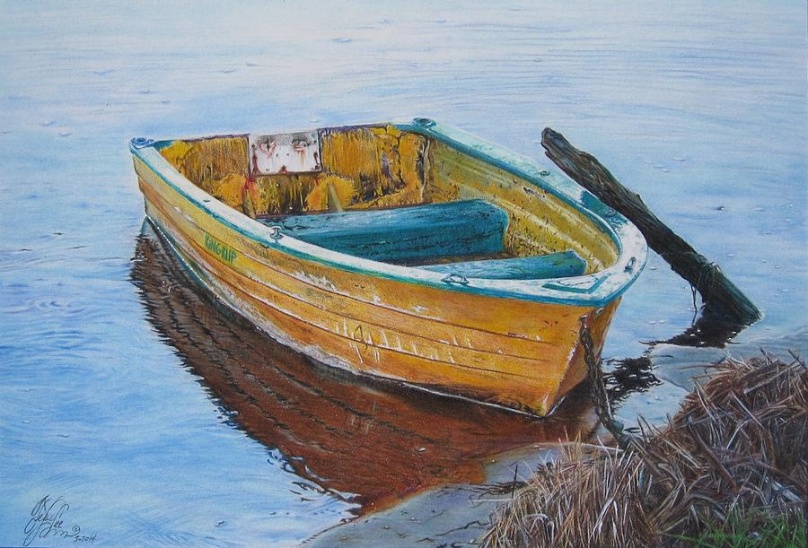

Slide 10
Pulling it across the grass , and then into the water, she dared to look behind her for the first time. Her stomach twisted with fear. The gang were storming down the hill, weaving in and out of the crumbling gravestones. Zoe moved faster. She clambered aboard and put the oars out, then started to pull. They were at the water now, and though one or two had stopped, the rest came splashing madly after her.

Slide 11
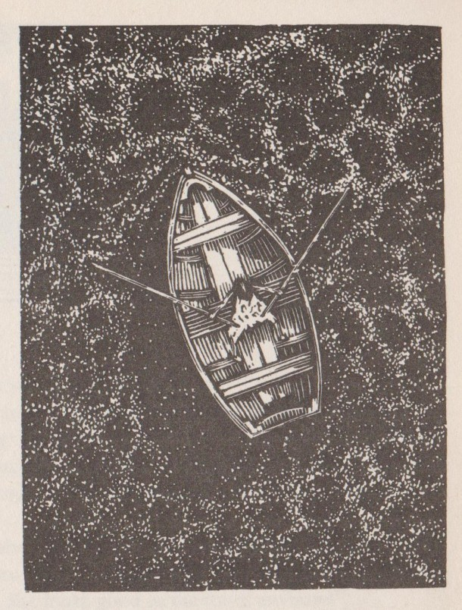
Partner Talk
How do you think Zoe is feeling at this point? Why?
What about those left on the shore - How do you think they are feeling?
Use evidence from the text.

Slide 12
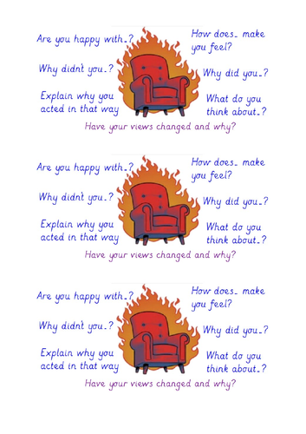
Hot Seating
I will need two volunteers to take on the roles of Zoe and one of the gang chasing her.
The rest of the class need to think of interesting questions to ask.
Try to choose open questions.

Slide 13

After we read to the end of chapter 2, tell me…
Was Zoe’s dad right to leave her behind?
You must explain your reasons for saying so using causal conjunctions.
Remember to give evidence form the text to support your answer.

