Slide 1

News Reports

Slide 2
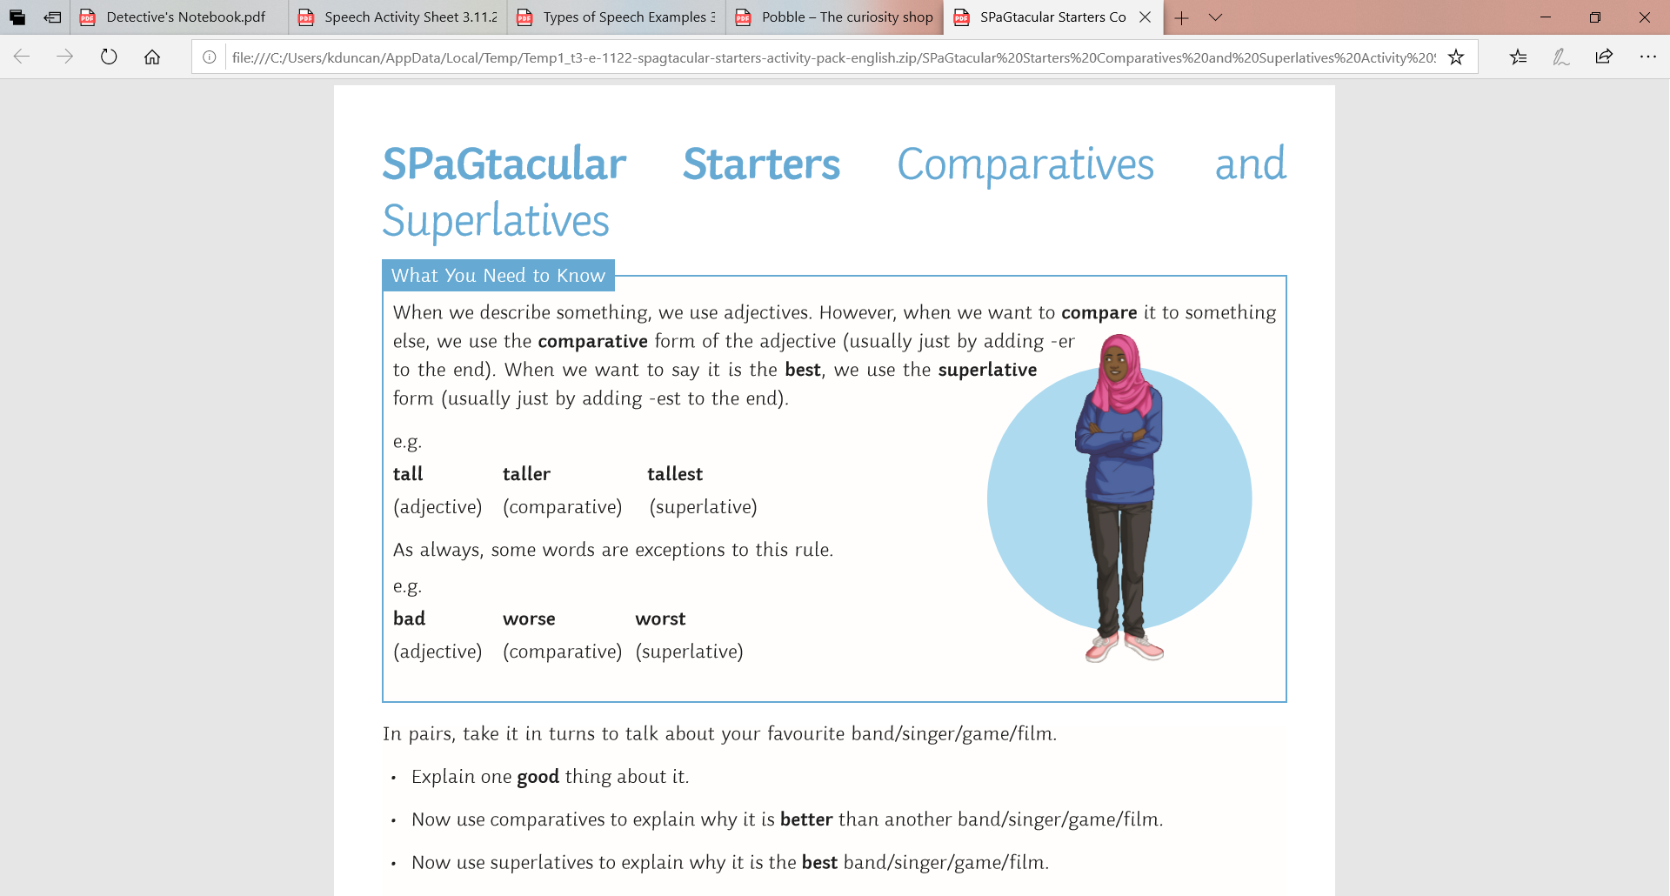
L.O: To ask questions to improve understanding 02.11.21
SPAG Starter-
Comparative and superlative adjectives are used to compare between a set of things.
P | Success Criteria | T
 | Must: I can make inferences to understand a text.
 | Should: I can write a list of questions to ask an interviewee based on the text.
 | Could: I can understand the difference between open and closed questions.
 | Even better if… I can select questions that prompt the interviewee to describe what happened in detail.
With your partner, take turns thinking of an adjective, then finding the comparative and the superlative forms.

Slide 3
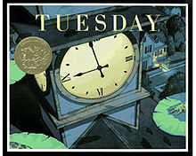
We will be reading Tuesday by David Wiesner.
What do you think this book might be about?
What can you tell from the front cover?

Slide 4
Partner talk:
What do you think this story is about? What happens?
What did you like about this story?
What do you dislike? Why do you think so?
What puzzles or questions do you have?

Slide 5
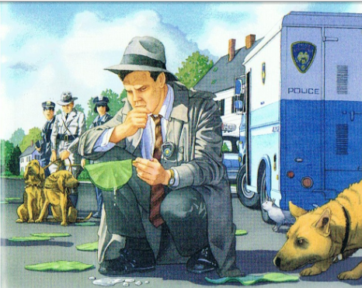
What questions do you think the police might be asking themselves? What would they be looking for? Who might they want to talk to?

Slide 6
Task
Imagine you are a police detective investigating the events of Tuesday.
Your task is to choose three characters from the story who might have seen something, and to write a list of questions to ask them.
How can you choose questions that will help them give you more information?
Closed Questions
These questions have short answers, usually yes or no.
E.g. Did you see toads yesterday night?
Closed Questions
These questions need to be answered in full sentences, usually with more detail.
E.g. Tell me about what you saw and heard yesterday night.

Slide 7
Plenary
Let’s have some volunteers to share their best question.
What information might we get in response?

