Slide 1
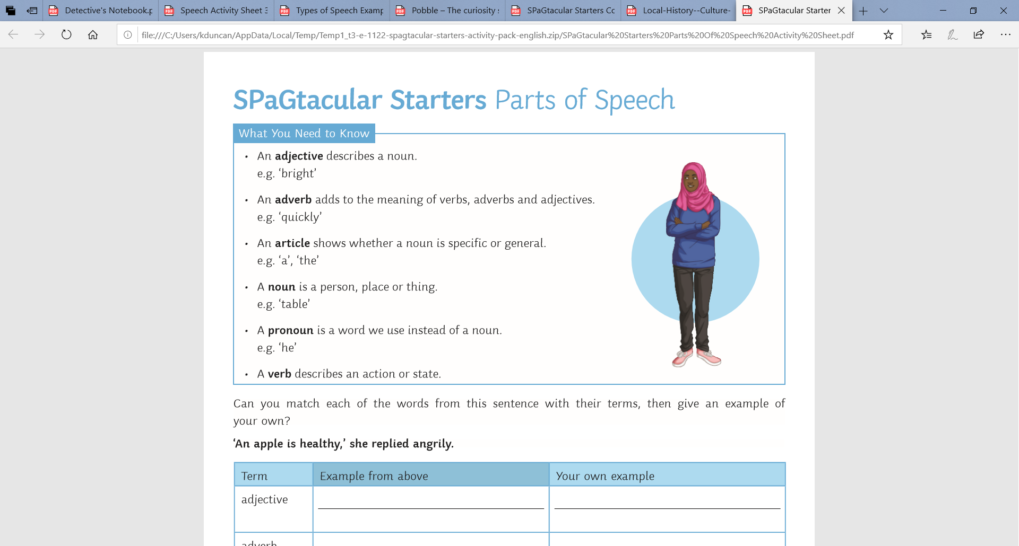
L.O: To use drama to explore the text 03.11.21
P | Success Criteria | T
 | Must: I can interview a character in role.
 | Should: I can make notes during the interview.
 | Could: I can record key information in the witnesses’ exact words.
 | Even better if… I can summarise what I think happened based on the evidence.
Match each of these features with the example sentence.
“An apple is healthy,” she replied angrily.
Now think of your own example.

Slide 2
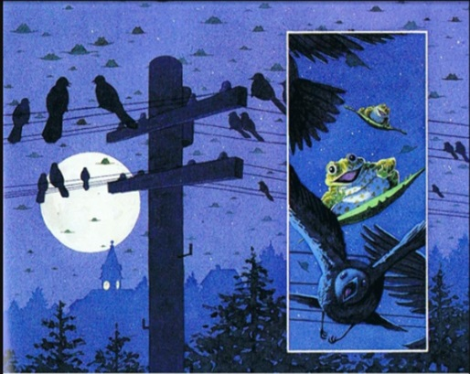
To begin, we will re-read Tuesday by David Wiessner.
Think about the questions and puzzles you had last time. Can you spot any clues to answer your questions?
Have you noticed anything new that you didn’t notice last time?

Slide 3
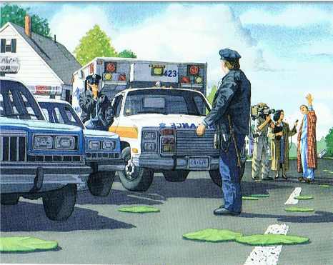

Your task will be to work in partners to role play a detective interviewing some of the key witnesses.
Use the Detective notebook page to write notes to record their answers.
If you think your partner said something especially important, ask them to repeat it and write it down in their exact words.

Slide 4
Once your interview is complete, you will need to write a transcript of what was said.
You should write this in the format of a play script.
What features of a play script do we need to remember?
Play script
Policeman: What else do you remember?
Mrs Grundy: Well, I remember quite a distinctive damp smell, a bit like a pond. And an overwhelming sense that everything was green. Strange really.
Try to be as accurate as possible when recording what your witness said.

Slide 5
Think about the evidence you would have found, and what the witnesses reported.
What conclusions do you think the detectives would come to about what happened?
With a partner, come up with a sentence or two to summarise what happened, using evidence to back up your ideas.
“We suspect that _______________ because _______________”.
“Due to _______________, we believe _________________”.

