Slide 1
L.O: To use different types of speech in writing 04.11.21
P | Success Criteria | T
 | Must: I can identify direct and reported speech.
 | Should: I can write and punctuate direct speech correctly.
 | Could: I can write and punctuate reported speech correctly.
 | Even better if… I can summarise direct speech and turn it into reported speech.

Slide 2
Direct Speech
Yesterday you were writing down direct speech- the exact words someone said.
How would this be shown in different kinds of writing, other than a play script? For example, a comic, narrative or news report?
You will work in groups of 3-4 to turn a few sentences of your play script into these different types of writing.

Slide 3
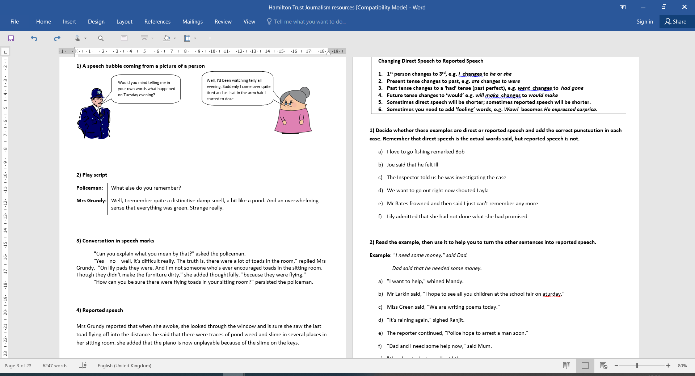
Take a look at these examples:
What differences do you notice?

Slide 4
Task
Using reported speech
Changing Direct Speech to Reported Speech
1st person changes to 3rd, e.g. I changes to he or she
Present tense changes to past, e.g. are changes to were
Past tense changes to a ‘had’ tense (past perfect), e.g. went changes to had gone
Future tense changes to ‘would’ e.g. will make changes to would make
Sometimes direct speech will be shorter; sometimes reported speech will be shorter.
Sometimes you need to add ‘feeling’ words, e.g. Wow! becomes He expressed surprise.
Complete these tasks by changing from direct speech to reported speech.
Ensure you use the correct punctuation.
Make sure you are using the right level of formality.

Slide 5
Peer Assessment.
Choose a new partner in a different year group. Check your partner’s work- do the sentences make sense? Is punctuation correct?
Are there any sentences you could have written in a different way? What effect would these changes have?

