Slide 1
https://app.pobble.com/lessons/lesson/6be24e85/
L.O: To edit and improve my report 10.11.21
Formal or informal language
P | Success Criteria | T
 | Must: I can review my writing and make improvements.
 | Should: I can ensure my punctuation is correct.
 | Could: I can ensure my tone is formal consistently.
 | Even better if… I can ensure I have justified all of my conclusions.

Slide 2
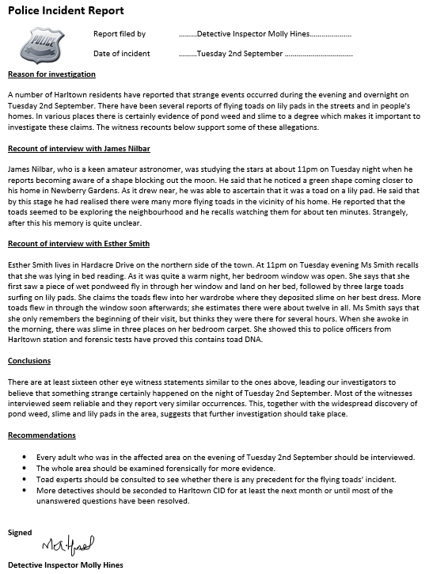
Let’s examine the example police report one more time.
Has this been written with formal or informal language?
How has speech been written?
First person or third person?
What tense has been used?
Take a second look at the detective’s conclusion.
Each of her conclusions and recommendations is backed up by the facts.

Slide 3
In this lesson your task is to improve and complete your report.
Make sure your are paying close attention to punctuation and word choices, in addition to using formal language.
Plenary- in pairs, check your partner’s work to ensure they have provided reasons or evidence for each of their conclusions or recommendations.

