Slide 1
To understand active and passive voice.
P | Success Criteria | T
 | Must: I can understand the features of active and passive voice.
 | Should: I write sentences using the active and passive voice.
 | Could: I can convert a passage from the active to passive voice.
 | Even better if… I can explain when each is most appropriate to use.
What do all complete sentences need? A capital letter, a subject, a verb and a piece of punctuation at the end.
Identify the subject and verb in these sentences.
The happy dog barked.
A dancer leapt athletically onto the stage.
Feeling like her lungs would burst, Mandy crossed the finishing line.

Slide 2
What do you notice about these two sentences?
John knocked a drink from his teacher's hand.
A drink was knocked from the teacher's hand by John.
Do these sentences mean the same thing?
What is different about them?
What/who is the subject of each sentence?

Slide 3
The first was written in the active voice. The second was written in the passive voice.
John knocked a drink from his teacher's hand.
John is the subject of the sentence. He is the one doing the action.
A drink was knocked from the teacher's hand by John.
The drink is the subject of the sentence. It is acted upon by John.
Most sentences are written in the active voice. The passive voice can be useful if you want to be impersonal or objective in a description.
It is frequently used in formal writing and is highly useful for newspapers.

Slide 4

Read through this news article. Can you identify Active and Passive voice?
https://www.bbc.co.uk/newsround/59237005

Slide 5
Task- to identify and change between active and passive voice.
Ugur Sahin developed the Covid-19 Vaccine.
The first English dictionary was written by Samuel Johnson.
Malala Yousafzai attended Oxford University.
Katherine Johnson was awarded the Presidential Medal of Honour.
You may need to alter some of the words in a sentence to make it work, but you should keep the meaning the same.

Slide 6
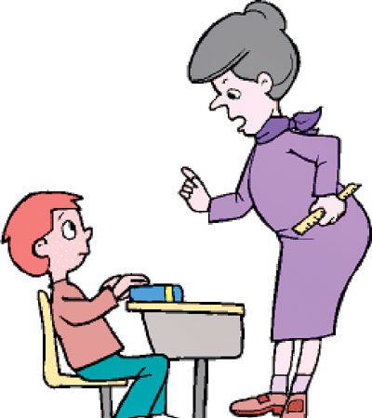
Plenary: Role play.
One child will be the teacher, one child will be the teacher.
The teacher will be asking questions such as “Who broke the ruler?”
The child will answer using the passive voice to avoid getting in trouble!

