Slide 1
How would we represent these sentences in reported speech?
L.O: To plan a news article about the events of Tuesday. 23.11.21
P | Success Criteria | T
 | Must: I can create a plan for my news article.
 | Should: I can distinguish between fantasy, fact and opinion.
 | Could: I can plan the plain facts of the story.
 | Even better if… I can choose ambitious vocabulary for my story.
“ I’m sorry I couldn’t play football; I had a headache,” explained Jimmy.
“I can’t find our suitcases anywhere!” Alex exclaimed worriedly.
“ I need help with my homework!” sighed Giovanna.

Slide 2
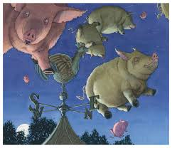
This week we will be working towards writing a newspaper article based on the end of ‘Tuesday’.
Journalists need to investigate the facts, so they can write an accurate story.
Explain to your partner, the difference between fantasy, facts and opinion.

Slide 3
With your partner, decide if these sentences are fact, opinion or fanstasy.
That man has a beard.
2. Red is the best colour.
3. Apples taste better than pears.
4. Fairies live in the tree at the bottom of the garden.
5. Peter can run faster than Paul.
6. Sophie was awarded first place in the baking contest.
What kind of sentence will be mostly used by journalists?

Slide 4
Working in teams of four, write down a list of suggestions of what the pigs might have got up to on their flying adventure.
You can add in details about the evidence left behind and who the witnesses might have been.
Try to write at least one full descriptive sentence each, such as.
The mischevious pigs flew through a carpet shop, leaving behind muddy trotter prints on all the new carpets.
Your group can help suggest ideas.

Slide 5

Swap papers with a different group. Your task now is to underline the facts of the story.
(Facts are things you can prove to be true).
Swap again, and now underline the opinions in a different colour.
(Opinions are what a person thinks or believes to be true).

Slide 6
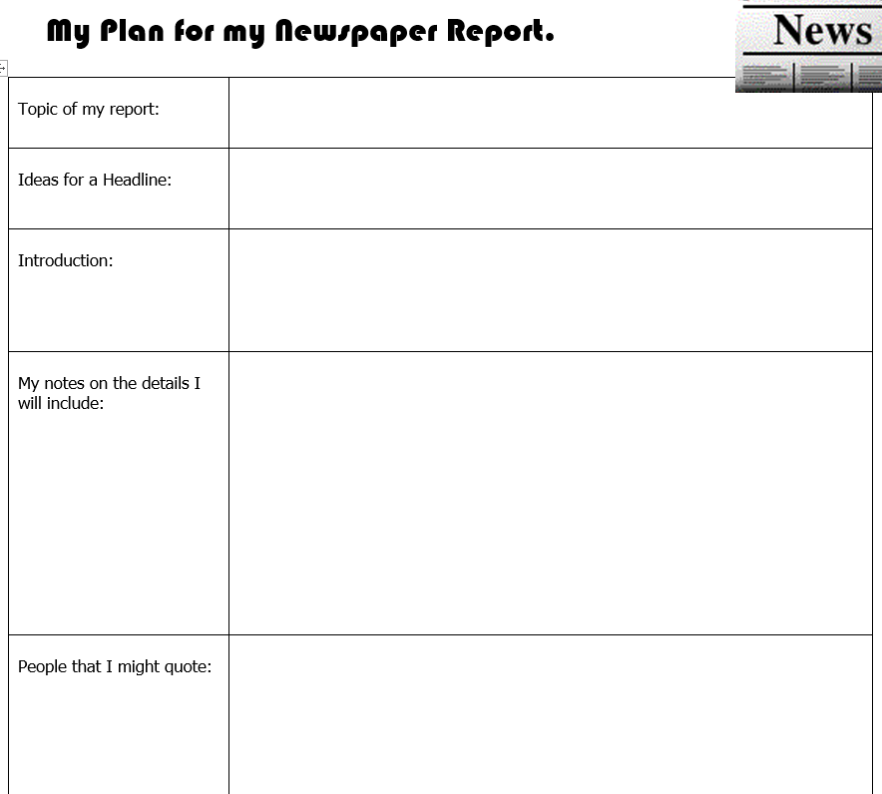
Your task is to plan a newspaper article about the events from the end of ‘Tuesday’.
Think about the facts of the story you will be reporting, and the evidence you have to back these up.
Make sure you know how to answer the main questions- Who? What? Where? When?

Slide 7
Read through both plans carefully in your partner groups.
Is there anything you have left out?

