Slide 1
LO: To predict what might happen from looking at the exterior of the book.
Success Criteria:
I can predict what the book may be about from looking at the front cover.
I can discuss what we know about the book after reading the blurb.
I can discuss why I may like/dislike the book.

Slide 2
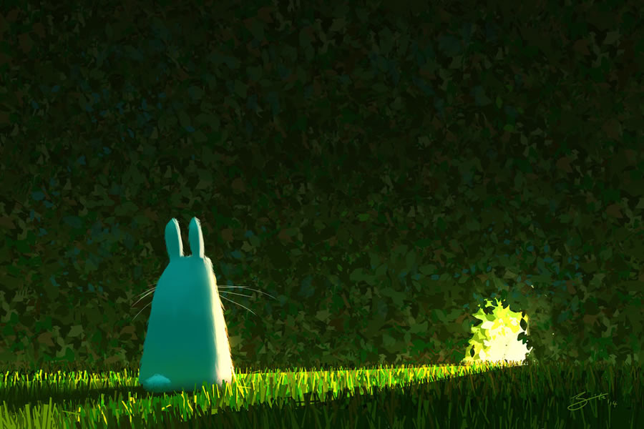
Notes:
Share an image of a scenario. Ask them to write on their whiteboard what they think may happen next.

Slide 3
Prediction:
What does this mean?
It means we think about what might happen on the basis of what has been read so far or on the images we have seen.

Slide 4
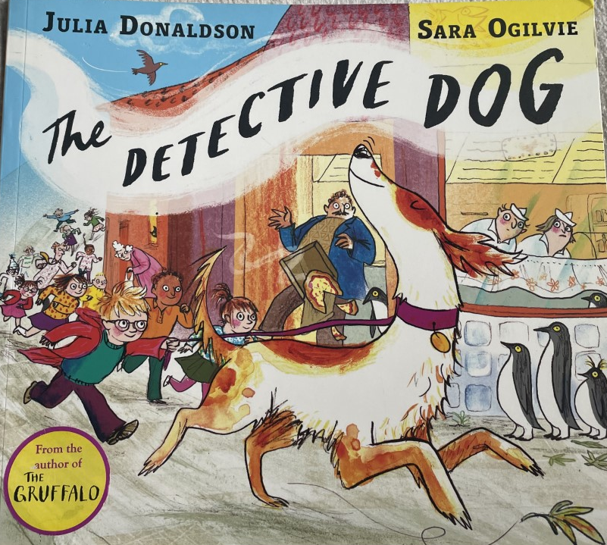

Slide 5
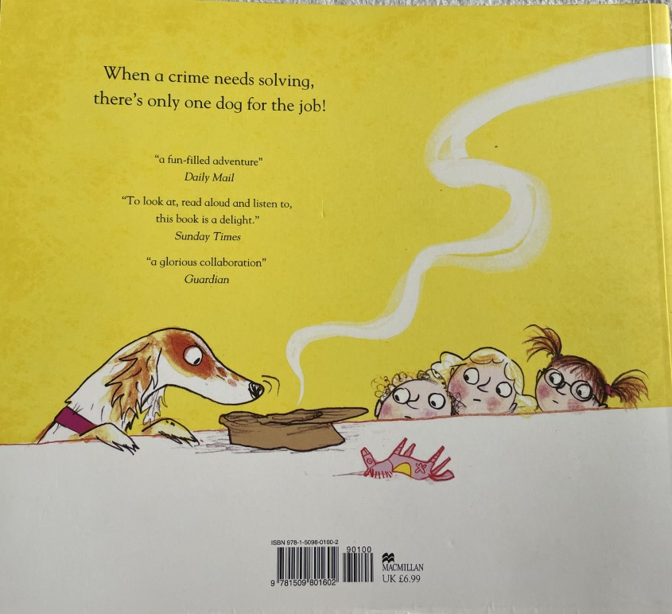

Slide 6


