Slide 1

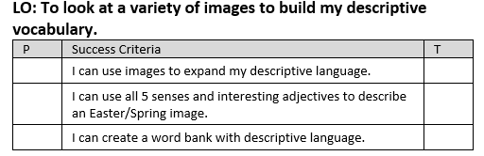

Slide 2
Starter
Below are some very boring and nondescript words. How many synonyms can you think of for each?
Synonym - A synonym is a word or phrase that means exactly or nearly the same as another word or phrase in the same language.
HOT COLD GOOD BAD
Notes:
Print off and fill in as a class- use for working wall.

Slide 3
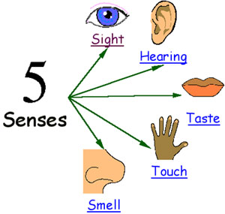
When you write about a setting or image, you need to make sure you use lots of description so a reader can picture themselves there.
A good way to do this is using our senses.
What can you see?
What can/could you hear?
What can/could you taste?
What can/could you touch?
What can/could you smell?

Slide 4
Next lesson we will be writing a poem to use in an Easter card to take home.
We need to make sure we have great descriptive language and vocabulary for this.
We are going to be looking at different Easter/Spring images around the classroom. On your post it notes I want you to write descriptive words or expanded noun phrases about the image you are looking at.
Think about the five senses when you are doing this.
Could you use alliteration in your expanded noun phrases?

Slide 5
We are now going to write a word bank that will help us write our poems next lesson.
Year 2: Fill in your word bank sheet. Think about which sense you are describing. Remember to use exciting synonyms.
Year 3: Write your work bank in your book. Remembering to use exciting/WOW synonyms for your descriptive language. You need to write expanded noun phrases as well.
Don’t forget to try and include alliteration!

Slide 6

Plenary:
Lets share some of our WOW descriptions.

