Slide 1
LO: To be able to create a character description using an image.
Success Criteria:
I can use an image of a character to describe their appearance.
I can use an image to describe feelings they may have.
I can use my adjectives in sentences.

Slide 2
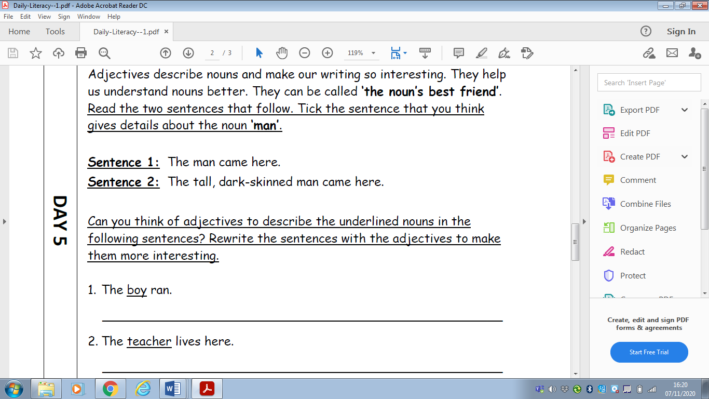
Notes:
Starter
Complete on whiteboards- y3 to focus on expanded noun phrases

Slide 3
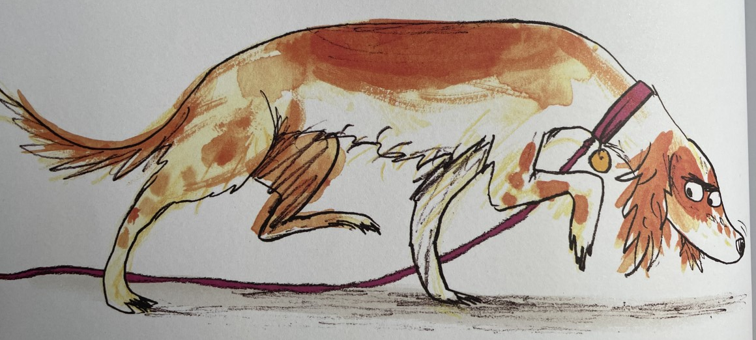
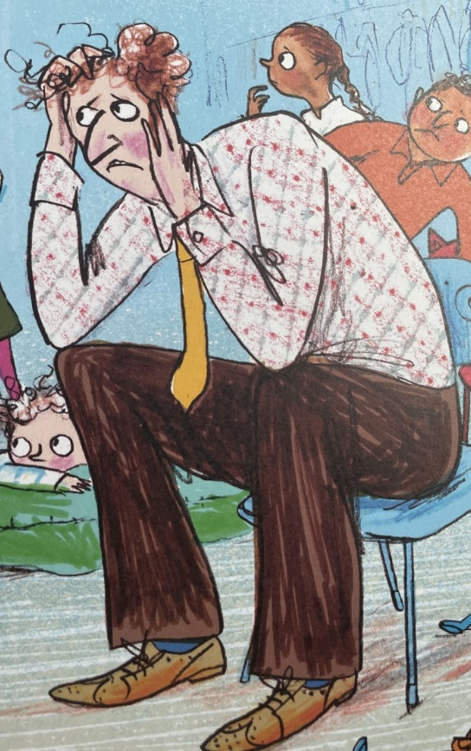
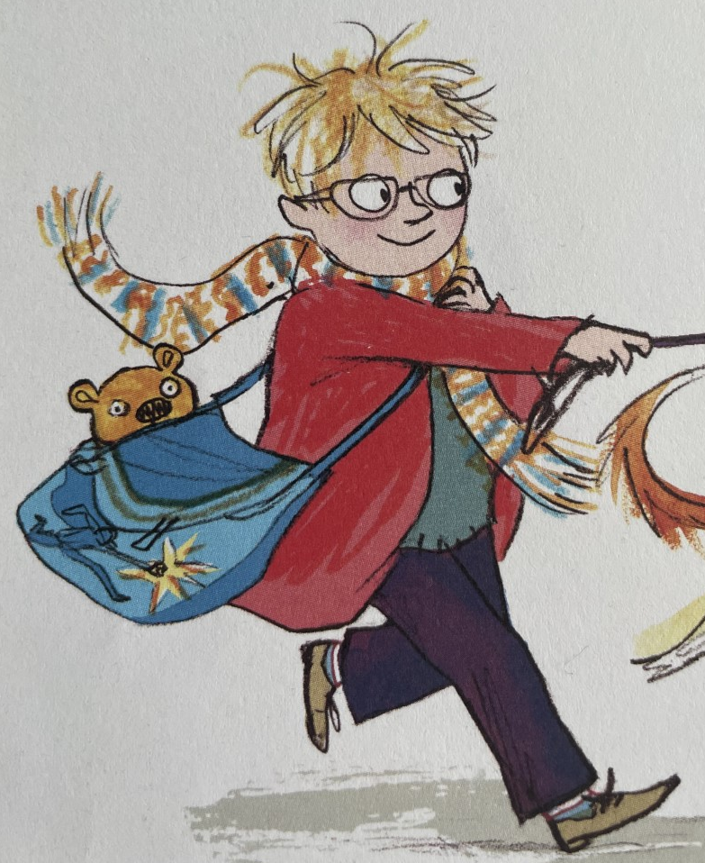
Today we are going to be describing a character within the book.
We are going to be doing this purely with an image, we aren’t going to read the book yet.
We can use either the dog, Mr Jones or Peter.

Slide 4
Role in the Wall
We are going to complete a role in the wall for Mr Jones.
Who can remember what a role in the wall is?
Notes:
Complete the role in the wall on large paper

Slide 5
Task:
On your sheet, you are going to complete your own role in the wall. You can choose to complete it for either Detective Dog, Peter or Mr. Jones.
Remember to include exciting adjectives and expanded noun phrases.
After you have completed your sheet, you are going to write about your character.
Year 2: you need to write a few sentences describing the character including adjectives and conjunctions if you can.
Year 3: You need to write a short paragraph describing the character and how they are feeling. Make sure you are including expanded noun phrases.

Slide 6
