Slide 1
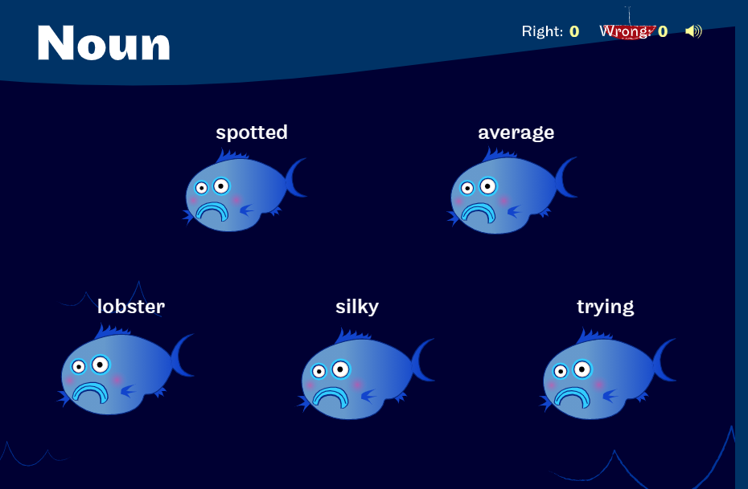
Starter:
Noun Explorer Game - Grammar - Sheppard Software

Slide 2
LO: To be able to understand how illustrations can add to the impact of a story.
Success Criteria:
I can discuss how illustrations play an important part in a book.
I can write descriptively.
I can use expanded noun phrases and co-ordinating/subordinating conjunctions.

Slide 3
Expanded Noun Phrases
Noun phrases can be very short:
a pen the girl
Quite often in our writing we need to add more details so that our readers know exactly what we are writing about.
a purple pen a young girl
When we add more details to our noun phrases they become expanded noun phrases.

Slide 4

Expanded Noun Phrases
One of the easiest ways to expand a noun phrase is to add an adjective before the noun:
a young man the blue butterfly
To expand the noun phrase further, we can add another adjective:
a young, handsome man the beautiful, blue butterfly

Slide 5
Expanded Noun Phrases
Can you expand these noun phrases by adding an adjective?
A _____________________ car.
A _____________________ house.
The ___________________ road.
Can you expand the noun phrases further by adding another adjective to each of them?

Slide 6


Expanded Noun Phrases
You can also expand a noun phrase by adding a preposition (information about where or when something is).
The boy on the ground was crying.
The bird in the tree sang every morning.
The man in the moon looked down at the Earth.

Slide 7
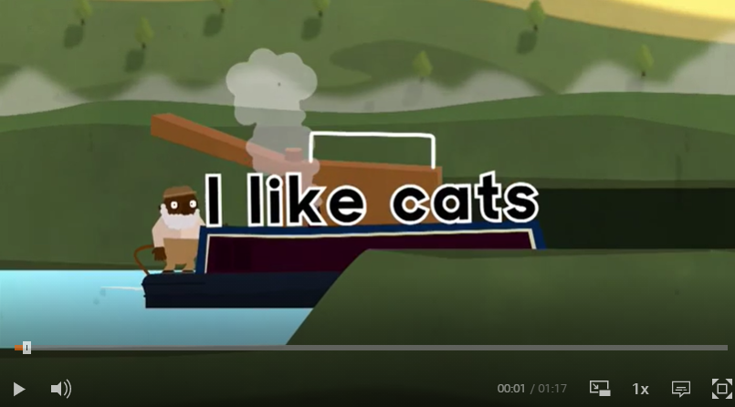
Co-ordinating conjunctions
Conjunctions are joining words that link together parts of a sentence. The three main coordinating conjunctions are ‘and’, ‘but’ and ‘or’.
They can be used to join together two clauses in a sentence. However, the clauses need to make sense on their own. For example:
I had a terrible cold. I still went to work.
You can add the coordinating conjunction ‘but’ in between these causes so the sentence reads:
I had a terrible cold but I still went to school.
Notes:
What are coordinating conjunctions? - BBC Bitesize

Slide 8
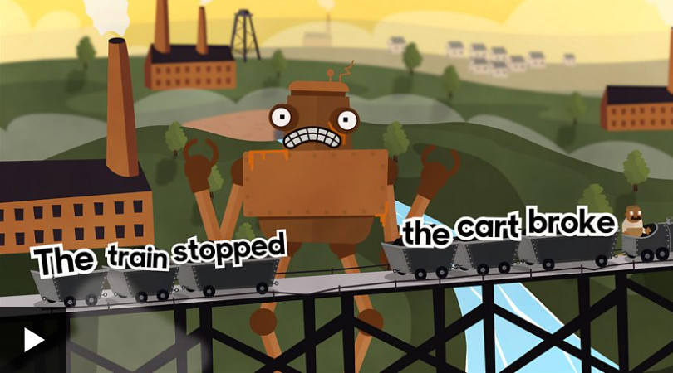
Subordinating conjunctions
A subordinating clause is a part of a sentence that adds additional information to the main clause. A subordinating conjunction is simply the word/words that is used to join a subordinating clause to another clause or sentence.
"He was annoyed, the train had stopped."
"He was annoyed because the train had stopped.“
By adding 'because' we are linking the subordinating clause "the train had stopped" with the main clause "He was annoyed".
Notes:
What are subordinating conjunctions? - BBC Bitesize

Slide 9
In today’s lesson we are focusing on the illustrations.
Who can remember what an illustration is?
Lets look at the illustrations in The Detective Dog.
What details can you spot?
What about the colours?
What do you like about them?
Notes:
Give chd photo copies of illustrations in book- give range so they have plenty to look at

Slide 10
Task:
Now that we have looked at all the illustrations, choose your favourite.
Firstly, have a discussion with your partner about why this illustration is your favourite and what is happening in the illustration.
Next, you are going to write a description of the illustration. You need to make sure you are using interesting adjectives, expanded noun phrases, and conjunctions if possible.

