Slide 1
LO: To plan my story using a story planner.
Success Criteria:
I can plan and structure a story. I can orally retell my story. I can understand the structure of a story.

Slide 2
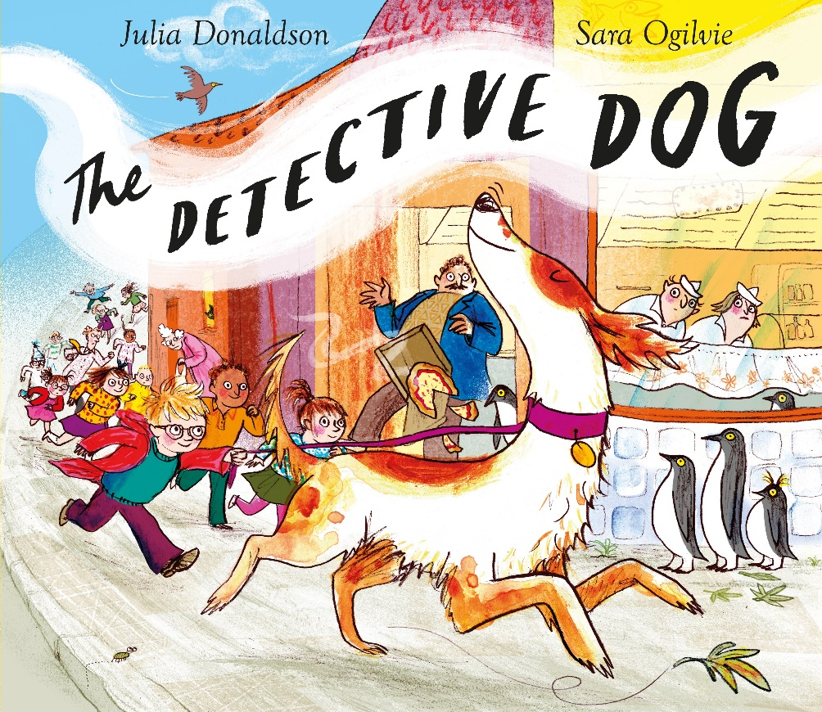
Starter:
We are going to retell the story of The Detective Dog without looking at the book!

Slide 3
This week we will be planning and writing our own story!
We will be including our new character that we created last week, and the setting we described will be included.
Today will be our first planning session.

Slide 4
What do we mean when we talk about the structure of the story?
Notes:
Do we know what it means when we say the structure? Can you think of vocabulary that may be used when discussing structure of a story? Can think about the structure of The Detective Dog?
On flipchart show the structure of a story as a mountain shape .

Slide 5
First will be where the characters and setting will be introduced.
Then a problem of some sort will come about which will build up.
Next comes the crisis/problem/dilemma- which is the middle of the story.
Then the crisis is sorted out and resolved.

Slide 6
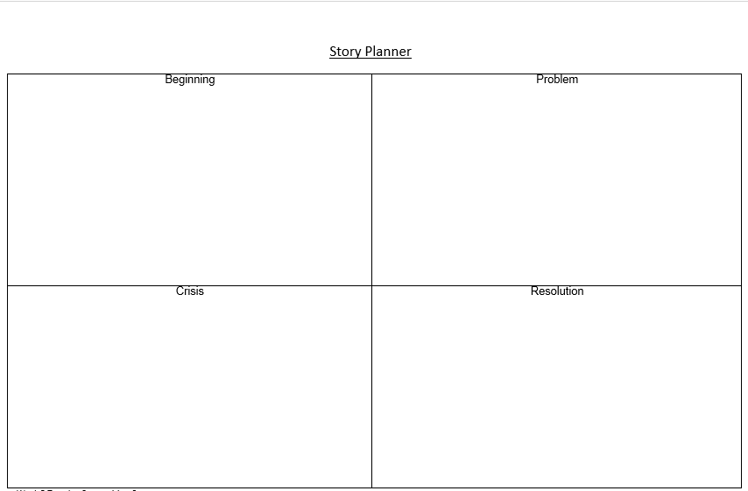
Today you are going to put these ideas into a story planner.

Slide 7
Lets make up our own story to show how to use the story planner sheet.
We only need brief/short notes at this stage.
You do not have to write full sentences at this stage, as you will use the plans to write their extended stories later.

Slide 8
Now you are going to use the story planner to plan your story.
Using the story planner sheet you need to make short notes in each of the four boxes- only bullet points is needed.
You need to make sure you are briefly showing what will happen in each part of the story, don’t worry about detail! We will be adding this tomorrow.

Slide 9
Extension:
If you finish your story, find a partner and tell them your story plan.
Can you give your partner give you feedback? Tell your partner one thing you loved and one thing to improve

Slide 10
Lets share some of our completed plans!
Can we give some feedback?
What is one thing you love?
What is one thing you think they can improve?

