Slide 1
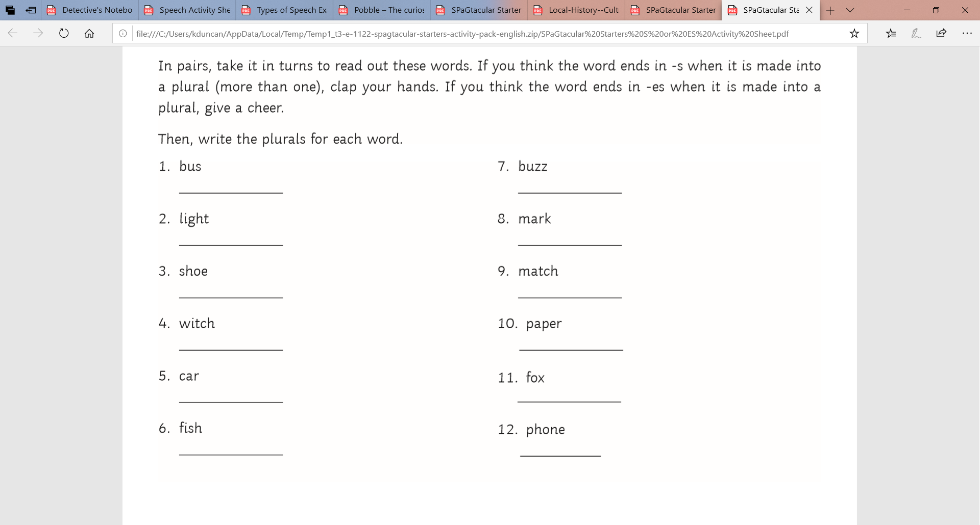
L.O: To use plan and write a report 09.11.21
P | Success Criteria | T
 | Must: I can include key information from the text.
 | Should: I can use formal language in my report.
 | Could: I can include reported speech from the interview.
 | Even better if… I can explain my conclusions about the case, backed up by evidence from the report.
Plurals challenge- show me the plural form of each of word.
Pay attention to spelling.

Slide 2
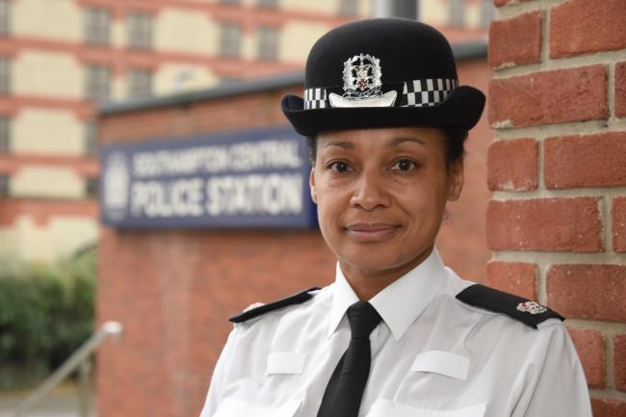
The police superintendent has asked you to write a report of the events of Tuesday.
With your partner, carefully read and annotate the example report.
What is the job of each paragraph?
How have they laid out the evidence?
What style of language has been used?

Slide 3
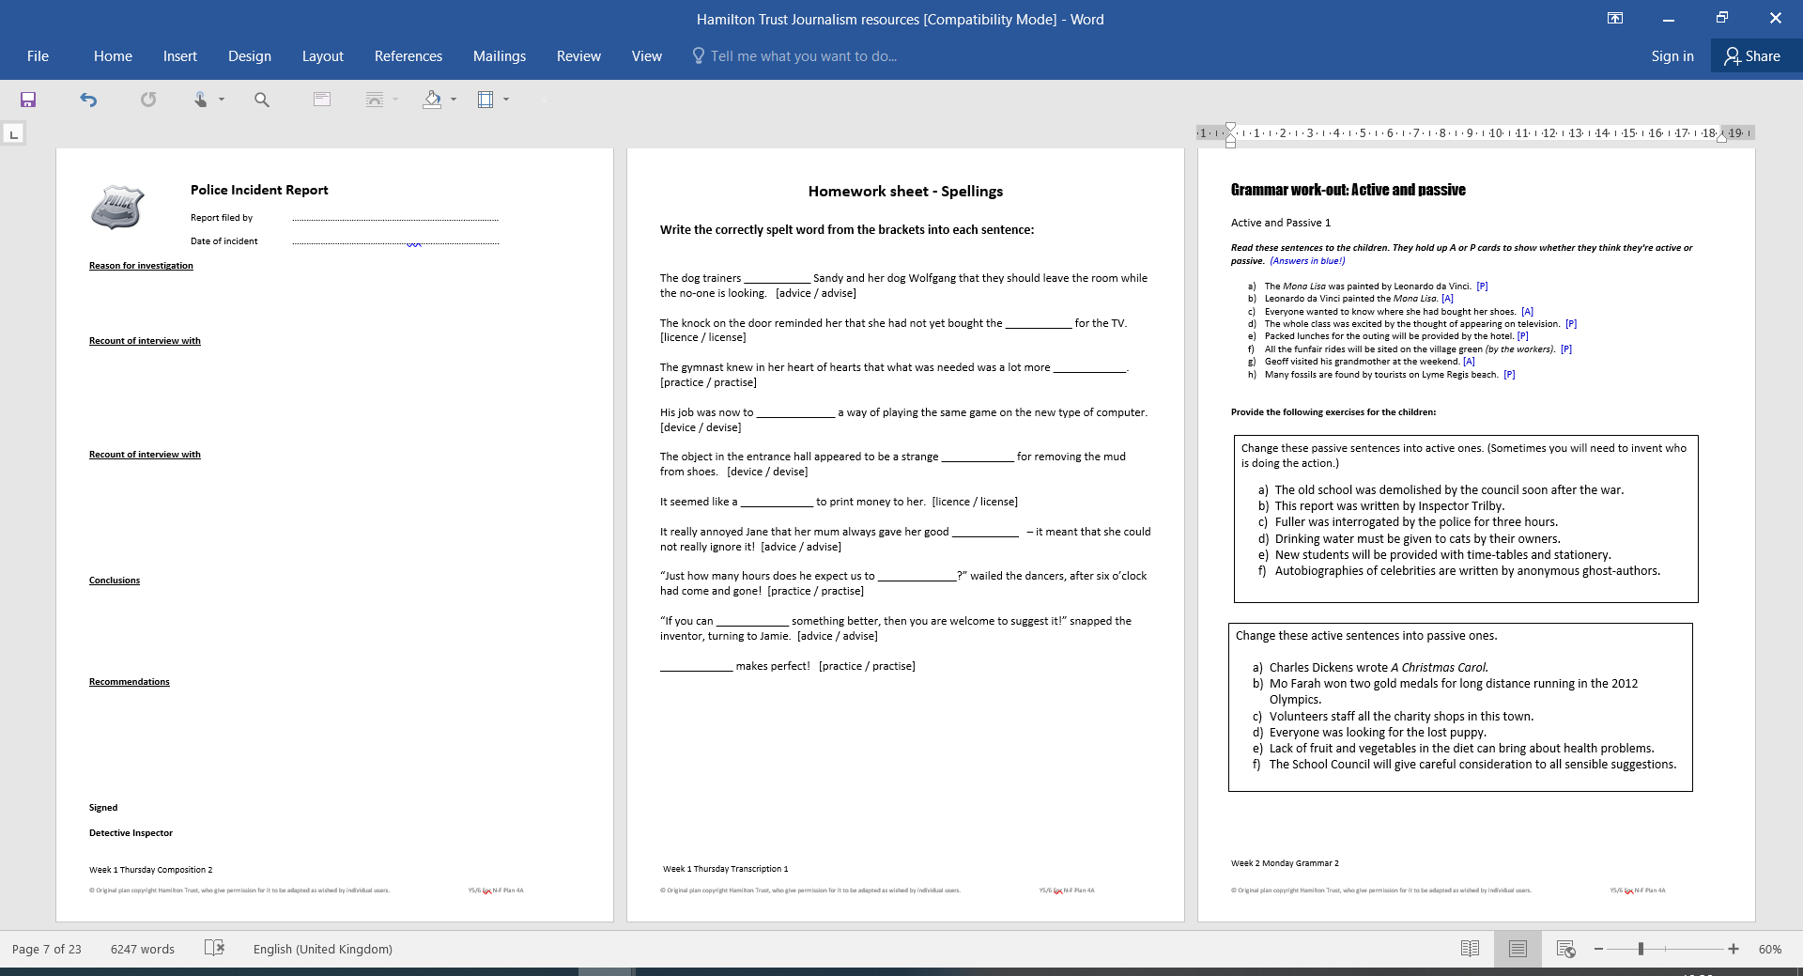
Task
Use the police report template to help you to write your own report.
Make sure you convert the direct speech from your witness interview into reported speech.

Slide 4
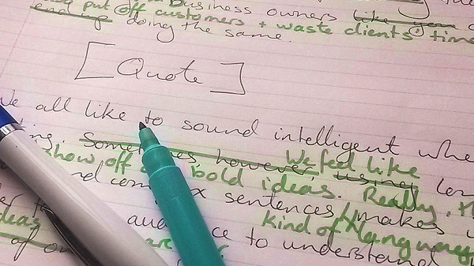
Plenary
Plenary
In groups of four, take turns reading through each of your reports and listening carefully. Suggest a few ways that each report might be improved, and magpie any brilliant ideas from each other.
You will have 5 minutes to make edits using your green pens.

