Slide 1
L.O: To justify inferences made about character’s thoughts and feelings. 12.01.22
P | Success Criteria | T
 | Must: I can make inferences about characters in the book.
 | Should: I can give a justification for my opinion.
 | Could: I can compare characters at different stages of the story.
 | Even better if… I can evaluate how the language and illustrations cause the characters to be viewed.
Explain to your partner- what are synonyms or antonyms?
Find a synonym and an antonym for each of these words.
freezing rough strong

Slide 2

What do you notice about the title of the book?
How is the title spelled? What do you notice about how upper and lower case letters have been used?
What do you think Grahame Baker-Smith is trying to convey here?

Slide 3
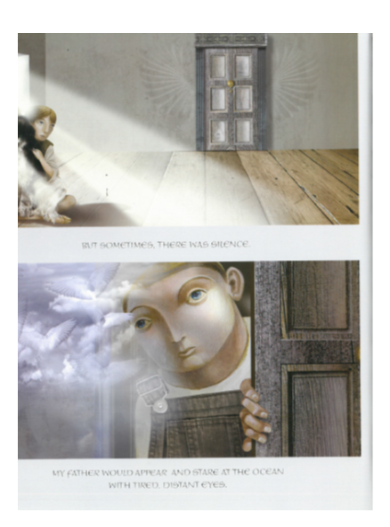
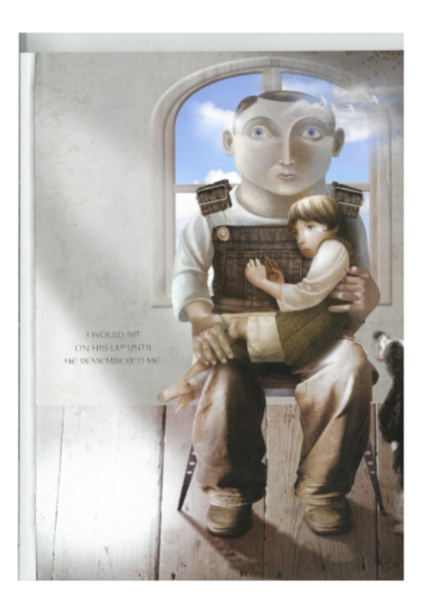

Slide 4
What does this tell us about the father?
What does it tell us about the boy?
What does it tell us about the relationship between the father and the boy?
Don’t forget- Point, Evidence, Explain!

Slide 5
3 – Minute challenge. Work with your partner to come up with as many synonyms for ‘sad’ as possible.
As a class, we will order them from the most sad, to the least sad.

Slide 6
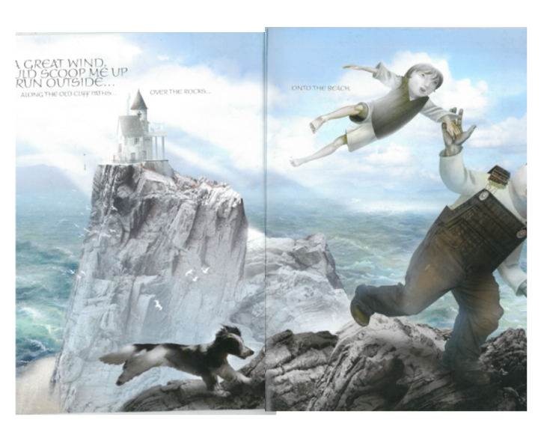

Slide 7
What do we know about the father now? What do we now know about the boy? What does it tell us about the relationship between the father and the boy at this stage? Has a change occurred? What has changed? How has it changed our point of view?

Slide 8
I think that the father is....... because.....
In the book, the picture/ words show that.... this suggests....
I think that the boy and dad...

