Slide 1

Poetry
Lesson 2

Slide 2
LO: To brainstorm ideas for my rhyming poem.
I can think of key vocabulary to use in my poem.
I can identify rhyming words for my key vocabulary.
I can record my ideas clearly to show my thought process.

Slide 3
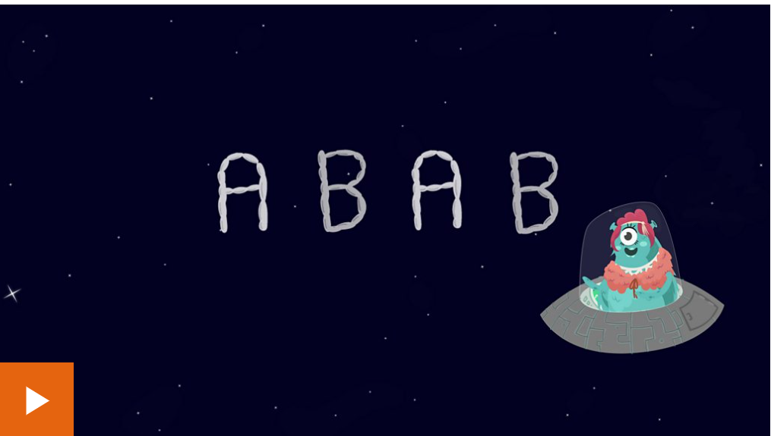
What is a rhyme scheme or patten?
Notes:
What is a rhyme? What is a rhyme scheme? Do all poems have to have a rhyme scheme? Give chn time to discuss.
What is a rhyme scheme? - BBC Bitesize

Slide 4
Rhyme hunt
How many rhymes can you think of for these words:
cold
snow
think
fall
flower
Notes:
Use IWB to brainstorm ideas.

Slide 5

In today’s lesson, we are going to be brainstorming ideas and thinking of the rhyming words because that is the tricky part!
You can either write a poem about a season e.g. winter, autumn, spring or summer or an easier animal e.g. dog, cat, fish.
Write down what you would like to write about on your whiteboard so I can check your ideas!
Notes:
Chn need to pick whether they want to write a poem about a season e.g. winter, autumn, spring or summer or an easier animal e.g. dog, cat, fish.

Slide 6
In today’s lesson, we are going to be brainstorming ideas and thinking of the rhyming words because that is the tricky part!
Winter
Notes:
Demonstrate how to create a key words brainstorm for their chosen topic using the example of winter. Ask chn to help brainstorm key words that link to winter e.g. cold, snow, ice, Christmas

Slide 7
Task 1:
Decide what you would like to write about and create a key words brainstorm like we did as a whole class for winter. Try to include as many different words as you can.
You have 10 minutes.

Slide 8
Rhyming brainstorm
gold
told
cold
strolled
behold
fold
sold
Notes:
Demonstrate creating a rhyming brainstorm for words that are relevant to my winter poem.

Slide 9
Task 2:
Pick 4 of your favourite words from your brainstorm and create rhyming brainstorms for each word.

