Slide 1

Poetry
Lesson 5

Slide 2
LO: To understand the conventions of spoken word poetry.
I understand what spoken word means.
I understand how to perform spoken word poetry.
I can identify the difference between written poetry and poetry created for spoken word recital.

Slide 3
Starter: Can you find different ways to say these sentences? Think about what different voices you can use.
The man is coming.
I don’t know.
I’m sorry.
Notes:
Think about different emotions we could use as well as volume. How does this change the meaning of each phrase?

Slide 4
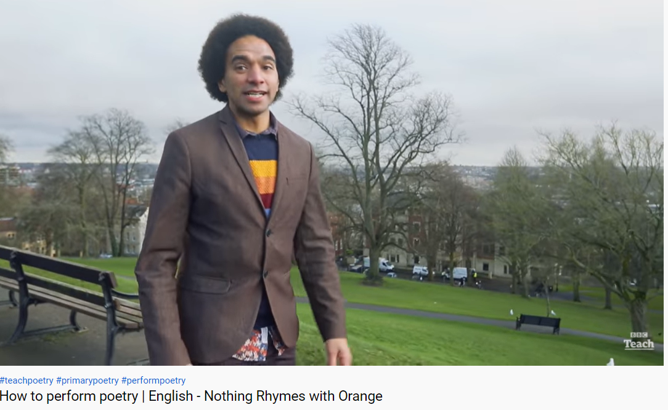
Notes:
https://www.youtube.com/watch?v=wFCcbFtd6Zo

Slide 5
Today we are going to practice performing poetry which we will share with the class at the end of the lesson.
What kind of things we could do to make our poem interesting?
Notes:
Chn should suggest changing their voice, make it louder or quieter, make it happier or more cross. Tell chn that they can also perform poetry with more than one person. E.g. in The Rainy day, one person could just say the words like zoom, pow, snap while the other reads the rest.

Slide 6
Your task:
In small groups, choose a poem to perform: The Rainy Day, Beach Orchestra, Autumn.
Remember that you might want to all read the poem together a certain way, or take it in turns to read parts, or have some people repeating certain words.

Slide 7

Let’s perform!

