Slide 1
Punctuation
Exciting Writing Edit Lesson 1

Slide 2
LO: To understand and use punctuation correctly and effectively.
Success Criteria:
I can understand the correct punctuation to use.
I can identify punctuation mistakes within a piece of writing.
I can edit and improve a piece of work focusing on punctuation.

Slide 3
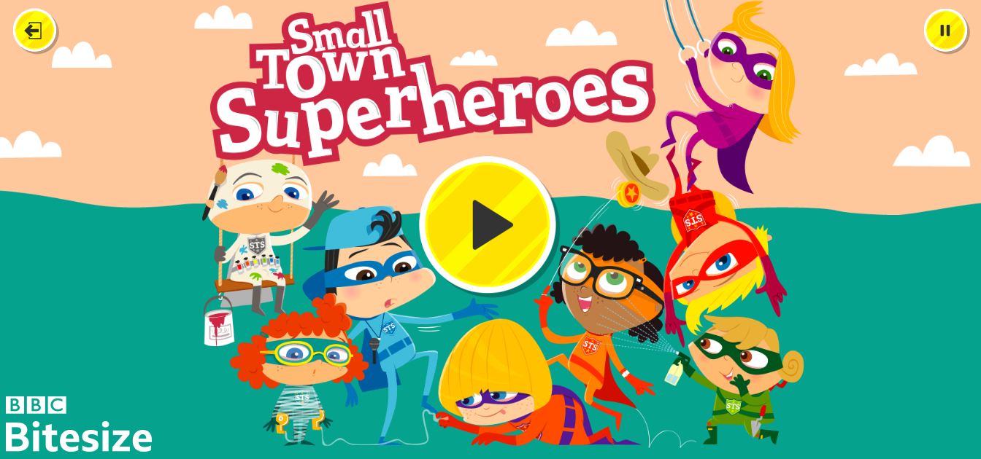
Starter:
Small Town Superheroes (bbc.co.uk)

Slide 4
In our sessions this week we will be focusing on the different editing stations.
Who can remember what our editing stations are?
Spelling station
Handwriting station
Word quality station
Sentence structure station
Punctuation station
In todays session we will be focusing on punctuation.

Slide 5
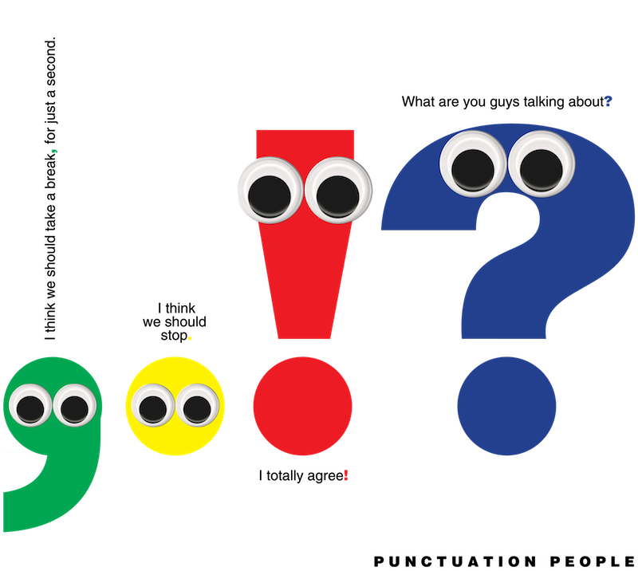
Punctuation
Punctuation is a set of marks that you use in writing to divide up groups of words and makes them easier to read.
When speaking, you vary the speed and loudness of words. In writing, punctuation shows these variations.
It helps make the meaning clear because it shows how you would say the words, as well as where sentences begin, slow down and end.

Slide 6
Capital Letters
A B C D E F G H I J K L M N O P Q R S T U V W X Y Z
You should always use a capital letter:
At the beginning of a sentence
For the pronoun ‘I’
For proper nouns – names of actual or specific people, places, objects, films or book titles.
For example: Theo, Miss Fenton, April, Monday, Italy, Declaration of Independence, ‘Frozen’.

Slide 7
Capital Letters
Which letters should be capitalised?
in july i am going to cornwall.
In July I am going to Cornwall.
my favourite film is ‘despicable me’.
My favourite film is ‘Despicable Me’.
finlay is coming to my house next wednesday.
Finlay is coming to my house next Wednesday.
Remember: the start of every sentence, pronoun ‘I’ and name of anything specific needs a capital letter.

Slide 8
Full Stop
.
Full stops are needed to split up sentences so that we know where to pause.
They are used when we have finished saying one thing and want to say something else.

Slide 9
Full Stop
We place full stops at the end of statements i.e. a sentence which tells you something.
For example:
Lara visited the zoo on Saturday.
Nothing is being asked and there is no strong emotion so we use a full stop to show that the sentence is complete.
Can you think of a sentence which would end with a full stop?

Slide 10
Question Mark
?
Question marks are used to show that a question has been asked.
You will often find yourself using them when writing dialogue (e.g. a character may ask something) or rhetorical questions.
For example:
Would you like a cup of tea?
Can you think of a sentence ending with a question mark?

Slide 11
Question Mark
Why?
Who?
If a sentence starts with a question word it will need a question mark at the end.
Where?
Can?
What?
Does?
Should?
How?
When?
Could?
Which?
May?
Whose?
Do?

Slide 12
Exclamation Mark
!
Exclamation marks are used if the sentence:
Is a command or order
Look out!
Expresses strong emotion e.g. surprise, very angry/happy/excited etc
This is the best day ever!
Loudly spoken
“Get down from there!” she yelled.
Can you think of a sentence which would end with an exclamation mark?

Slide 13
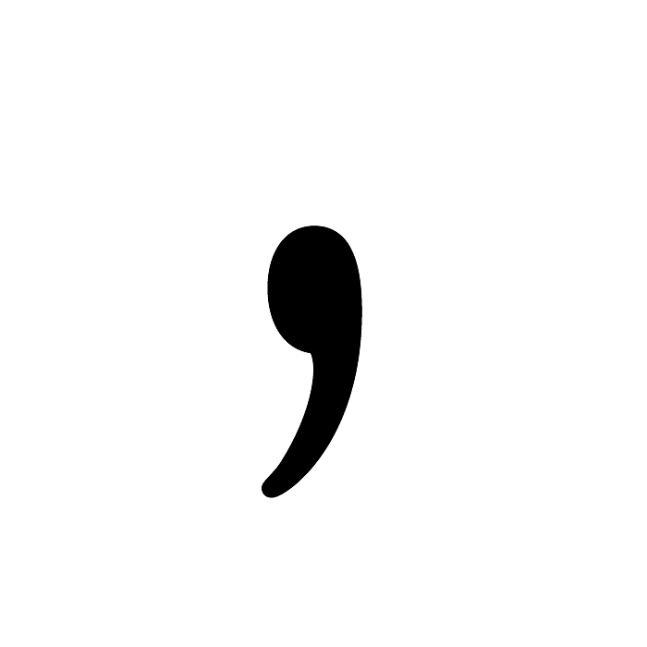
Commas
The comma stands for a short pause that separates a word or a group of words from another in a sentence.
You normally use it where you would pause very slightly if you were speaking. Commas are often essential to make the meaning clear.
We can use commas for lists and long sentences.
This Photo by Unknown Author is licensed under CC BY-NC

Slide 14
What is an apostrophe?
It looks like a comma – ‘ – but we place it above the line of writing.
It takes up the space of a letter.
It is used for various reasons.
Why do we use them?
To show who owns what (possession)
This is Jane’s cat.
To fill in for missing letters (contractions)
She’s gone to the cinema with her friends.

Slide 15
Task one:
You need to write your own sentences, making sure you are punctuating correctly.
Include the punctuation that we have discussed today.
Think about the different punctuation you need to use:
The dog went for a walk.
I’m so excited!
What time is it?
“Do you want to go to the shop? I need to buy milk, bread, butter and jam.” said Max.

Slide 16
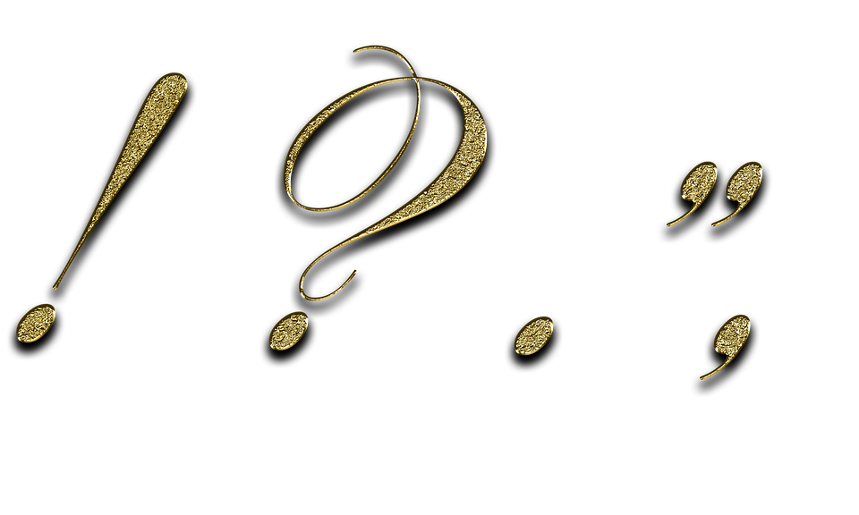
Task two:
Looking at this piece of writing, you need to highlight the mistakes and then correct it.
This is how you will be editing your writing on Thursday.

