Slide 1

Stone Age Boy
Lesson 7

Slide 2
LO: To write a set of instructions for a Stone Age activity.
I can organise sentences about an activity chronologically.
I can use imperative verbs in my writing.
I can use a variety of time connectives.

Slide 3
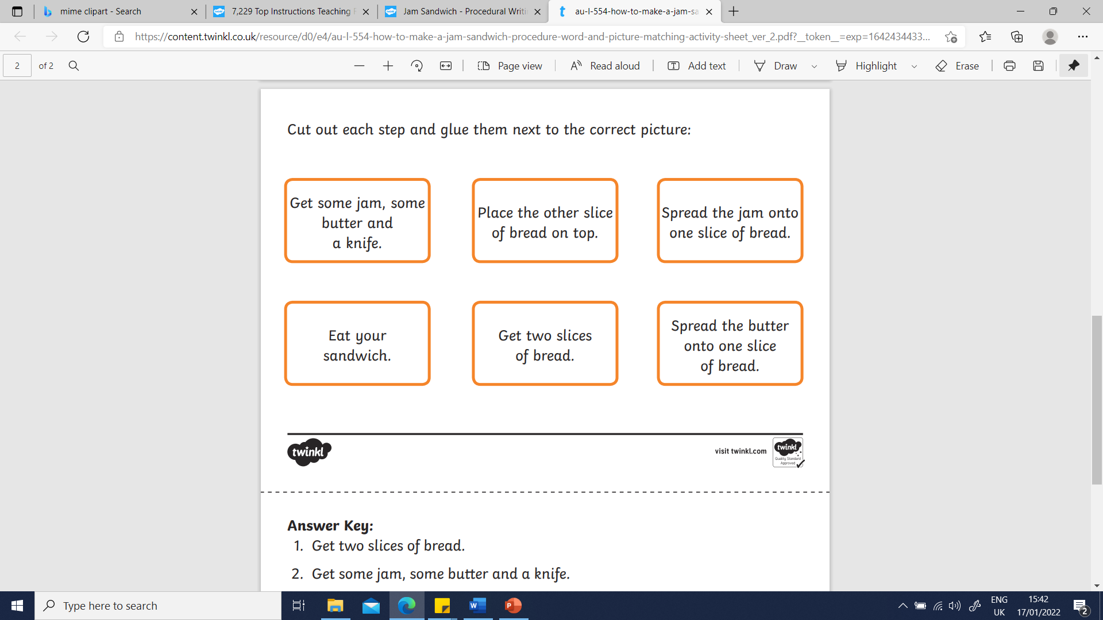
Starter:
Who can mime these instructions in the order I have given?
Notes:
Do these instructions make sense? Why is it important to write instructions in the correct order? Can we label them so they are in the correct order?

Slide 4
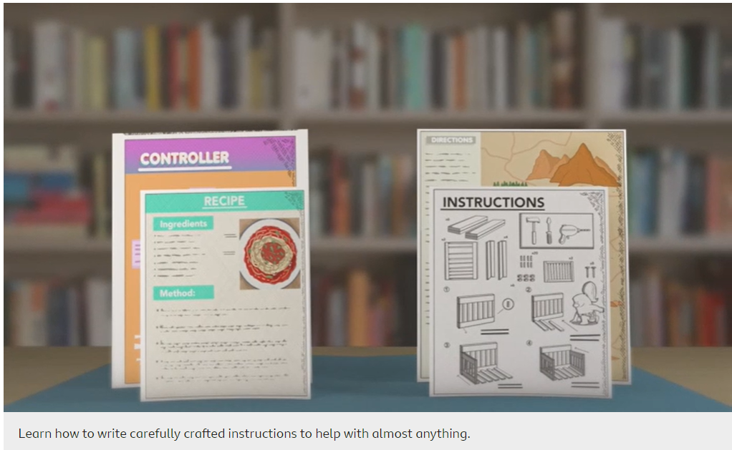
Notes:
Writing instructions - Year 6 - P7 - English - Home Learning with BBC Bitesize - BBC Bitesize

Slide 5
Key features of instructions:
Title
What you need/equipment list
Chronological order
Bossy/imperative verbs – command sentences
Pictures/diagram
Time connectives
Adverbs/adjectives for detail
Prepositions
Notes:
Model the use of imperative verbs in a sentence on whiteboard and how to use these when we are writing our instructions.

Slide 6
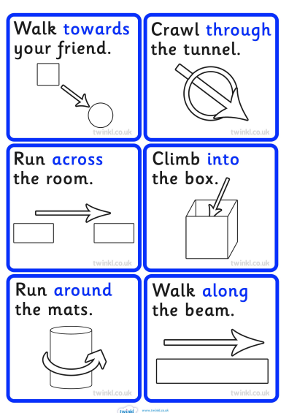
Prepositions
Prepositions in instructions provide quite specific information on how to do something e.g. how to prepare the food: how long to cook it for, how to cook it, the shapes to cut or roll it into, and much more.
Here are some examples of prepositions in instructions.
Notes:
YR3 – model using prepositions in instructions using PPT.

Slide 7
Your task:
Using your notes from last lesson, create a set of instructions for your Stone Age task.
Remember to include the key features of instructions and to use the word mats to help you!
Notes:
Pupils to use their notes to create instructions for their Stone Age task.
YR2/YR3 LA – create instructions for making a fire . Pupils to use word bank template to aid.
YR2 MA - pupils to create instructions for making different stone tools. Pupils to use check list to help.
YR2 HA/YR3 MA/HA – Chn to use an activity of their choice. Chn pushed to include prepositions in their instructions.
Extension challenge – add diagrams to show the process using arrows to show each step.

Slide 8
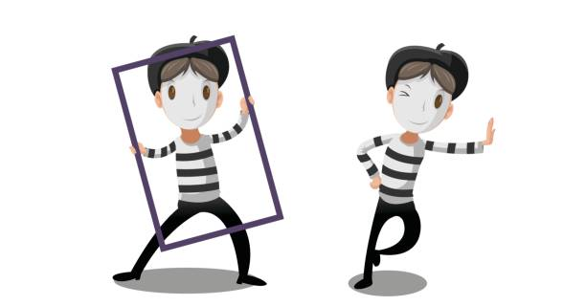
Plenary
Using your partners instructions, can you use mime to act out each part of the instructions. Make sure you involve the imperative verbs correctly in your mime. We are going to watch a few children perform their mime.

