Slide 1
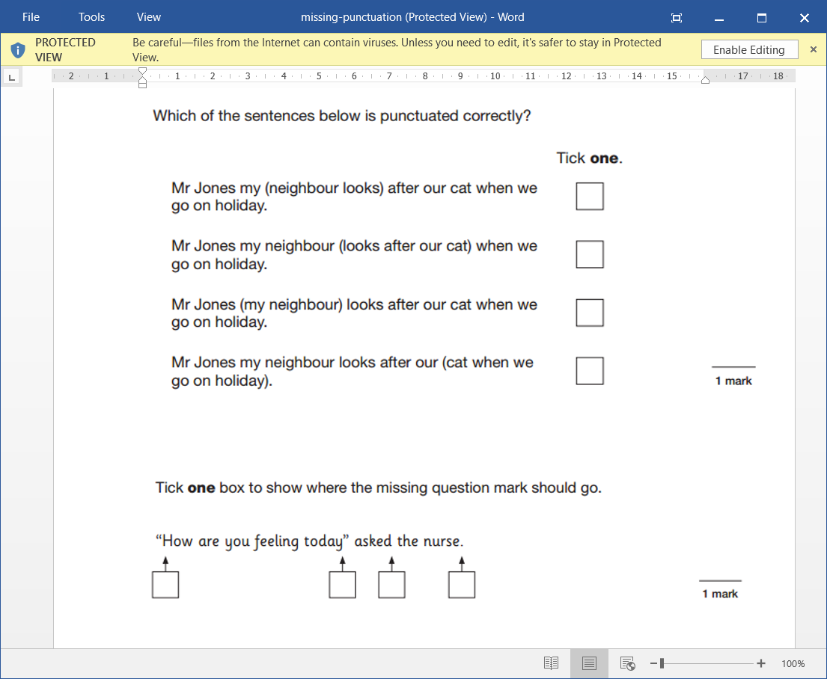
LO: To write a letter in role as an evacuee. 02.02.22
Must- I can write using the features of a letter.
Should- I can convey how my character is feeling.
Could- I can include historical vocabulary such as billeting officer.
Even better if- I can write using an authentic level of formality.

Slide 2
Last lesson we learned how children were evacuated from the cities to the countryside.
Evacuee Label:
Children were given labels to help prevent mix-ups.
Make your own label, and use string to wear it for the rest of the lesson.
Sound Journey:
Listen to the sounds and imagine yourself as one of the children sent to the country as an evacuee.
What might you be thinking and feeling on your journey?

Slide 3
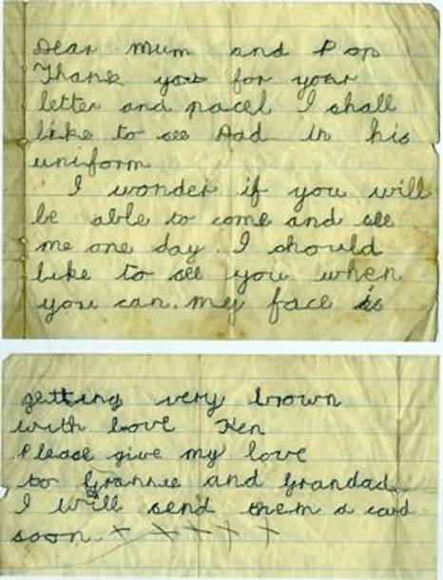
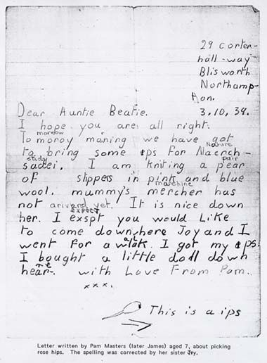
Letters written by evacuee children.

Slide 4
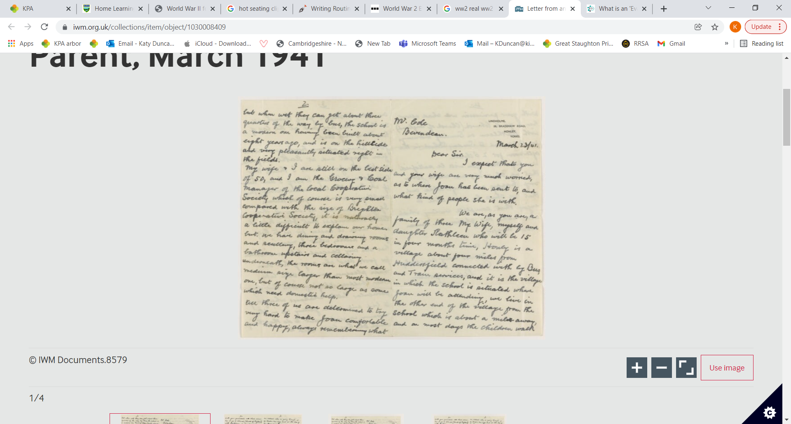
Letter written by a host family parent.

Slide 5
Task: To write a letter home in role as an evacuee.
What are some of the features of a letter?
the sender’s address
the date
an appropriate greeting
an introduction
writing that shows a chatty, informal style
a conclusion
a complimentary close
the sender’s name
Try to include the following features:
Description of events and settings.
Emotive language to explain how your character is feeling.
Formal language that might have been used in 1940. (I expect you would, I should like to…)

Slide 6
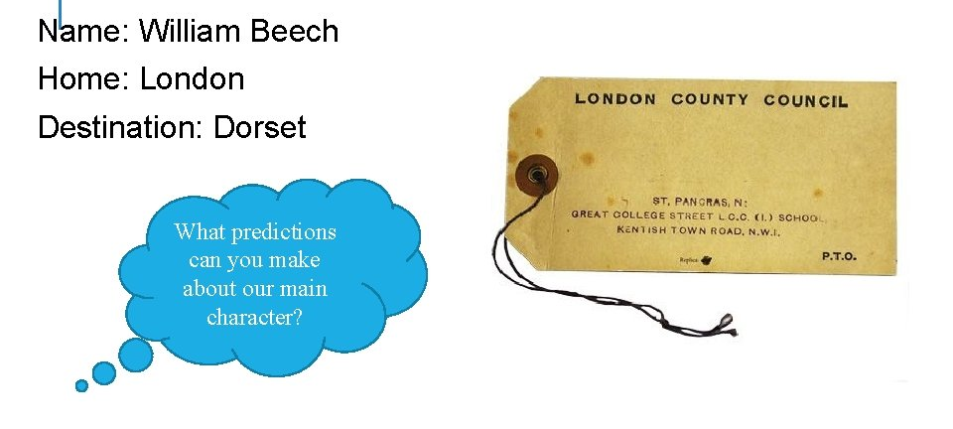
This label belongs to one of the main characters of our new text, Goodnight Mr Tom by Michelle Magorian.

