Slide 1
Writing instructions
WB 29.11.21

Slide 2
LO: To write instructions about our assessment week.
I can write chronologically and use time connectives.
I can include imperative (bossy) verbs.
I can be clear and concise in my writing.

Slide 3

What is an instruction? When might you use instructions?

Slide 4
When might we use instructions?
Notes:
Let’s brainstorm our ideas.

Slide 5
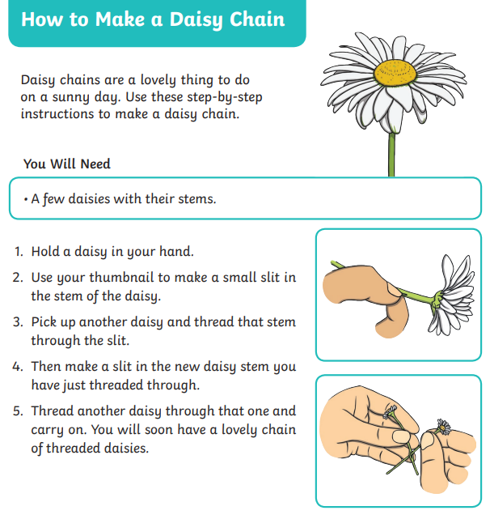
Let’s look at an example together. What do we notice?
Notes:
Give chn a copy in pairs. What do they notice? Any key features?

Slide 6
Let’s look at an example together. What do we notice?
Title
Introduction
‘You will need’ list
Chronological instructions
Bossy verbs (put, do, get, go)
Time connectives (next, then, first, finally)
Straight to the point, not using adjectives.
Notes:
Give chn a copy in pairs. What do they notice? Any key features?

Slide 7
We are going to be writing a set of instructions about assessment week.
What will we put in out ‘You will need’ box?
What could we write in our introduction?

Slide 8
First, go to the toilet as you will not be allowed to go during the test.
Then, make sure to have a small drink.
Find your seat and make sure the correct test is in front of you.
After that, write your name on the front.
When the teacher says to start, you can begin your test. Remember to try your best to answer every question.
If you have a question during the test or need a rubber, put your hand up.
When the test is finished, make sure to close your test paper and do not talk until the papers have been collected.
Finally, you have finished your test and you can relax!
Notes:
My example. What did I do well? What could I improve?

Slide 9
With a partner, can you create a set of instructions about assessment week.
Remember to write in chronological order (time order) and use the word mats to help you.

Slide 10
Word bank
test paper assessment
toilet correct rubber name allowed seat teacher question finished

