Slide 1
Y3 LO: To be able to divide 2 digits by 1 digit with exchange.
Y2 LO: To be able to divide by five.
I can recall my five times tables.
I can use my knowledge of grouping and sharing to complete division.
I can discuss how recalling my times tables can help with division.
I can confidently partition numbers.
I can understand not all numbers can be shared equally.
I can use a place value grid to show my exchange.

Slide 2
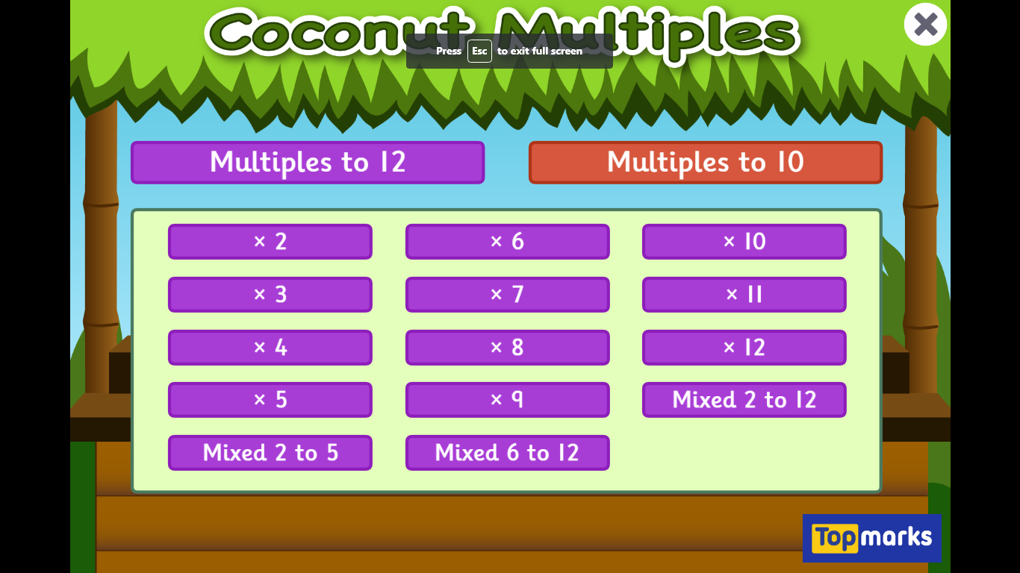
Starter:
Notes:
Coconut multiples –
5 times tables.
https://www.topmarks.co.uk/times-tables/coconut-multiples
Have the Y3 complete a selection of division questions using the five times table. Have them use one of the methods they learnt last week.

Slide 3
What is division?
Dividing is sharing into equal groups. You might see it written differently in questions e.g.
divided by
share equally
equal groups of
divided into
share
Notes:
Recap

Slide 4
Can we say our five times tables?

Slide 5
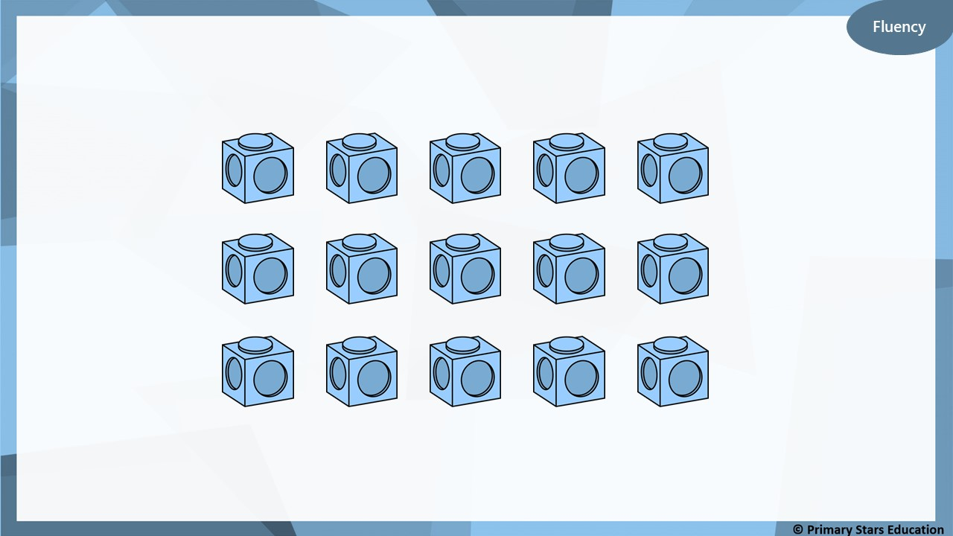
How many groups of 5 can you make?
3 groups of 5

Slide 6
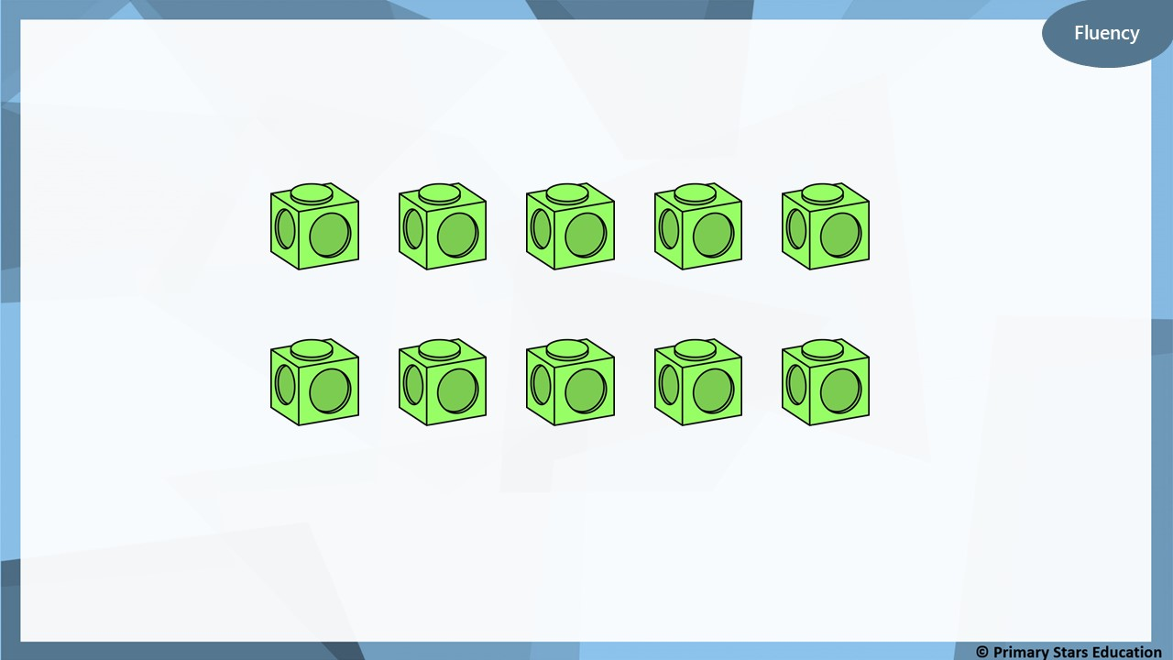
How many groups of 5 can you make?
2 groups of 5

Slide 7
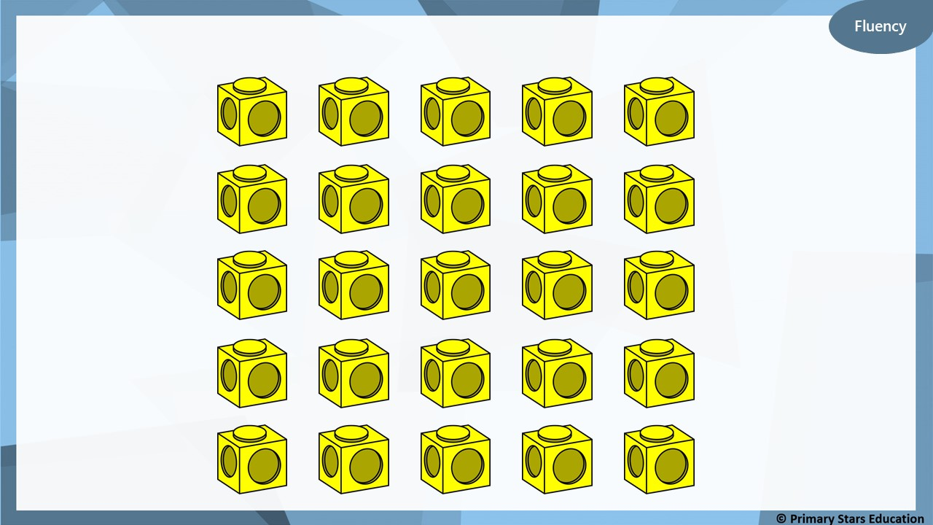
How many groups of 5 can you make?
5 groups of 5

Slide 8
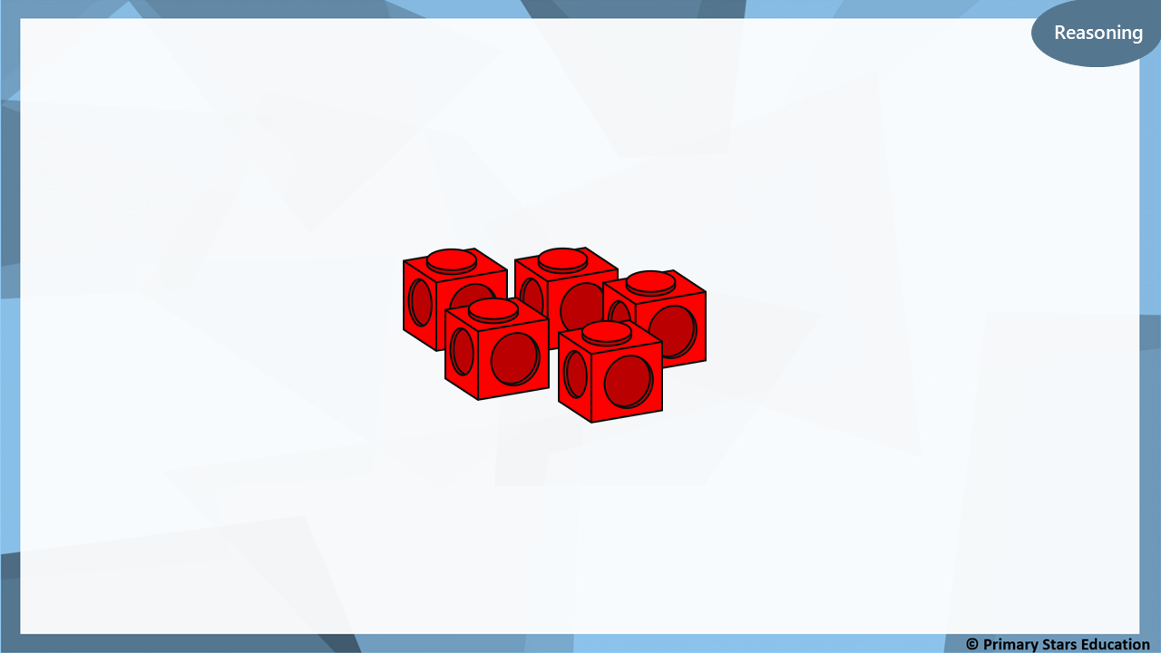
30 cubes will make 7 towers of 5.
True or false?
Explain your answer.
False.
30 cubes will make 6 towers of 5 as 30 ÷ 5 = 6 (not 7).

Slide 9

Dom built a number of towers that are 5 cubes high.
How many towers could Dom have built?
List all possible answers.
The amount of cubes I started with was between 40 and 60.
9, 10 or 11 towers.

Slide 10


Lesson 3
Step: Divide by 5

Slide 11

Take 20 cubes.
How many towers of 5 can you make?
4
You can make _____ towers of 5.
_____ towers of 5 is the same as 20.
20 is the same as _____ towers of 5.
4
4

Slide 12

Take 30 cubes.
How many towers of 5 can you make?
6
You can make _____ towers of 5.
_____ towers of 5 is the same as 30.
30 is the same as _____ towers of 5.
6
6

Slide 13
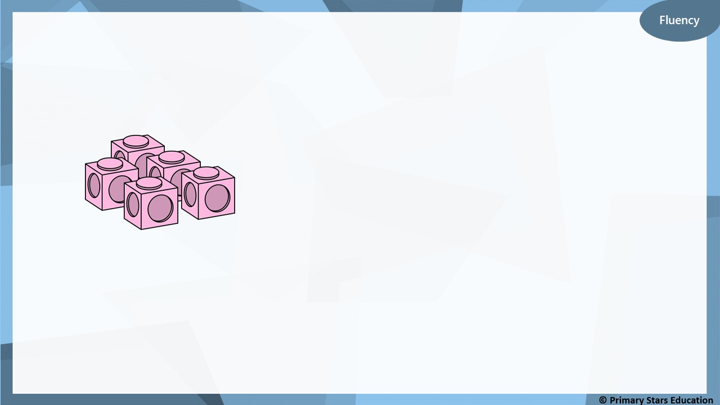
How many towers of 5 can you make from 45 cubes?
9
You can make _____ towers of 5.
_____ towers of 5 is the same as 45.
45 is the same as _____ towers of 5.
9
9

Slide 14
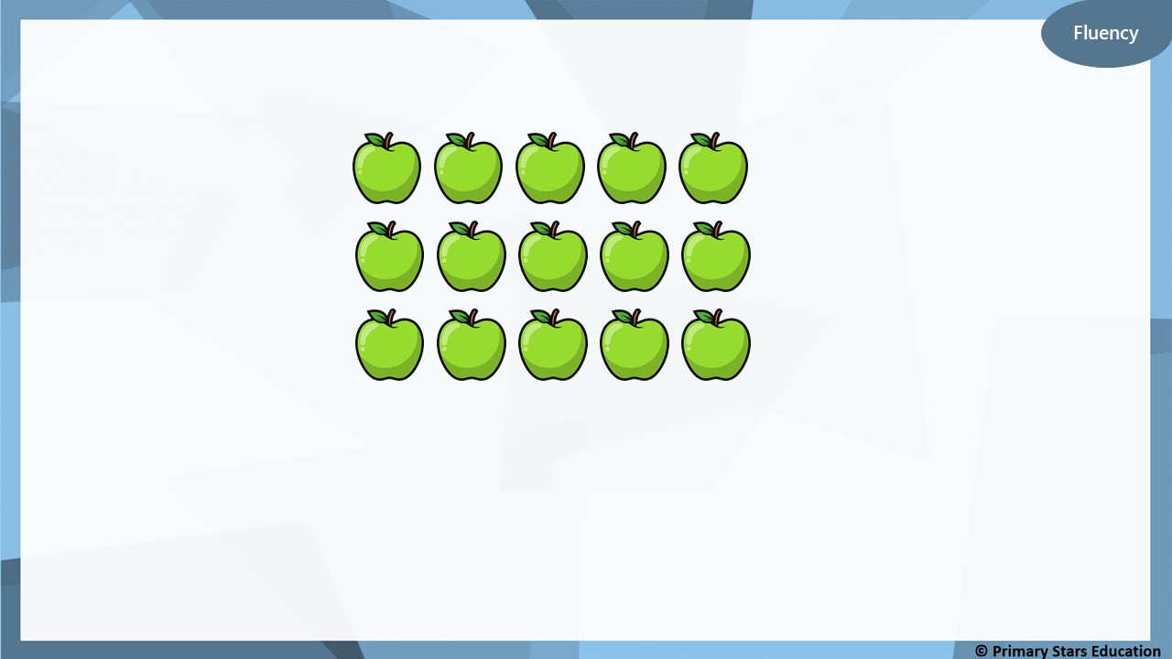
15 apples are shared between 5 horses.
3
How many apples will each horse get? _____
15
÷
5
=
3

Slide 15

Fluency
35 acorns are shared between 5 squirrels.
7
How many acorns will each squirrel get? _____
35
÷
5
=
7

Slide 16
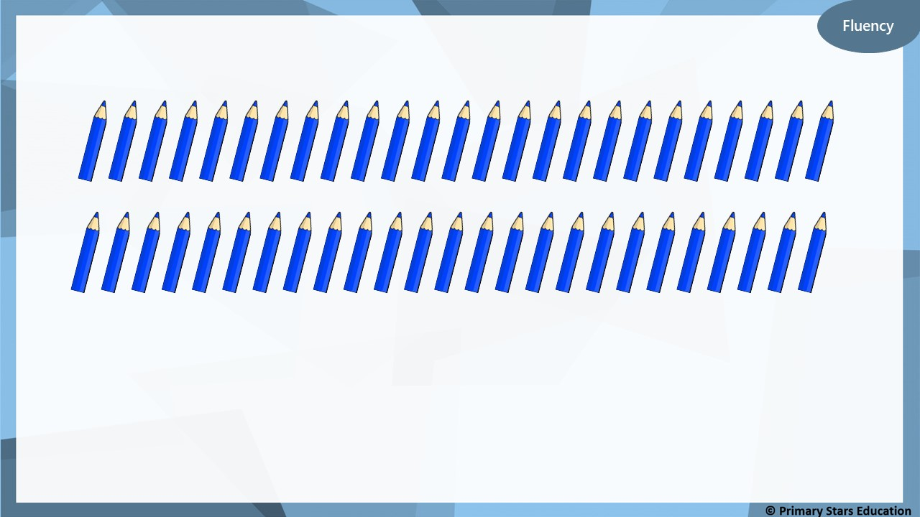
50 pencils are shared between 5 children.
10
How many pencils will each child get? _____
50
÷
5
=
10

Slide 17

Group the 1p coins into 5s.
How many groups of 5 do we need to make 15p?
3
_____ groups of 5 1ps = 15 x 1p coins.
_____ groups of 5p = 15p.
15p = _____ x 5p.
15p ÷ 5p = _____.
3
3
3

Slide 18

Group the 1p coins into 5s.
How many groups of 5 do we need to make 25p?
5
_____ groups of 5 1ps = 25 x 1p coins.
_____ groups of 5p = 25p.
25p = _____ x 5p.
25p ÷ 5p = _____.
5
5
5

Slide 19
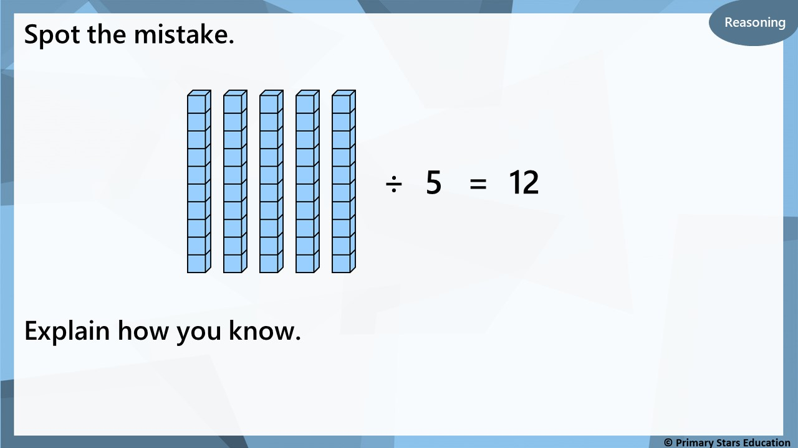
50 ÷ 5 = 10 (not 12).

Slide 20

My number is greater between 10 and 40. I have 5 equal groups.
What number could Ben have started with and how many
would be in each group?
Start with 35 ÷ 5 = 7 in each group.
Start with 30 ÷ 5 = 6 in each group.
Start with 25 ÷ 5 = 5 in each group.
Start with 20 ÷ 5 = 4 in each group.
Start with 15 ÷ 5 = 3 in each group.
Notes:
How can we show the problem using objects/images?
How does knowing your 5 times table help when dividing by 5?
How many towers of 5 could you make from ___
___ towers of 5 is the same as ____.
___ is the same as ___ towers of 5.
___ towers of cubes make ____.
Circle all the multiples of 5 on a 100 square. What do you notice about the numbers? Can you explain the pattern? How does this help you to divide these numbers?
When would we count in 5s?

Slide 21
Year 2 Activity:
Complete the worksheet.
Use resources to support you and check your answers.
Could you use multiplication to help you check your answers?

Slide 22



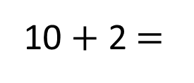
48 ÷ 4 =
12
48
Tens | Ones
40
8
÷ 4
÷ 4
10
2
10 + 2 $=$
12

Slide 23
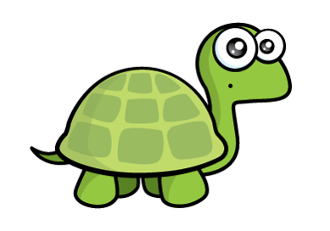
42 ÷ 3 =
14
But those groups aren’t equal!
Tens | Ones
42
40
30
12
2

Slide 24

96 ÷ 4 =
24
Have a think
Tens | Ones

Slide 25
51 ÷ 3 =
17
Have a think
Tens | Ones

Slide 26


Varied Fluency 1
True or false?
 | ÷ | 4 | = | 15
10
10
1
1
10
10
1
1
10
1
1
10
1
1
© Classroom Secrets Limited 2018

Slide 27
Varied Fluency 1
True or false?
False, 68 ÷ 4 = 17.
40 ÷ 4 = 10, 28 ÷ 4 = 7 and 10 + 7 = 17.
68 | ÷ | 4 | = | 17
10
10
1
1
10
10
1
1
10
1
1
10
1
1
© Classroom Secrets Limited 2018

Slide 28
Varied Fluency 2
Share the partitioned counters equally to help you
solve the calculation:
54 | ÷ | 3 | =
10
10
1
10
1
10
1
10
1
© Classroom Secrets Limited 2018

Slide 29
Varied Fluency 2
Share the partitioned counters equally to help you
solve the calculation.
54 ÷ 4 = 18.
30 ÷ 3 = 10, 24 ÷ 3 = 8 and 10 + 8 = 18.
54 | ÷ | 3 | = | 18
10
10
1
10
1
10
1
10
1
© Classroom Secrets Limited 2018

Slide 30
Varied Fluency 3
Using place value counters, partition and solve the calculation below.
45 | ÷ | 3 | =
10
1
10
1
10
1
10
1
1
© Classroom Secrets Limited 2018

Slide 31
Varied Fluency 3
Using place value counters, partition and solve the calculation below.
30 ÷ 3 = 10, 15 ÷ 3 = 5 and 10 + 5 = 15.
45 | ÷ | 3 | = | 15
10
1
10
1
10
1
10
1
1
© Classroom Secrets Limited 2018

Slide 32
Varied Fluency 4
Write the calculation represented below and
find the correct answer.
10
10
10
10
10
10
1
1
1
1
10
10
10
1
1
13
12
18
© Classroom Secrets Limited 2018

Slide 33
Varied Fluency 4
Write the calculation represented below and
find the correct answer.
10
10
10
10
1
1
1
1
1
1
1
1
10
10
10
10
1
1
1
1
1
1
1
1
96 ÷ 8
13
12
18
© Classroom Secrets Limited 2018

Slide 34
Reasoning 1
The teacher has 63 stickers that they share equally between three pupils.
The children think they will get 22 stickers each.
Use the partitioning method to work out if the children are correct.
Explain your answer.
10
10
1
10
10
1
10
10
1
© Classroom Secrets Limited 2018

Slide 35
Reasoning 1
The teacher has 63 stickers that they share equally between three pupils.
The children think they will get 22 stickers each.
Use the partitioning method to work out if the children are correct.
Explain your answer.
The children are not correct because…
10
10
1
10
10
1
10
10
1
© Classroom Secrets Limited 2018

Slide 36
Reasoning 1
The teacher has 63 stickers that they share equally between three pupils.
The children think they will get 22 stickers each.
Use the partitioning method to work out if the children are correct.
Explain your answer.
The children are not correct because 63 ÷ 3 = 21.
30 ÷ 3 = 10; 33 ÷ 3 = 11; 10 + 11 = 21. They will get 21 stickers each.
10
10
1
10
10
1
10
10
1
© Classroom Secrets Limited 2018

Slide 37
Problem Solving 1
Here are some digit cards.
Use the partitioning method to complete two number sentences
with these cards.
4
16
48
12
3
 | ÷ |  | =
 | ÷ |  | =
© Classroom Secrets Limited 2018

Slide 38
Problem Solving 1
Here are some digit cards.
Use the partitioning method to complete two number sentences
with these cards.
4
16
48
12
3
48 | ÷ | 4 | = | 12
48 | ÷ | 3 | = | 16
40 ÷ 4 =10
8 ÷ 4 = 2
10 + 2 = 12
30 ÷ 3 = 10
18 ÷ 3 = 6
10 + 6 = 16
© Classroom Secrets Limited 2018

Slide 39
Problem Solving 2
Dividing by 2, 3, 4, 5, or 8 with no remainders, insert the missing numbers or symbols to complete the comparison statements below.
A. | 52 | ÷ | 4 |  | > |  | 36 | ÷
B. |  | ÷ | 3 |  | = |  | 80 | ÷ | 4
C. | 48 | ÷ | 8 |  | < |  |  | ÷ | 3
D. | 50 | ÷ | 5 |  |  |  | 72 | ÷ | 8
© Classroom Secrets Limited 2018

Slide 40
Problem Solving 2
Dividing by 2, 3, 4, 5, or 8 with no remainders, insert the missing numbers or symbols to complete the comparison statements below.
A. | 52 | ÷ | 4 |  | > |  | 36 | ÷ | 3
B. | 60 | ÷ | 3 |  | = |  | 80 | ÷ | 4
C. | 48 | ÷ | 8 |  | < |  | 42 | ÷ | 3
D. | 50 | ÷ | 5 |  | > |  | 72 | ÷ | 8
© Classroom Secrets Limited 2018

Slide 41
Year 3 Activity:
Complete the worksheet.
Use resources to support you and check your answers.
Could you use multiplication to help you check your answers?

