Slide 1
Y3 LO: To be able to divide 2 digits by 1 digit.
Y2 LO: To be able to divide by two.
I can recall my two times tables.
I can use my knowledge of grouping and sharing to complete division.
I can represent division number sentences using the division symbol.
I can confidently partition numbers.
I can understand the importance of equal groups.
I can divide a 2-digit number by 1 digit.

Slide 2
Starter:
With the cubes on your table, can you share them into 2 equal groups.
Now have a go at sharing them in equal groups of 2.
What is the same/different?
Notes:
Have Y3 times table practice sheet during starter.

Slide 3
What is division?
Dividing is sharing into equal groups. You might see it written differently in questions e.g.
divided by
share equally
equal groups of
divided into
share
Notes:
Recap

Slide 4
Can we say our two times tables?

Slide 5
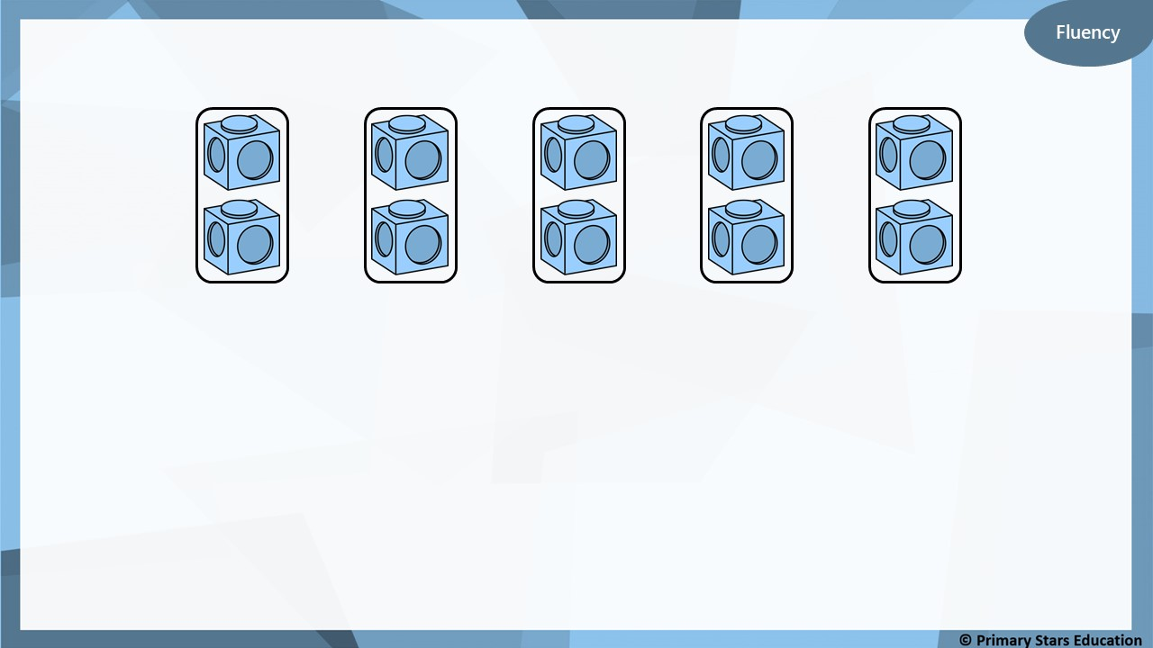
Complete the stem sentences.
10
10
5
2
There are ______ cubes altogether.
There are ______ in each group.
There are ______ groups.
÷
=
2
5
x
2
=
10
5
Notes:
Discuss with chd the link between 10/5=2 and 5 x 2 = 10

Slide 6
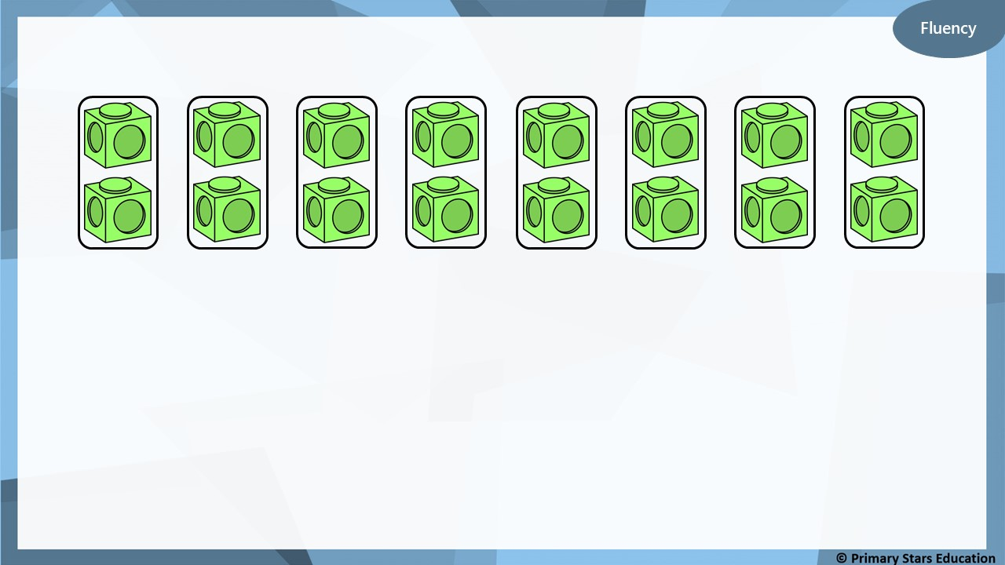
Complete the stem sentences.
16
16
8
2
There are ______ cubes altogether.
There are ______ in each group.
There are ______ groups.
÷
=
2
8
x
2
=
16
8

Slide 7
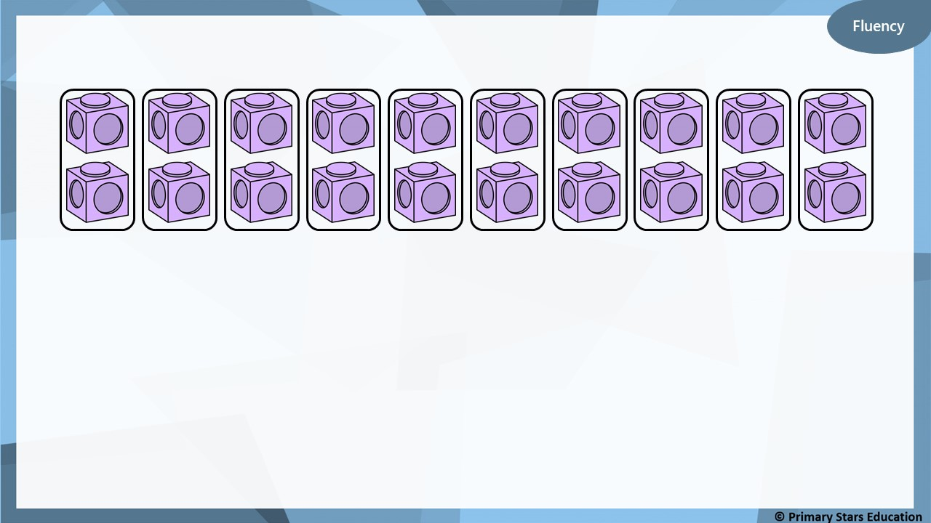
Complete the stem sentences.
20
20
10
2
There are ______ cubes altogether.
There are ______ in each group.
There are ______ groups.
÷
=
2
10
x
2
=
20
10

Slide 8
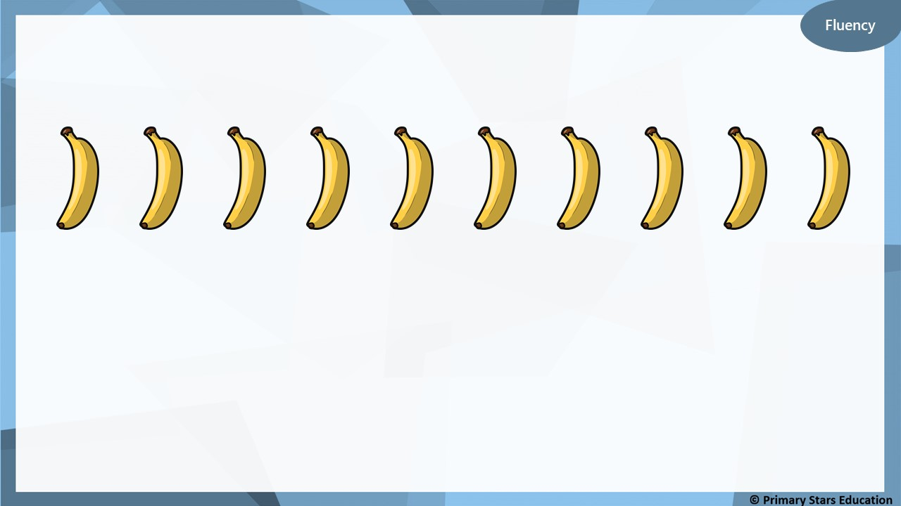
Group the bananas into pairs.
10
÷
5
=
2
5
x
2
=
10

Slide 9
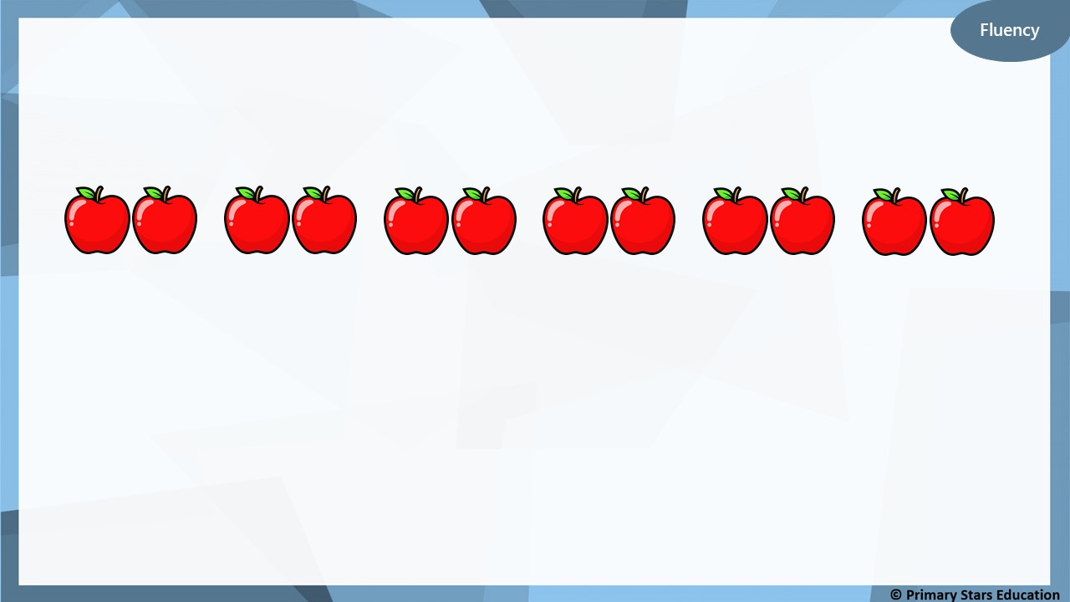
Group the apples into pairs.
12
÷
6
=
2
6
x
2
=
12

Slide 10
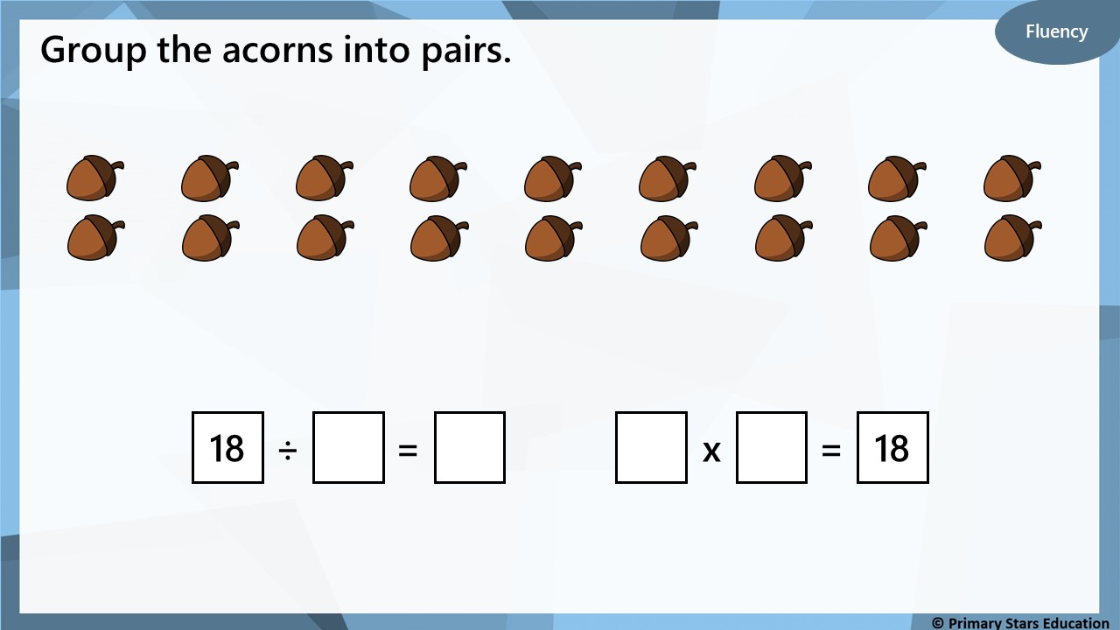
9
2
9
2

Slide 11

Jenny and Pete share 16 sweets between them equally.
Reasoning
There are 16 sweets altogether.
There are 2 groups.
There are 8 sweets in each group.
16
2 | 2 | 2 | 2 | 2 | 2 | 2 | 2
Does the bar model show this calculation?
No.
The bar model shows 8 groups of 2. There should be 2 groups of 8.

Slide 12
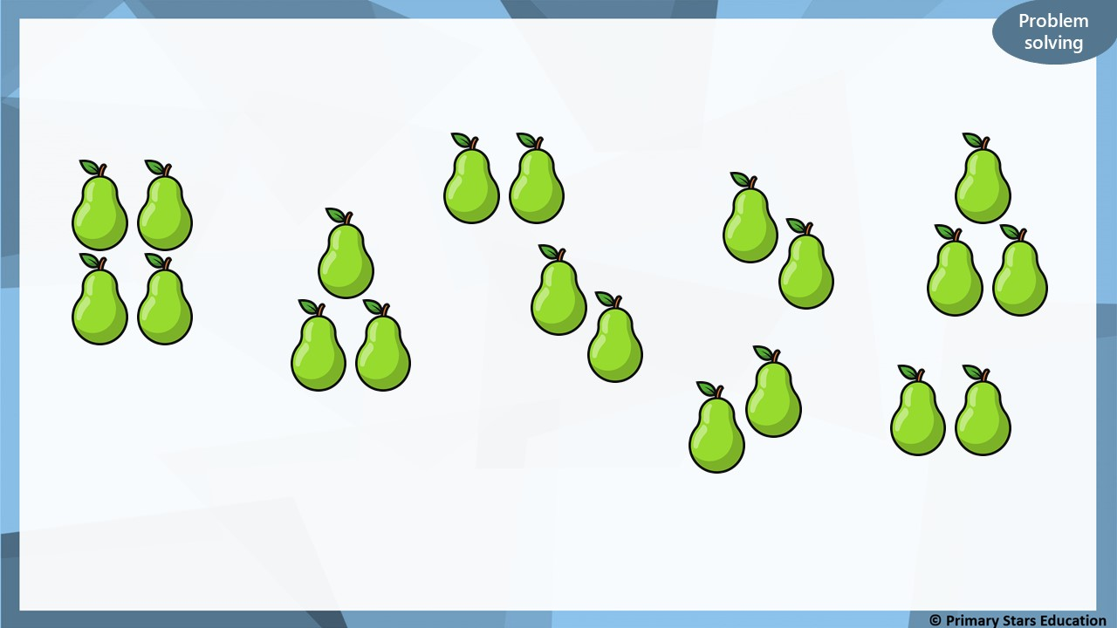
Sue and Jason share these pears equally.
How many pears will they get each?
There are 20 pears in total.
They will get 10 pears each.
Notes:
What do you notice when you group these objects into twos? Is there a link between dividing by 2 and halving? What is different about sharing into two groups and grouping in twos?

Slide 13
Year 2 Activity:
Complete the worksheet.
Use resources to support you and check your answers.
Could you use multiplication to help you check your answers?

Slide 14
On your whiteboard you are going to show how you partition the number I am going to give you.
Notes:
Practice with a variety of 2 digit n umbers
Discuss how you can partition in a variety of ways but ensure all have a concrete understanding of tens and ones.

Slide 15
27 ÷ 3 =
48 ÷ 4 =
56 ÷ 8 =
Notes:
complete the questions on PP using one of the methods they learnt last week on their whiteboards.

Slide 16

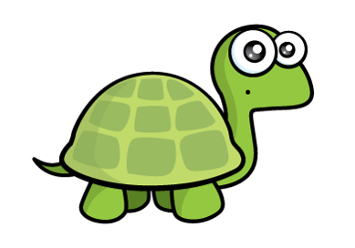


There are 4 counters in each group.
But your counters have different values. The value of each group must be equal too.

Slide 17

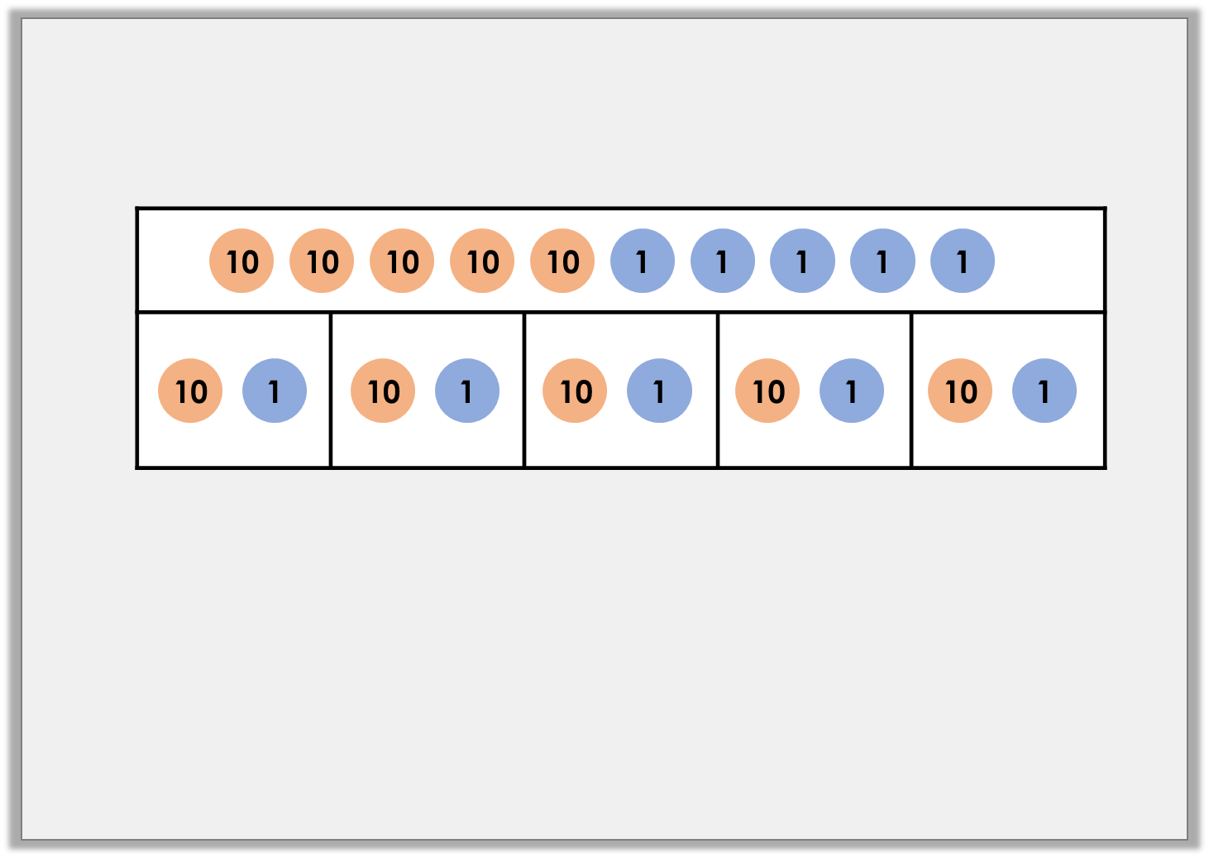

Varied Fluency 1
Use the bar model to complete the division calculation.
55 | ÷ | 5 | =
© Classroom Secrets Limited 2018

Slide 18
Varied Fluency 1
Use the bar model to complete the division calculation.
55 | ÷ | 5 | = | 11
© Classroom Secrets Limited 2018

Slide 19
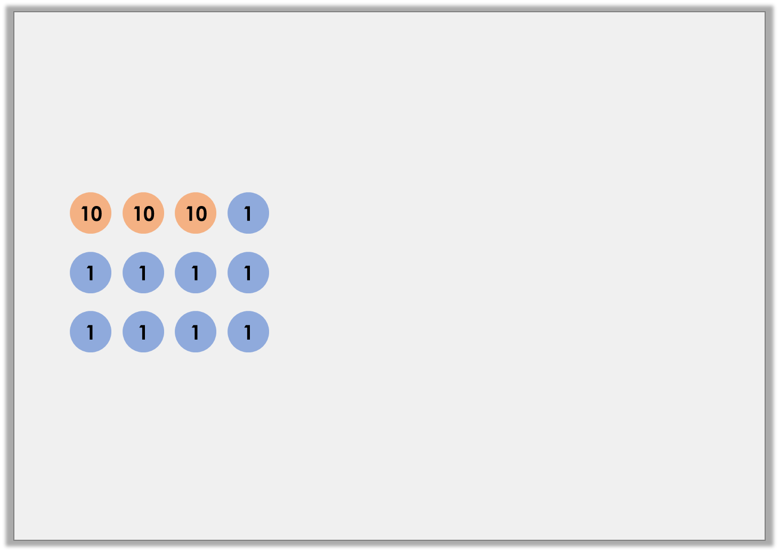
Varied Fluency 2
Complete the division calculation using the part-whole model.
39 ÷ 3
30 ÷ 3
9 ÷ 3
© Classroom Secrets Limited 2018

Slide 20
Varied Fluency 2
Complete the division calculation using the part-whole model.
39 ÷ 3
13
30 ÷ 3
10
9 ÷ 3
3
© Classroom Secrets Limited 2018

Slide 21
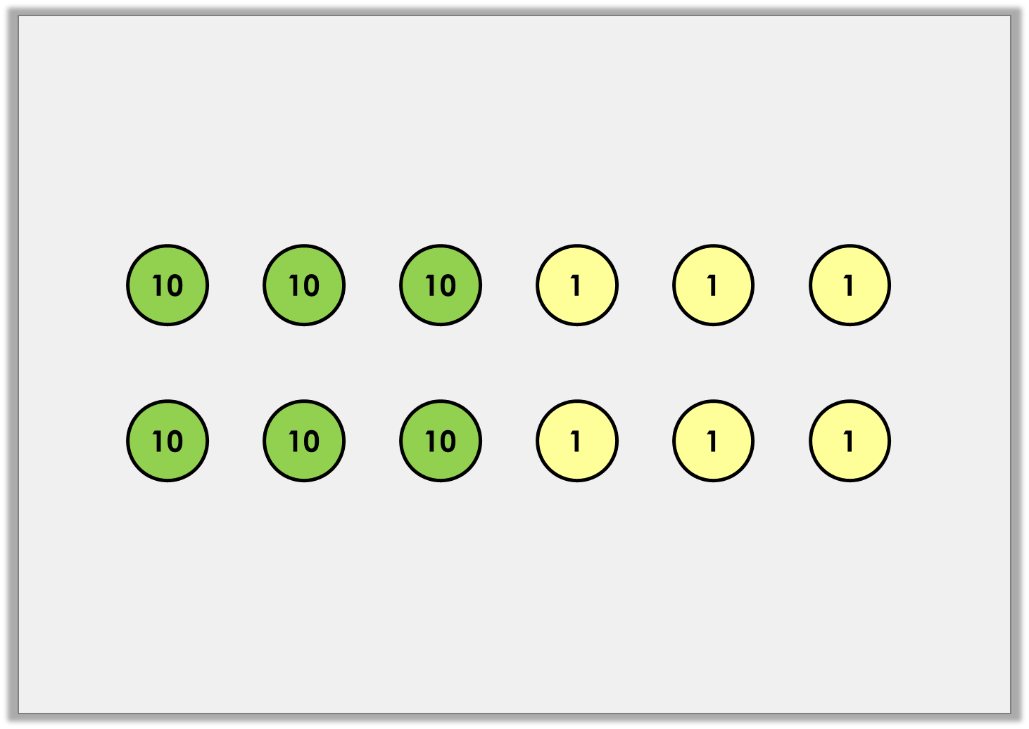
Varied Fluency 3
True or false?
If the number below is divided by 2, the answer will be 36.
© Classroom Secrets Limited 2018

Slide 22
Varied Fluency 3
True or false?
If the number below is divided by 2, the answer will be 36.
False. The answer would be 33.
66 ÷ 3 = 33
© Classroom Secrets Limited 2018

Slide 23
Varied Fluency 4
Using place value counters, complete the bar model and calculation below.
48
48 | ÷ |  | =
© Classroom Secrets Limited 2018

Slide 24
Varied Fluency 4
Using place value counters, complete the bar model and calculation below.
48
10
1
1
10
1
1
10
1
1
10
1
1
48 | ÷ | 4 | = | 12
© Classroom Secrets Limited 2018

Slide 25
Reasoning 1
Circle the odd one out.
Explain your reasoning.
A.
B.
68 ÷ 2
Tens | Ones
60 ÷ 2
8 ÷ 2
C.
88
44 | 44
© Classroom Secrets Limited 2018

Slide 26
Reasoning 1
Circle the odd one out.
Explain your reasoning.
C is the odd one out because…
A.
B.
68 ÷ 2
Tens | Ones
60 ÷ 2
8 ÷ 2
C.
88
44 | 44
© Classroom Secrets Limited 2018

Slide 27
Reasoning 1
Circle the odd one out.
Explain your reasoning.
C is the odd one out because both A and B show the division 68 ÷ 2 whereas C shows 88 ÷ 2.
A.
B.
68 ÷ 2
Tens | Ones
60 ÷ 2
8 ÷ 2
C.
88
44 | 44
© Classroom Secrets Limited 2018

Slide 28
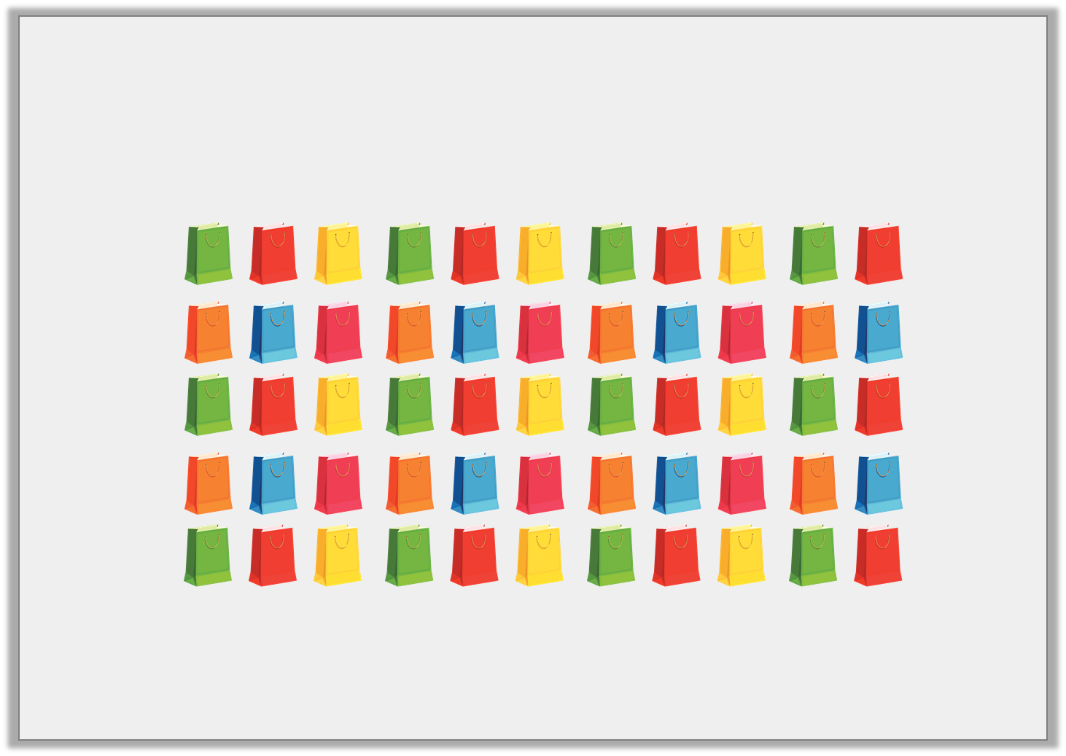
Problem Solving 1
Lesley has 55 empty party bags.
Her five children fill an equal number of party bags with toys.
How many party bags does each child fill?
© Classroom Secrets Limited 2018

Slide 29
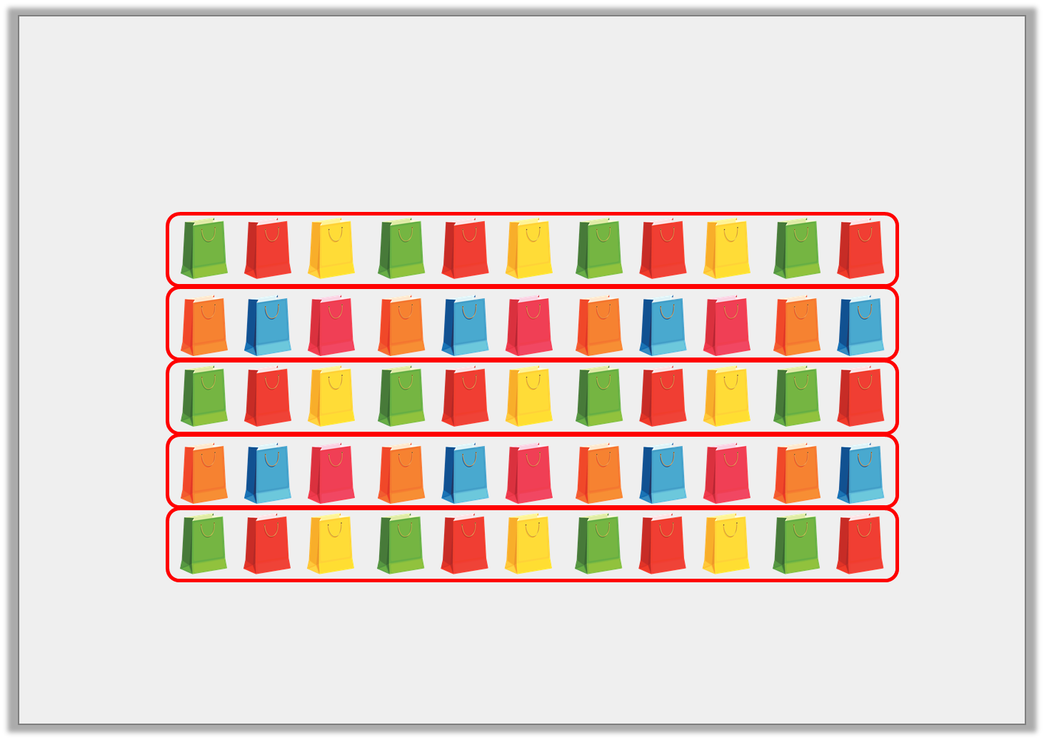
Problem Solving 1
Lesley has 55 empty party bags.
Her five children fill an equal number of party bags with toys.
How many party bags does each child fill?
Each child fills 11 bags because 55 ÷ 5 = 11.
© Classroom Secrets Limited 2018

Slide 30
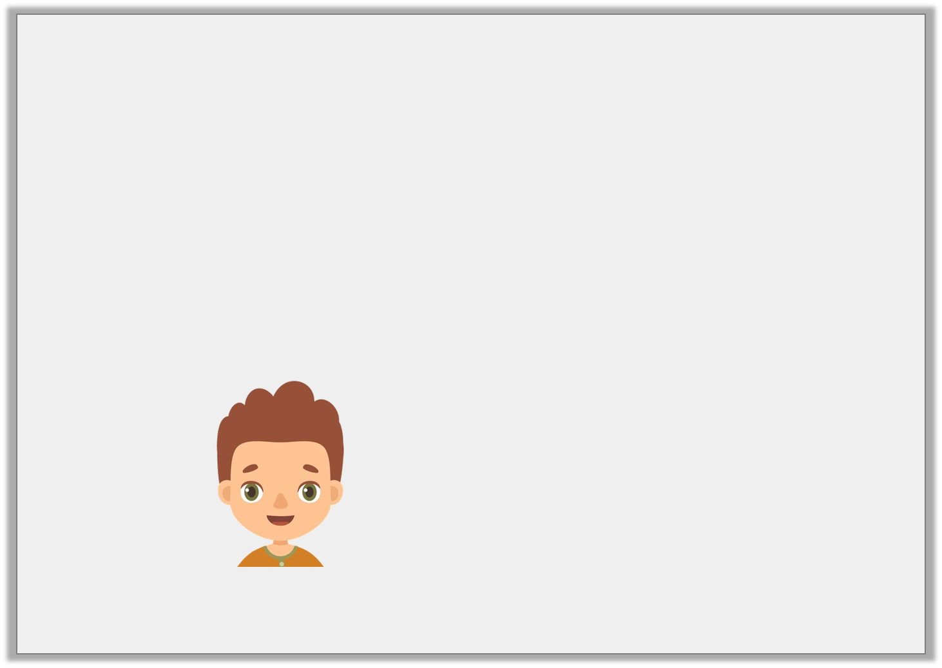
Problem Solving 2
Use the clues to work out Edgar’s number.
I am thinking of a number.
When I divide my number by 3,
I get the answer 22.
What is my number?
© Classroom Secrets Limited 2018

Slide 31
Problem Solving 2
Use the clues to work out Edgar’s number.
Edgar’s number is 66 because 66 ÷ 3 = 22.
I am thinking of a number.
When I divide my number by 3,
I get the answer 22.
What is my number?
© Classroom Secrets Limited 2018

Slide 32
Year 3 Activity:
Complete the worksheet.
Use resources to support you and check your answers.
Could you use multiplication to help you check your answers?

