Slide 1
Y3 LO: To be able to divide by four.
Y2 LO: To be able to make equal groups and share.
I can represent division as equal sharing pictorially.
I can discuss the whole and the equal parts.
I can use equal sharing to represent division when solving division word problems.
I can recall and use multiplication facts for the four times tables.
I can discuss different methods to complete division.
I can choose the most suitable method to complete my calculations.

Slide 2
Starter:
With the cubes on your table, can you share them into a variety of different number of groups.
How many are in each group? How did you do this?
What was the easiest method? Is there another way?
How can you check you are correct?

Slide 3
What is division?
Dividing is sharing into equal groups. You might see it written differently in questions e.g.
divided by
share equally
equal groups of
divided into
share
Notes:
Reminder

Slide 4



Fluency
Complete the sentences to share 8 cubes between two boxes.
8
There are _____ cubes altogether. There are _____ boxes. There are _____ cubes in each box.
2
4

Slide 5


Fluency
Complete the sentences to share 10 marbles between 2 jars.
10
There are _____ marbles altogether. There are _____ jars. There are _____ marbles in each jar.
2
5

Slide 6


Fluency
Complete the sentences to share 9 acorns between 3 squirrels.
9
There are _____ acorns altogether. There are _____ squirrels. There are _____ acorns for each squirrel.
3
3

Slide 7


Fluency
Complete the sentences to share 15 sweets between
three paper bags.
15
There are _____ sweets altogether. There are _____ paper bags. There are _____ sweets in each paper bag.
3
5

Slide 8

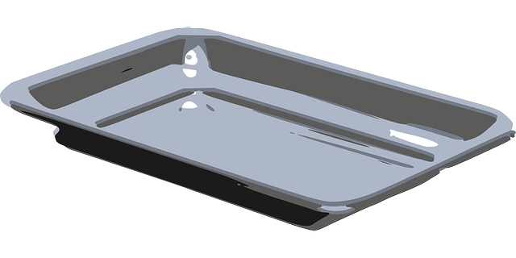
Fluency
Complete the sentences to share 12 doughnuts between
4 trays.
12
There are _____ doughnuts altogether. There are _____ trays. There are _____ doughnuts on each tray.
4
3

Slide 9
Fluency
Complete the number sentence to show 20 shared
between 10.
2
20 ÷ 10 =

Slide 10
Fluency
Complete the number sentence to show 15 shared
between 5.
3
15 ÷ 5 =

Slide 11
Fluency
Complete the number sentence to show 25 shared
between 5.
5
25 ÷ 5 =

Slide 12
Fluency
Complete the number sentence to show 50 shared
between 5.
10
50 ÷ 5 =

Slide 13
Does this number sentence match the shared groups?
Reasoning
15 ÷ 5 = 3
No.
It should be 15 ÷ 3 = 5 (15 shared between 3 groups).

Slide 14

Tam has 30 sweets and shares them between 5 friends.
Mo has 30 sweets and shares them between 10 friends.
Whose friends will receive the most sweets? How do you know?
Tam’s friends will receive the most sweets because Mo is
sharing with more people.
Tam’s friends will receive 6 sweets each.
Mo’s friends will receive 3 sweets each.

Slide 15
Year 2 Activity:
Complete the worksheet. Choose the level you feel most comfortable with.
Don’t forget to use counters and cubes to help.

Slide 16

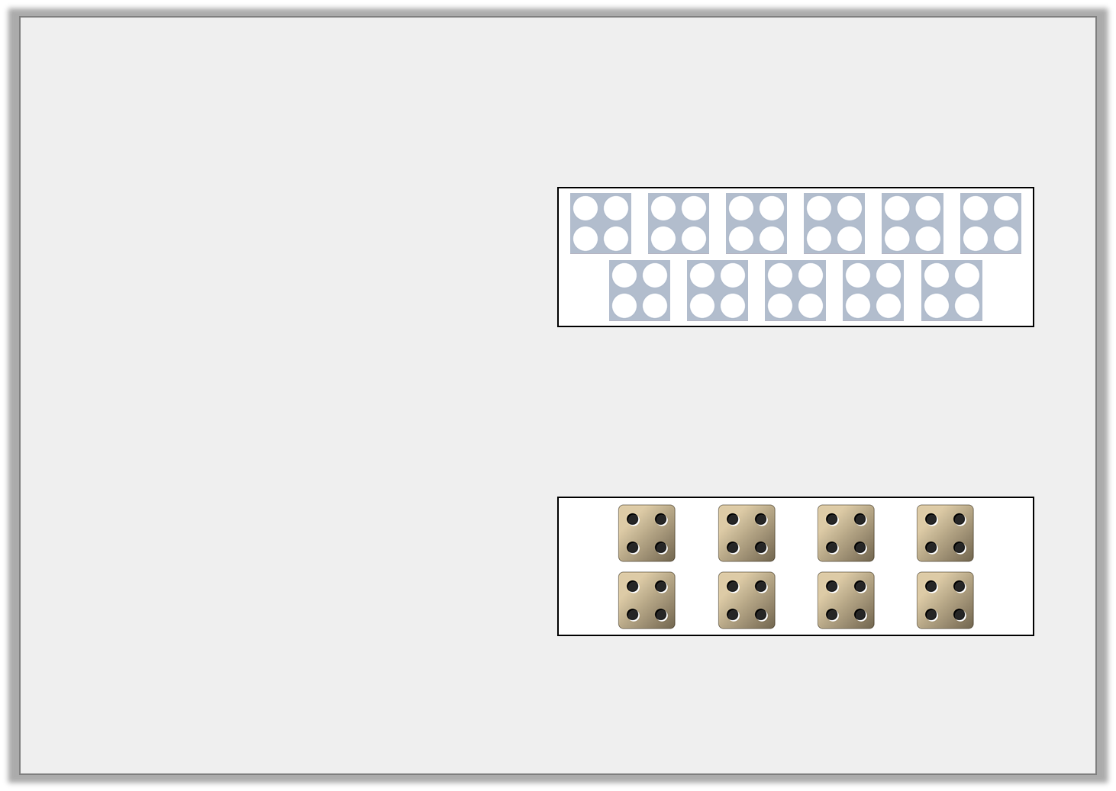

Varied Fluency 1
Match each calculation to the correct representation.
A. 7 x 4
4 | 4 | 4 | 4 | 4 | 4 | 4
B. 8 x 4
C. 11 x 4
© Classroom Secrets Limited 2018

Slide 17
Varied Fluency 1
Match each calculation to the correct representation.
A. 7 x 4
4 | 4 | 4 | 4 | 4 | 4 | 4
B. 8 x 4
C. 11 x 4
© Classroom Secrets Limited 2018

Slide 18
Different ways to divide:
Splitting into equal groups
Counting back
Groupings of a number until you reach the total number
Notes:
These are the methods we will be focusing on.
Recap.
Give them an example to complete on their whiteboard with a method of their choice e.g., 12 divided by 3.
Then give them an example for the four times table

Slide 19
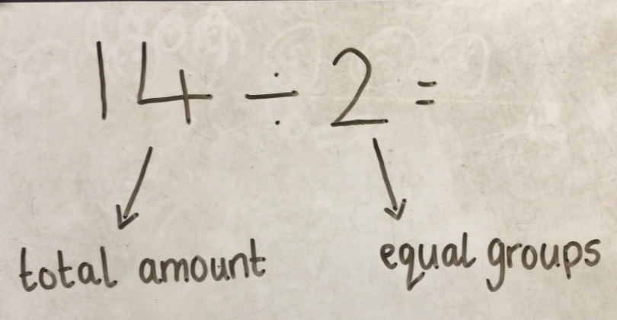
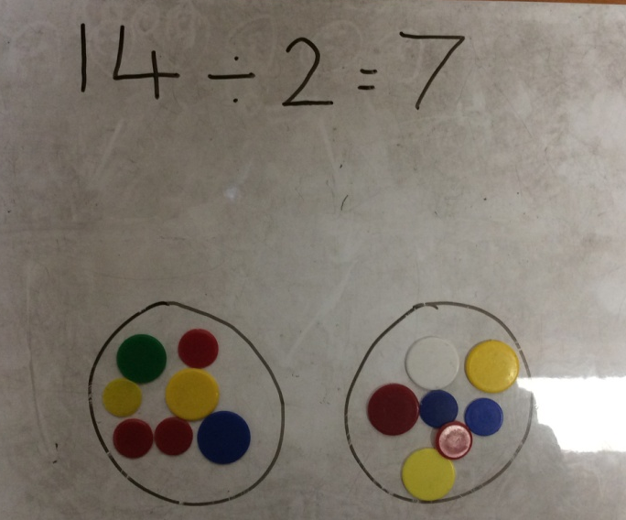
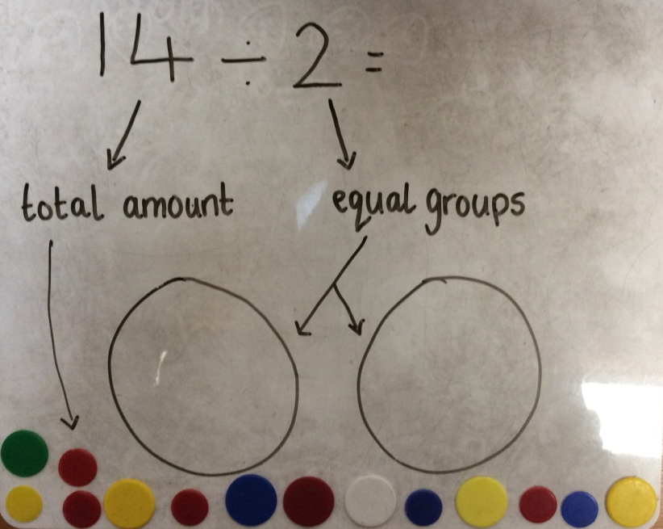
14 ÷ 2 = 7
Step 1
Step 3
Step 2
Notes:
Method one: splitting into equal groups.
show practically to chd. Remind chd that what we are dividing by is the number of groups and the first number Is the amount of cubes or counters we need.
Remind chd that commutative law does not work with division, we must follow the order of the question.
Have chd practically show it.

Slide 20
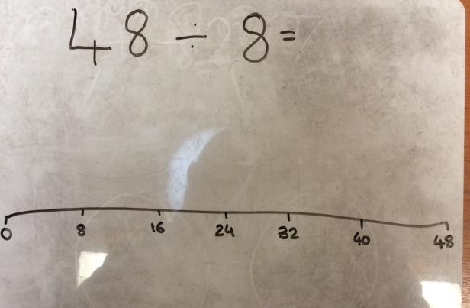
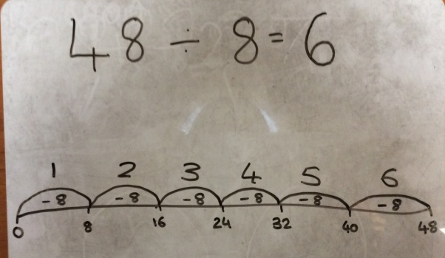
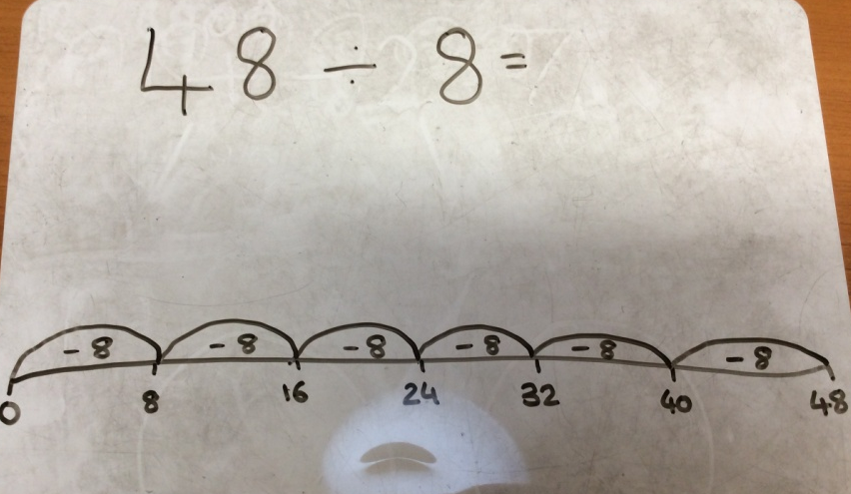
48 ÷ 8 = 6
Step 1
Step 3
Step 2
Notes:
Counting backwards method:
Draw no line with intervals of what we are dividing by to start with. Then counting back until we get to 0. We then count how many jumps which gives us our answer.
Have chd do this on a whiteboard at the same time.

Slide 21
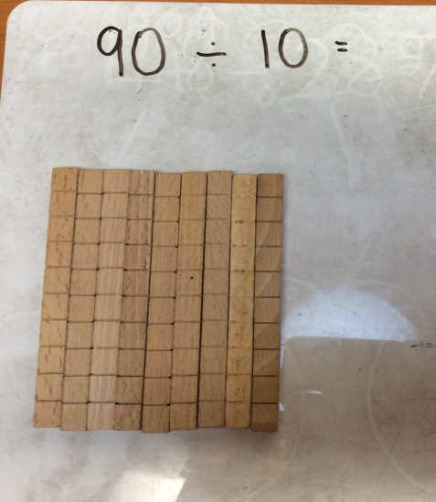
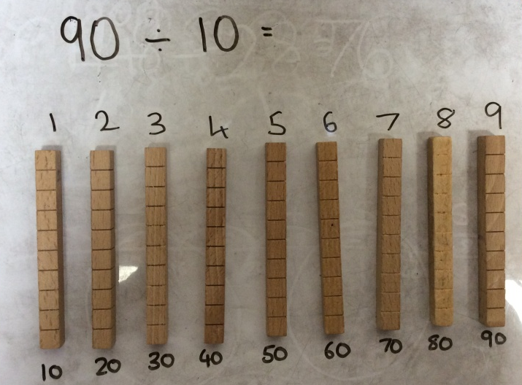
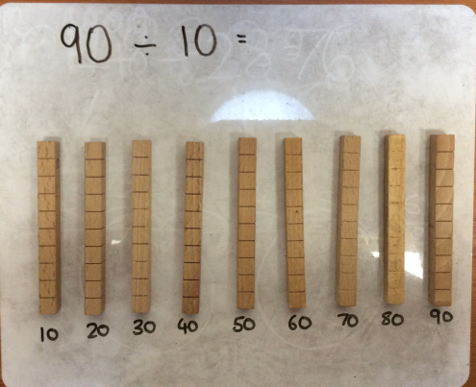
90 ÷ 10 = 9
Step 1
Step 3
Step 2
Notes:
Grouping method:
Start with cubes of the amount you are dividing- explain we have chosen 9 sticks of 10 instead of 90 ones due to it being more efficient,
Step 2 I need to make groups of 10, this is easier due to having sticks of ten.
Step 3 then I need to count how many groups of 10 I have.
Have chd complete alongside practically.

Slide 22
Varied Fluency 1
True or false? The calculation below is correct.
36 ÷ 4 = 9
36
© Classroom Secrets Limited 2018

Slide 23
Varied Fluency 1
True or false? The calculation below is correct.
True
36 ÷ 4 = 9
36
9 | 9 | 9 | 9
© Classroom Secrets Limited 2018

Slide 24
Varied Fluency 2
Circle the correct answer.
28 ÷ 4 = ?
5
6
7
© Classroom Secrets Limited 2018

Slide 25
Varied Fluency 2
Circle the correct answer.
28 ÷ 4 = 7
5
6
7
© Classroom Secrets Limited 2018

Slide 26
Varied Fluency 3
Use the number line to solve the calculation.
32 ÷ 4 = ?
0 |  |  |  |  |  |  |  | 32
© Classroom Secrets Limited 2018

Slide 27
Varied Fluency 3
Use the number line to solve the calculation.
32 ÷ 4 = 8
0 | 4 | 8 | 12 | 16 | 20 | 24 | 28 | 32
© Classroom Secrets Limited 2018

Slide 28
Year 3 Activity:
Choose your sheet of questions and complete in your book. Unless it tells you which method to use, you can choose a method we have looked at today to complete the question.
Don’t forget to use cubes or counters to help you as well.
Today we are focusing on the four times table.

Slide 29

Notes:
Model how to present in book.

Slide 30
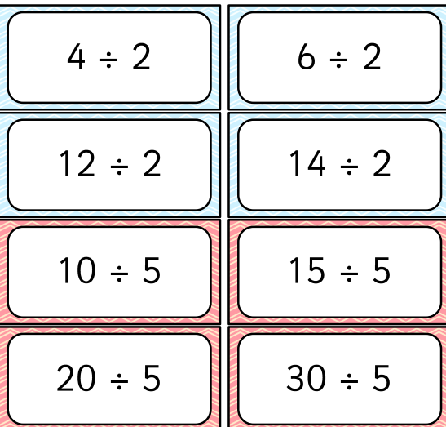
Plenary
Notes:
Children will be given a division calculation or description of shared groups. They must complete the task card describing the shared groups.

