Slide 1
Y3 LO: To be able to divide by eight.
Y2 LO: To be able to represent division as grouping. (practical)
I can use manipulatives to show equal groups in different representations.
I can use my knowledge of my two-, five- and ten-times tables to support my learning.
I can use stem sentences to describe my groups.
I can recall and use multiplication facts for the eight times tables.
I can discuss different methods to complete division.
I can choose the most suitable method to complete my calculations.

Slide 2
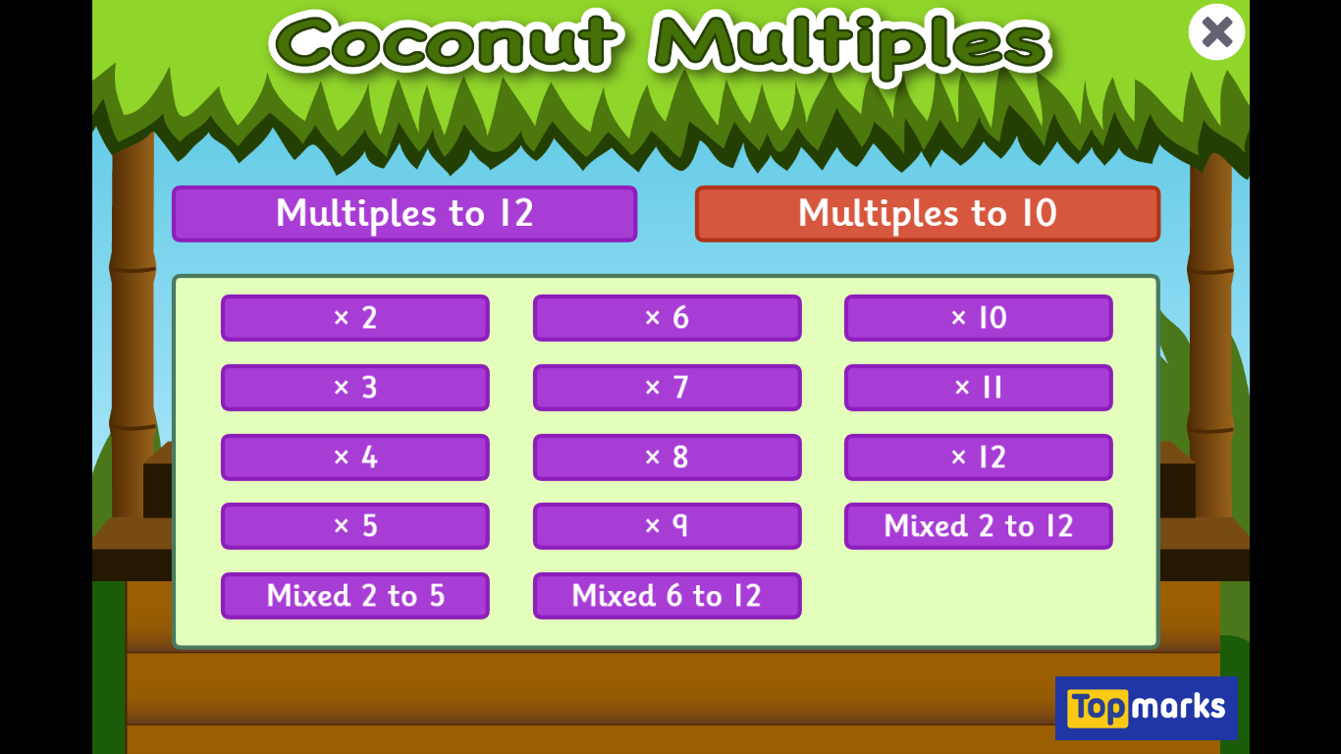
Starter:
Notes:
Coconut multiples:
2, 5, 10, 3, 4 and 8.
https://www.topmarks.co.uk/times-tables/coconut-multiples

Slide 3
What is division?
Dividing is sharing into equal groups. You might see it written differently in questions e.g.
divided by
share equally
equal groups of
divided into
share
Notes:
Reminder

Slide 4

Fluency
There are 10 in total. There are 2 in each group.
How many groups? ______
5
Answer

Slide 5
Fluency
There are 8 in total. There are 2 in each group.
How many groups? ______
4
Answer

Slide 6
Fluency
There are 12 in total. There are 3 in each group.
How many groups? ______
4
Answer

Slide 7
Fluency
There are 9 in total. There are 3 in each group.
How many groups? ______
3
Answer

Slide 8
Fluency
There are 10 in total. There are 5 in each group.
How many groups? ______
2
Answer

Slide 9
Fluency
There are 20 in total. There are 5 in each group.
How many groups? ______
4
Answer

Slide 10

Kat says,
I have 35 counters.
There are 5 counters in each group,
so I will have 6 groups.
Do you agree with Kat?
No.
There will be 7 groups of 5.

Slide 11
Problem solving
There are 40 counters.
How many equal groups can you make?
2 groups of 20
4 groups of 10
5 groups of 8
8 groups of 5
10 groups of 4
20 groups of 2

Slide 12
Year 2 Activity:
Using cubes or counters can you complete the equal groups sheet.
You will be representing the groups using pictures, repeated addition and describe the groups using stem sentences.
Level 1: create equal groups of 2
Level 2: create equal groups of 2 and 5
Level 3: create equal groups of 2, 3, 5 and 10

Slide 13


Introduction
Place the numbers into the correct part of the Venn Diagram.
18
28
8
4
Multiple of 3
Multiple of 4
30
24
12
3
5
6
16
10
© Classroom Secrets Limited 2018

Slide 14
Introduction
Place the numbers into the correct part of the Venn Diagram.
Multiple of 3
Multiple of 4
3
6
18
30
4
8
16
28
12
24
5
10
© Classroom Secrets Limited 2018

Slide 15
Varied Fluency 1
Using the bar model, complete the calculation below.
?
8 | 8 | 8 | 8 | 8 | 8 | 8
 | x |  | =
© Classroom Secrets Limited 2018

Slide 16
Varied Fluency 1
Using the bar model, complete the calculation below.
56
8 | 8 | 8 | 8 | 8 | 8 | 8
7 | x | 8 | = | 56
© Classroom Secrets Limited 2018

Slide 17
Different ways to divide:
Splitting into equal groups
Counting back
Groupings of a number until you reach the total number
Notes:
These are the methods we will be focusing on.
Recap.
Give them an example to complete on their whiteboard with a method of their choice e.g., 12 divided by 4.
Then give them an example for the eight times table

Slide 18
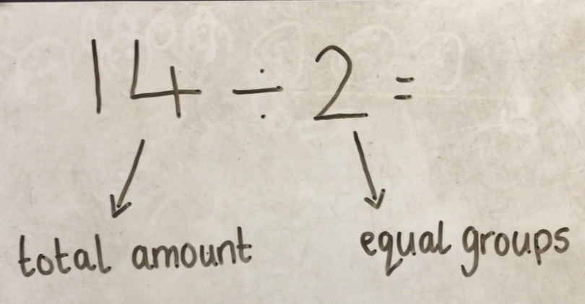
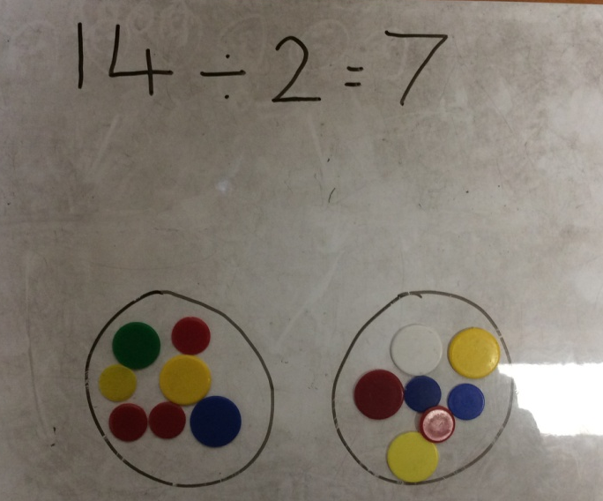
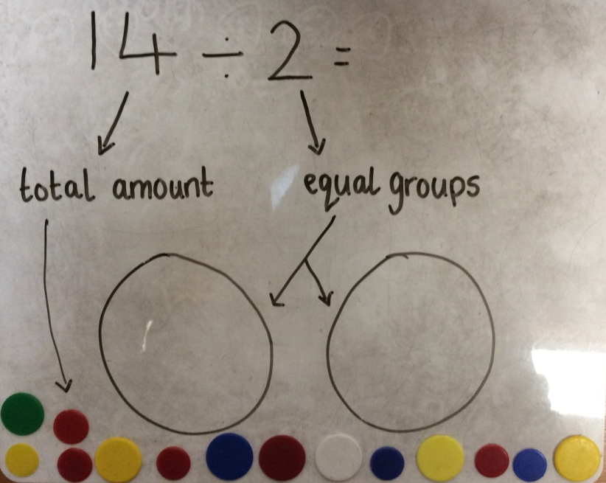
14 ÷ 2 = 7
Step 1
Step 3
Step 2
Notes:
Method one: splitting into equal groups.
show practically to chd. Remind chd that what we are dividing by is the number of groups and the first number Is the amount of cubes or counters we need.
Remind chd that commutative law does not work with division, we must follow the order of the question.
Have chd practically show it.

Slide 19
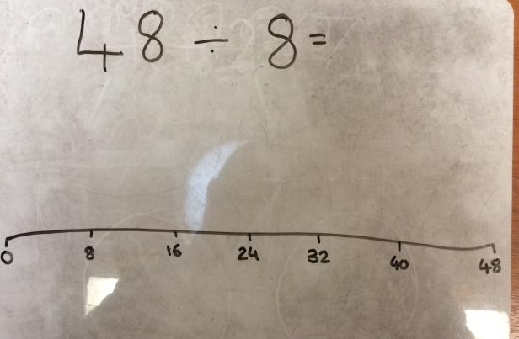
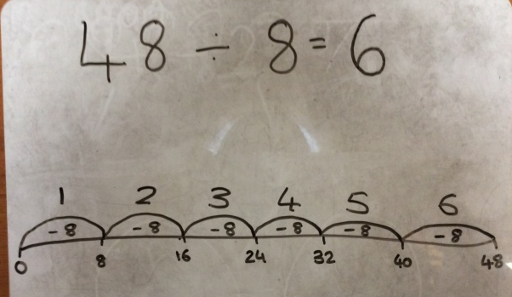
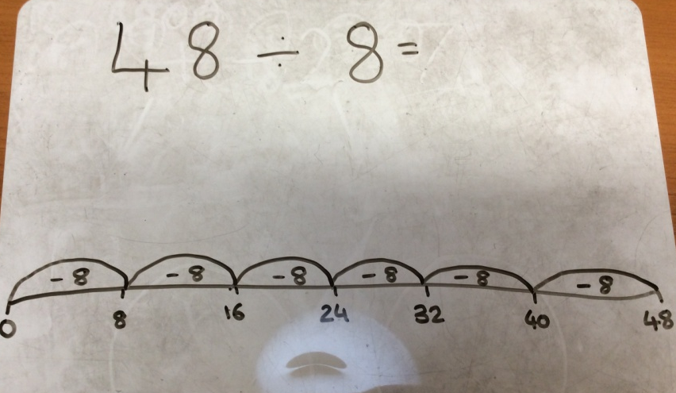
48 ÷ 8 = 6
Step 1
Step 3
Step 2
Notes:
Counting backwards method:
Draw no line with intervals of what we are dividing by to start with. Then counting back until we get to 0. We then count how many jumps which gives us our answer.
Have chd do this on a whiteboard at the same time.

Slide 20
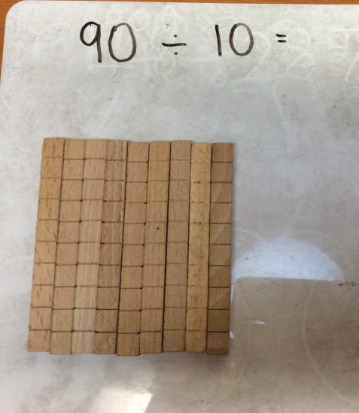
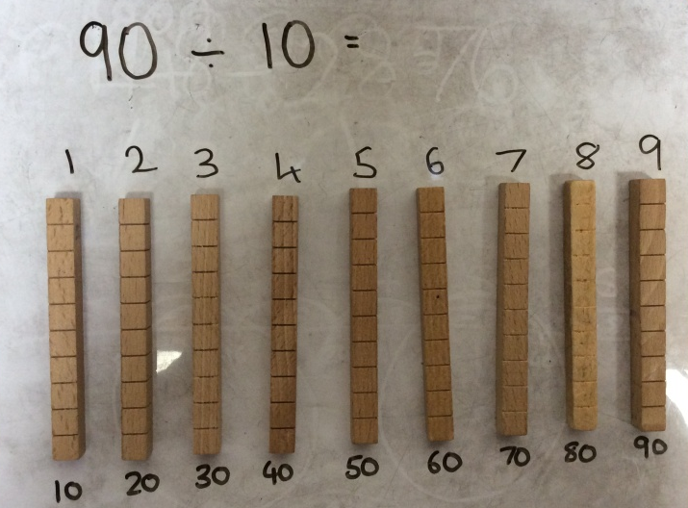
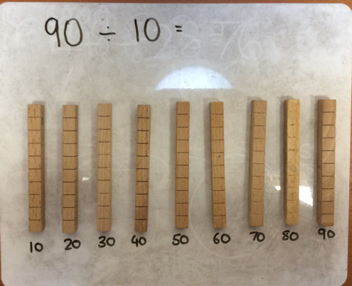
90 ÷ 10 = 9
Step 1
Step 3
Step 2
Notes:
Grouping method:
Start with cubes of the amount you are dividing- explain we have chosen 9 sticks of 10 instead of 90 ones due to it being more efficient,
Step 2 I need to make groups of 10, this is easier due to having sticks of ten.
Step 3 then I need to count how many groups of 10 I have.
Have chd complete alongside practically.

Slide 21
Varied Fluency 1
True or false?
16 | ÷ | 8 | = | 2
16
© Classroom Secrets Limited 2018

Slide 22
Varied Fluency 1
True or false?
True
16 | ÷ | 8 | = | 2
16
2 | 2 | 2 | 2 | 2 | 2 | 2 | 2
© Classroom Secrets Limited 2018

Slide 23
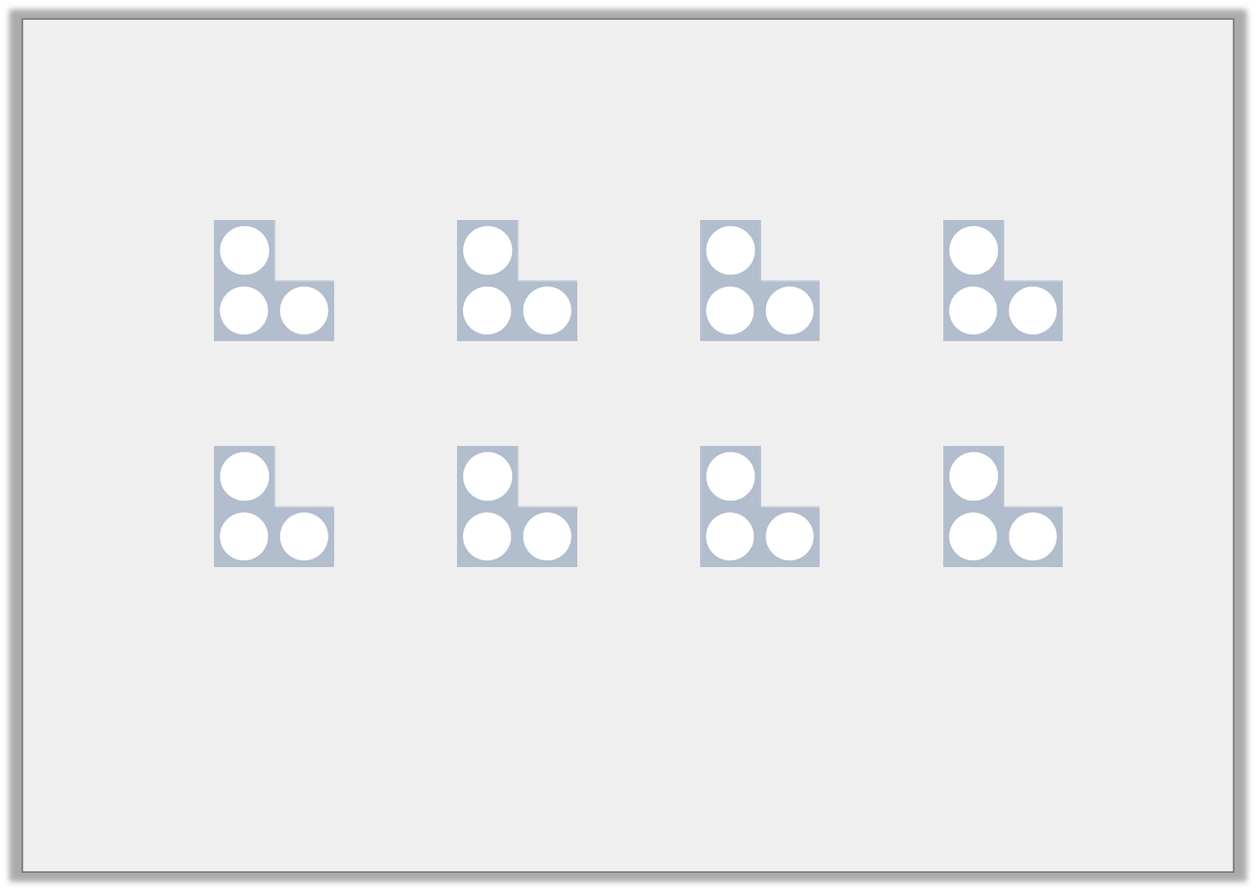
Varied Fluency 2
Complete the calculation to match the representation.
 | ÷ | 8 | =
© Classroom Secrets Limited 2018

Slide 24
Varied Fluency 2
Complete the calculation to match the representation.
24 | ÷ | 8 | = | 3
© Classroom Secrets Limited 2018

Slide 25
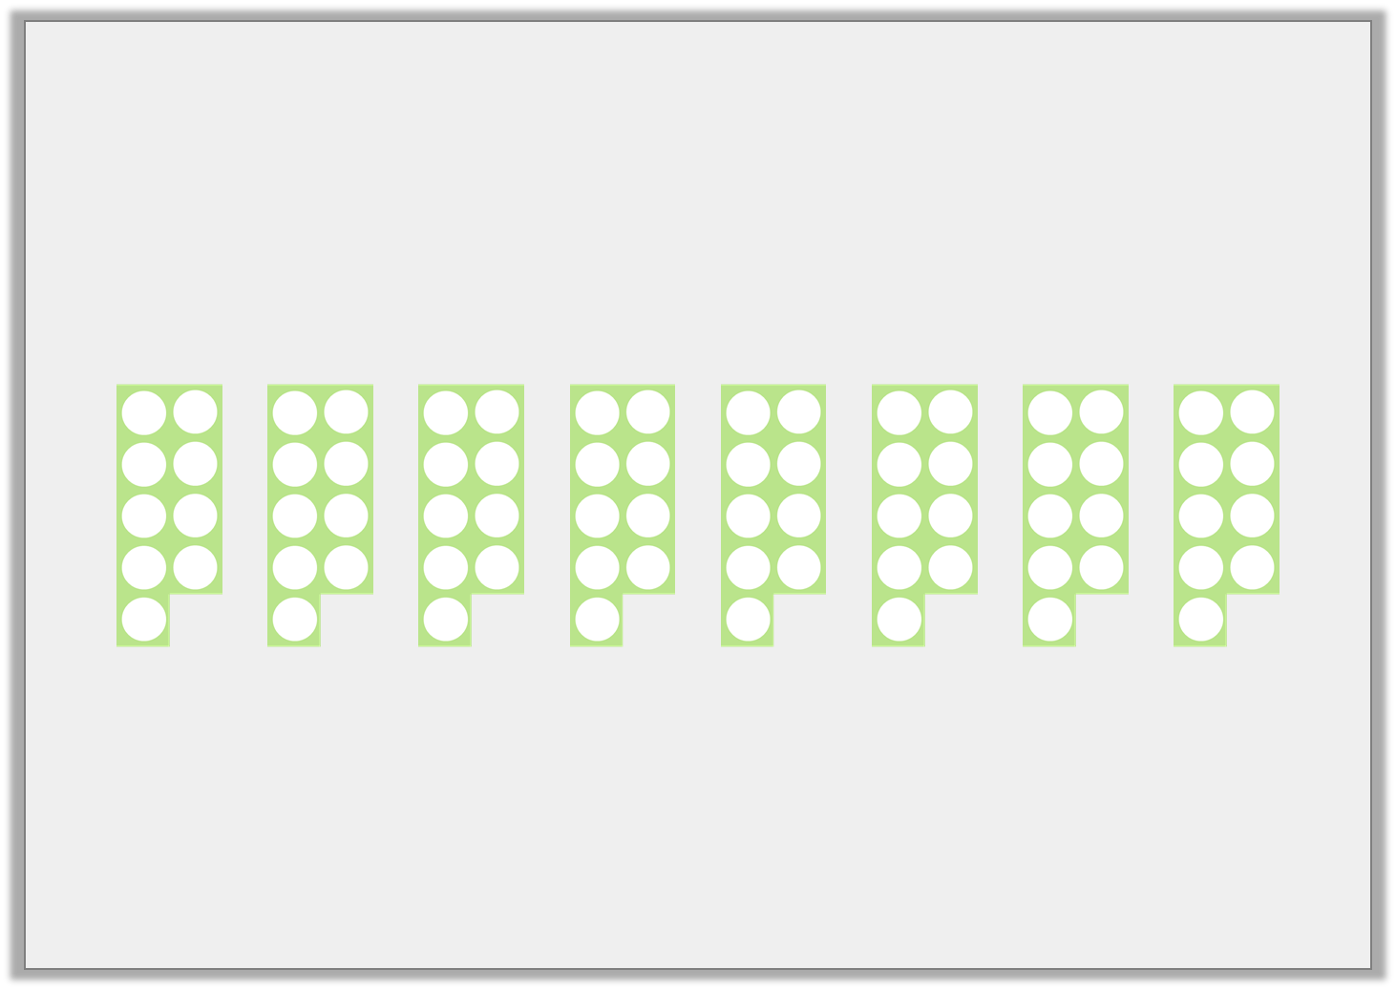
Varied Fluency 3
Complete the bar model to show the calculation below.
72 | ÷ | 8 | =
72
© Classroom Secrets Limited 2018

Slide 26
Varied Fluency 3
Complete the bar model to show the calculation below.
72 | ÷ | 8 | = | 9
72
9 | 9 | 9 | 9 | 9 | 9 | 9 | 9
© Classroom Secrets Limited 2018

Slide 27
Varied Fluency 4
Create two number sentences using the digit cards below.
48
=
8
6
72
÷
48
© Classroom Secrets Limited 2018

Slide 28
Varied Fluency 4
Create two number sentences using the digit cards below.
48 ÷ 8 = 6
48 ÷ 6 = 8
48
=
8
6
72
÷
48
6 | 6 | 6 | 6 | 6 | 6 | 6 | 6
48
8 | 8 | 8 | 8 | 8 | 8
© Classroom Secrets Limited 2018

Slide 29
Year 3 Activity:
Choose your sheet of questions and complete in your book. Unless it tells you which method to use, you can choose a method we have looked at today to complete the question.
Don’t forget to use cubes or counters to help you as well.
Today we are focusing on the eight times table.

Slide 30

Notes:
Model how to present in book.

Slide 31
Plenary
There are 20. We need 5 in each group. How many groups?
Notes:
Show 5 groups of 4.
Ask children to spot the mistake. Explain there should be 4 groups of 5.

