Slide 1
Y3 LO: To be able to discuss related calculations.
Y2 LO: To be able to represent division as grouping.
I can discuss the difference between grouping and sharing.
I can recognise the link between division, multiplication, and repeated addition.
I can use equal grouping to represent division when solving division word problems.
I can recall my times tables I have learnt so far.
I can use my times tables facts to help with related facts.
I can understand the link between the related calculations and use this to answer word problems.

Slide 2
Starter:
You have 20 cubes on your table.
How many groups of:
2
5
10
Can anymore groups be made?
Notes:
Put 20 cubes in the middle of each table.
Ask them how many groups of:
2?
5?
10?
Can any more groups be made?
4 groups of 5.

Slide 3
What is division?
Dividing is sharing into equal groups. You might see it written differently in questions e.g.
divided by
share equally
equal groups of
divided into
share
Notes:
Reminder

Slide 4


Fluency
There are 24 apples.
We need to put 2 apples in each basket.
How many baskets will we need?
24
There are ______ apples altogether.
There are ______ apples in each basket.
There are ______ baskets.
2
12

Slide 5

Fluency
Sweets come in packs of 20.
We need to put 5 sweets in each jar.
How many jars will we need?
20
There are ______ sweets altogether.
There are ______ sweets in each jar.
There are ______ jars.
5
4

Slide 6
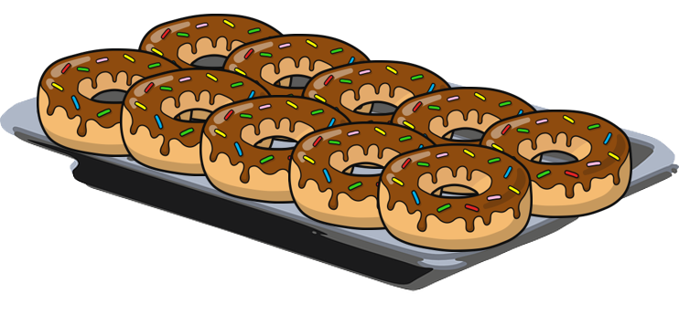
Fluency
Doughnuts come in packs of 100.
We need to put 10 doughnuts on each tray.
How many trays will we need?
100
There are ______ doughnuts altogether.
There are ______ doughnuts on each tray.
There are ______ trays.
10
10

Slide 7


Fluency
Lee has 15 eggs.
He puts 3 eggs in each box.
How many boxes can he fill?
15
÷
5
=
3
15
5
x
3
=
15
3
3
3
3
3
Lee can fill 5 boxes.

Slide 8


Fluency
John has 20 fish.
He puts 4 fish in each tank.
How many tanks can he fill?
20
÷
5
=
4
20
5
x
4
=
20
4
4
4
4
4
John can fill 5 tanks.

Slide 9
Fluency
Use the number line to work out how many equal
groups of 2 can be made from 16.
2
2
2
2
2
2
2
2
0
1
2
3
4
5
6
7
8
9
10
11
12
13
14
15
16
8 equal groups of 2 can be made.

Slide 10
Fluency
Use the number line to work out how many equal
groups of 5 can be made from 20.
5
5
5
5
0
1
2
3
4
5
6
7
8
9
10
11
12
13
14
15
16
17
18
19
20
4 equal groups of 5 can be made.

Slide 11

Che says,
5 equal groups of 5 will be made from 30.
True or false?
False.
6 equal groups of 5 will be made from 30.

Slide 12

The amount he started with is: greater than 10 but less than 24.
How many could be in each group?
Ben has 4 equal groups.
20 ÷ 4 = 5 in each group.
16 ÷ 4 = 4 in each group.
12 ÷ 4 = 3 in each group.

Slide 13
Year 2 Activity:
Complete the worksheets. Choose the level you are most comfortable with.
Don’t forget to use cubes and counters to help you.

Slide 14
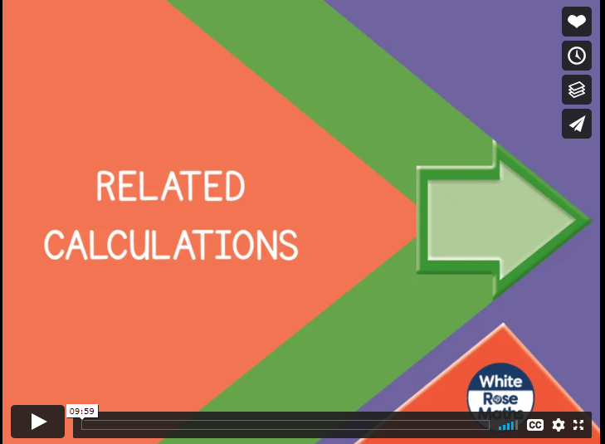
Notes:
Spr3.1.3 - Related calculations on Vimeo

Slide 15


Introduction
Complete the statements:
2 x 30 is equal to | 3 x 20
4 x 20 is equal to
5 x 40 is equal to
3 x 90 is equal to
6 x 30 is equal to
© Classroom Secrets Limited 2018

Slide 16
Introduction
Complete the statements:
2 x 30 is equal to | 3 x 20
4 x 20 is equal to | 2 x 40
5 x 40 is equal to | 4 x 50
3 x 90 is equal to | 9 x 30
6 x 30 is equal to | 3 x 60
© Classroom Secrets Limited 2018

Slide 17
Varied Fluency 1
Match the related facts.
A. | 5 | x | 6
1. | 9 | x | 40
B. | 4 | x | 90
2. | 60 | x | 5
10
10
10
10
10
10
10
10
10
10
10
10
10
10
10
10
10
10
10
10
10
10
10
10
10
10
10
10
10
10
10
10
10
10
10
10
C. | 2 | x | 80
3. | 8 | x | 20
10
10
10
10
10
10
10
10
10
10
10
10
10
10
10
10
© Classroom Secrets Limited 2018

Slide 18
Varied Fluency 1
Match the related facts.
A. | 5 | x | 6
1. | 9 | x | 40
B. | 4 | x | 90
2. | 60 | x | 5
10
10
10
10
10
10
10
10
10
10
10
10
10
10
10
10
10
10
10
10
10
10
10
10
10
10
10
10
10
10
10
10
10
10
10
10
C. | 2 | x | 80
3. | 8 | x | 20
10
10
10
10
10
10
10
10
10
10
10
10
10
10
10
10
© Classroom Secrets Limited 2018

Slide 19
Varied Fluency 2
Tick the fact that will help you solve 80 x 3.
8 | x | 6 | = | 48
3 | x | 8 | = | 24
2 | x | 8 | = | 16
© Classroom Secrets Limited 2018

Slide 20
Varied Fluency 2
Tick the fact that will help you solve 80 x 3.
8 | x | 6 | = | 48
3 | x | 8 | = | 24 |  | ✓
2 | x | 8 | = | 16
© Classroom Secrets Limited 2018

Slide 21
Varied Fluency 3
True or false?
If 4 x 80 = 320, then 320 divided by 80 = 40.
© Classroom Secrets Limited 2018

Slide 22
Varied Fluency 3
True or false?
False. 320 divided by 80 = 4.
If 4 x 80 = 320, then 320 divided by 80 = 40.
© Classroom Secrets Limited 2018

Slide 23
Varied Fluency 4
Complete the fact family.
80 | x | 3 | =
 | x | 30 | = | 240
240 | ÷ |  | = | 80
 | ÷ | 8 | =
© Classroom Secrets Limited 2018

Slide 24
Varied Fluency 4
Complete the fact family.
80 | x | 3 | = | 240
8 | x | 30 | = | 240
240 | ÷ | 3 | = | 80
240 | ÷ | 8 | = | 30
© Classroom Secrets Limited 2018

Slide 25
Reasoning 1
Erica has written some number sentences about a fact family, but she’s made a mistake.
Find and explain her mistake.
2 | x | 8 | = | 16
20 | x | 8 | = | 160
16 | ÷ | 8 | = | 2
160 | ÷ | 2 | = | 8
© Classroom Secrets Limited 2018

Slide 26
Reasoning 1
Erica has written some number sentences about a fact family, but she’s made a mistake.
Find and explain her mistake.
Erica has made a mistake because…
2 | x | 8 | = | 16
20 | x | 8 | = | 160
16 | ÷ | 8 | = | 2
160 | ÷ | 2 | = | 8
© Classroom Secrets Limited 2018

Slide 27
Reasoning 1
Erica has written some number sentences about a fact family, but she’s made a mistake.
Find and explain her mistake.
Erica has made a mistake because she has put 160 ÷ 2 = 8.
We know that 16 ÷ 2 = 8, and we know that 160 is 10 times bigger than 16, so the answer also needs to be 10 times bigger. The correct answer is 160 ÷ 2 = 80.
2 | x | 8 | = | 16
20 | x | 8 | = | 160
16 | ÷ | 8 | = | 2
160 | ÷ | 2 | = | 8
© Classroom Secrets Limited 2018

Slide 28
Problem Solving 1
Using the number cards below, create five different multiplication or division sentences.
40
12
4
30
3
120
© Classroom Secrets Limited 2018

Slide 29
Problem Solving 1
Using the number cards below, create five different multiplication or division sentences.
Various answers, for example:
4 x 3 = 12; 3 x 4 = 12; 12 ÷ 3 = 4; 40 x 3 = 120; 30 x 4 = 120
40
12
4
30
3
120
© Classroom Secrets Limited 2018

Slide 30


Reasoning 2
Hamza says,
Do you agree? Explain why.
This array shows a multiplication fact that is related to 2 x 4.
10
10
10
10
10
10
10
10
© Classroom Secrets Limited 2018

Slide 31
Reasoning 2
Hamza says,
Do you agree? Explain why.
Hamza is correct because…
This array shows a multiplication fact that is related to 2 x 4.
10
10
10
10
10
10
10
10
© Classroom Secrets Limited 2018

Slide 32
Reasoning 2
Hamza says,
Do you agree? Explain why.
Hamza is correct because the array shows 20 x 4 or 2 x 40, both of which are related facts to 2 x 4.
This array shows a multiplication fact that is related to 2 x 4.
10
10
10
10
10
10
10
10
© Classroom Secrets Limited 2018

Slide 33
Year 3 Activity:
Complete the worksheet. Choose the level you feel most comfortable with.
Then move onto the problem solving sheets.

