Slide 1
Money
Lesson 1
15.11.21

Slide 2
Y2 LO: To be able to count money (pence).
Y3 LO: To be able to count money (pence) recap.
I can recognise coins.
I can combine amounts to make a particular value.
I can use my understanding to solve problem solving questions.
I can confidently recognise coins.
I can combine amounts to make a particular value.
I can use my understanding to solve problem solving questions.

Slide 3

Fluency
1p

Slide 4
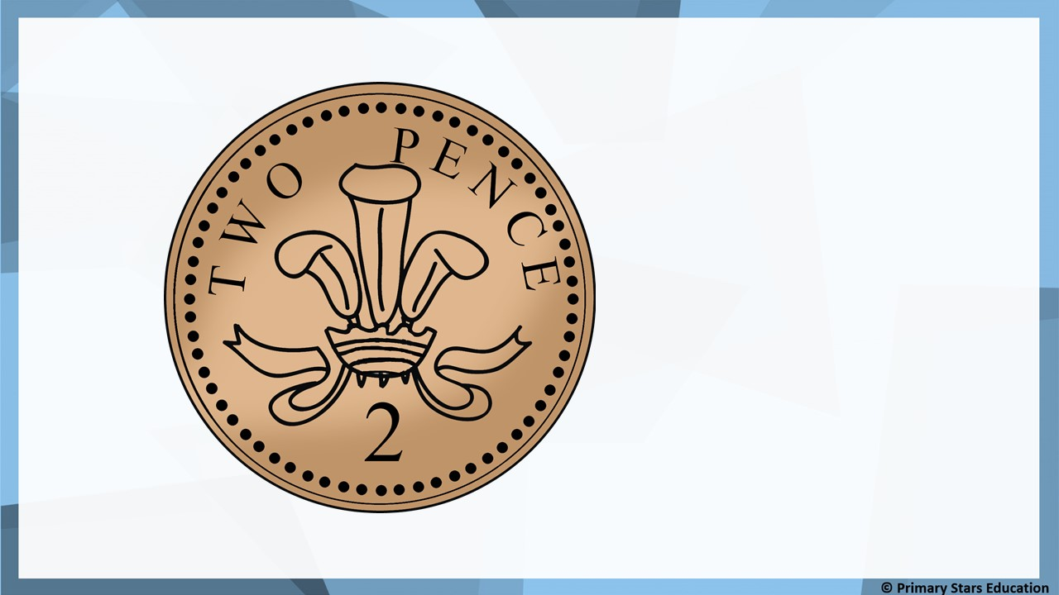
Fluency
2p

Slide 5

Fluency
5p

Slide 6

Fluency
10p

Slide 7

Fluency
20p

Slide 8
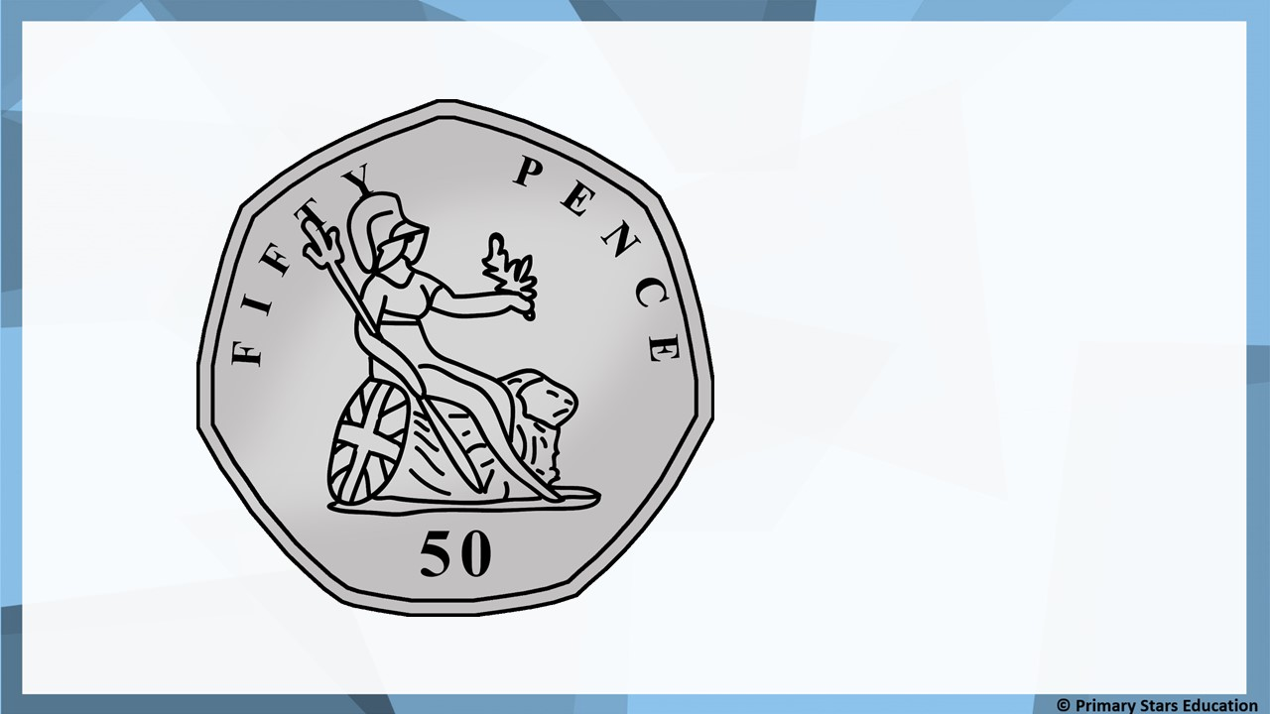
Fluency
50p

Slide 9
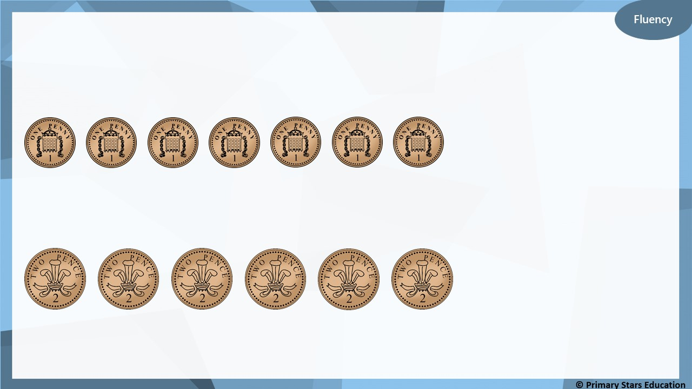
What amounts are shown?
7p
12p

Slide 10
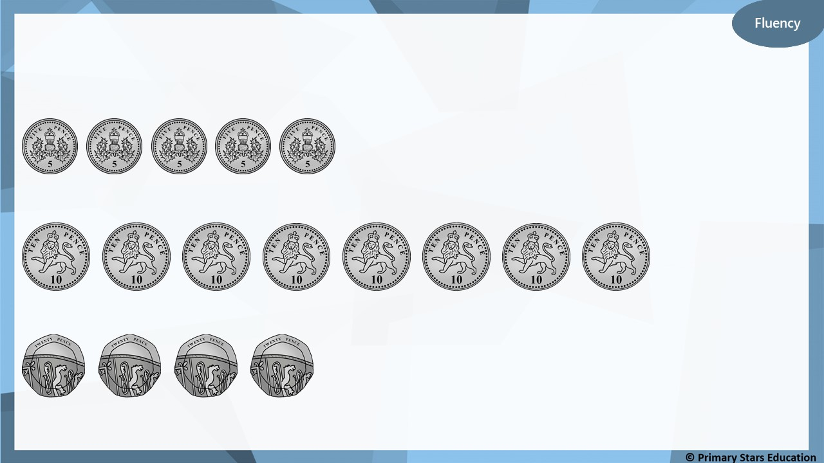
What amounts are shown?
25p
80p
80p

Slide 11
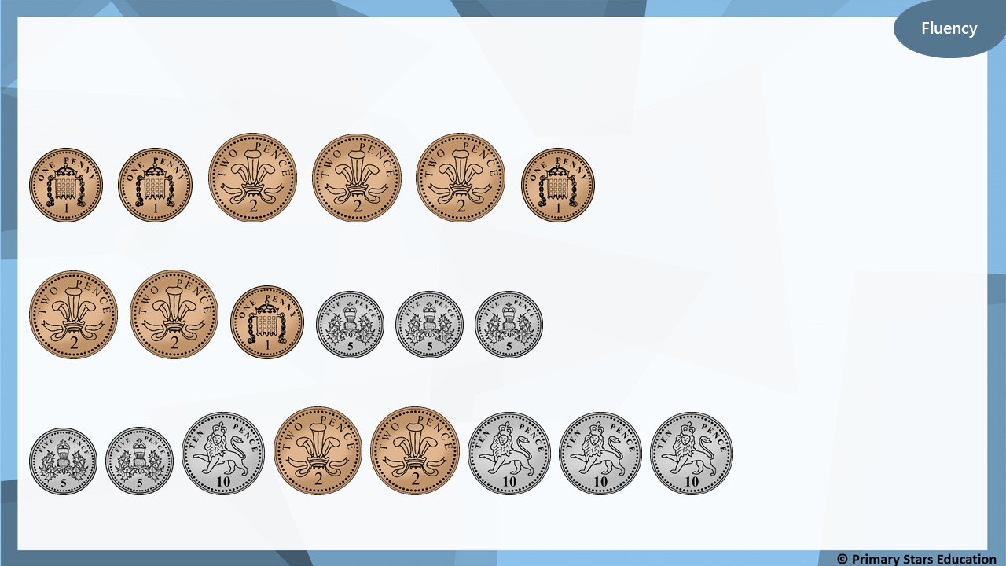
What amounts are shown?
9p
20p
54p

Slide 12
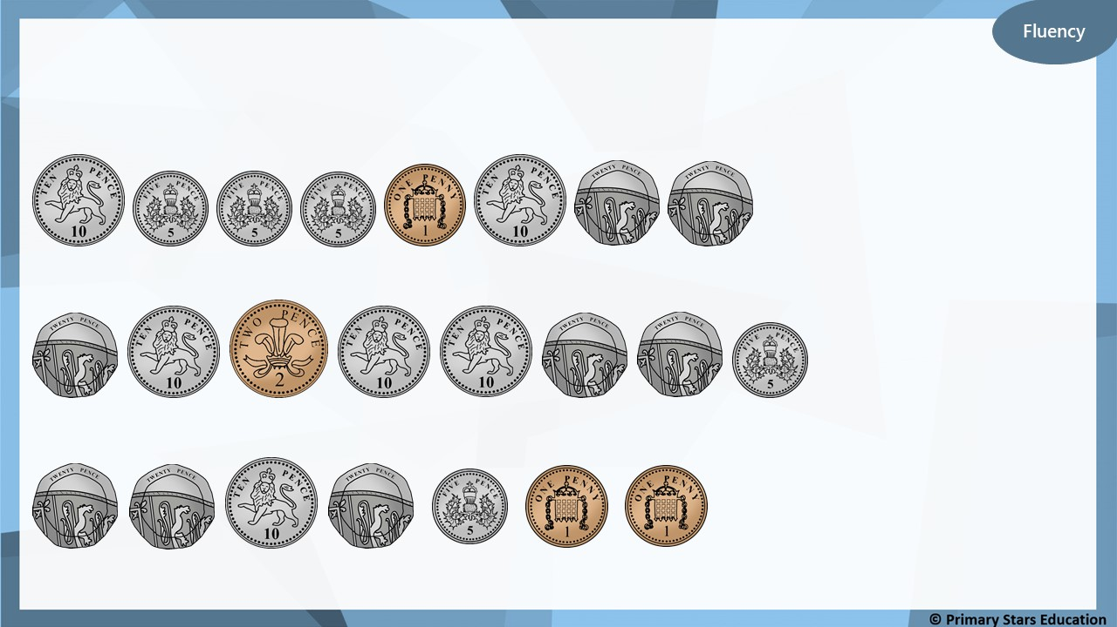
What amounts are shown?
76p
97p
77p

Slide 13
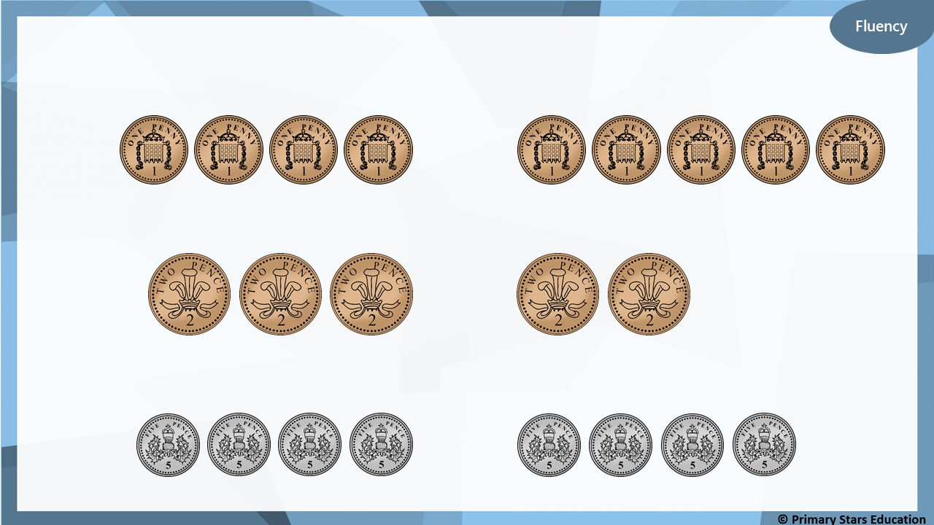
Use <, > or = to compare the money.
<
>
=

Slide 14
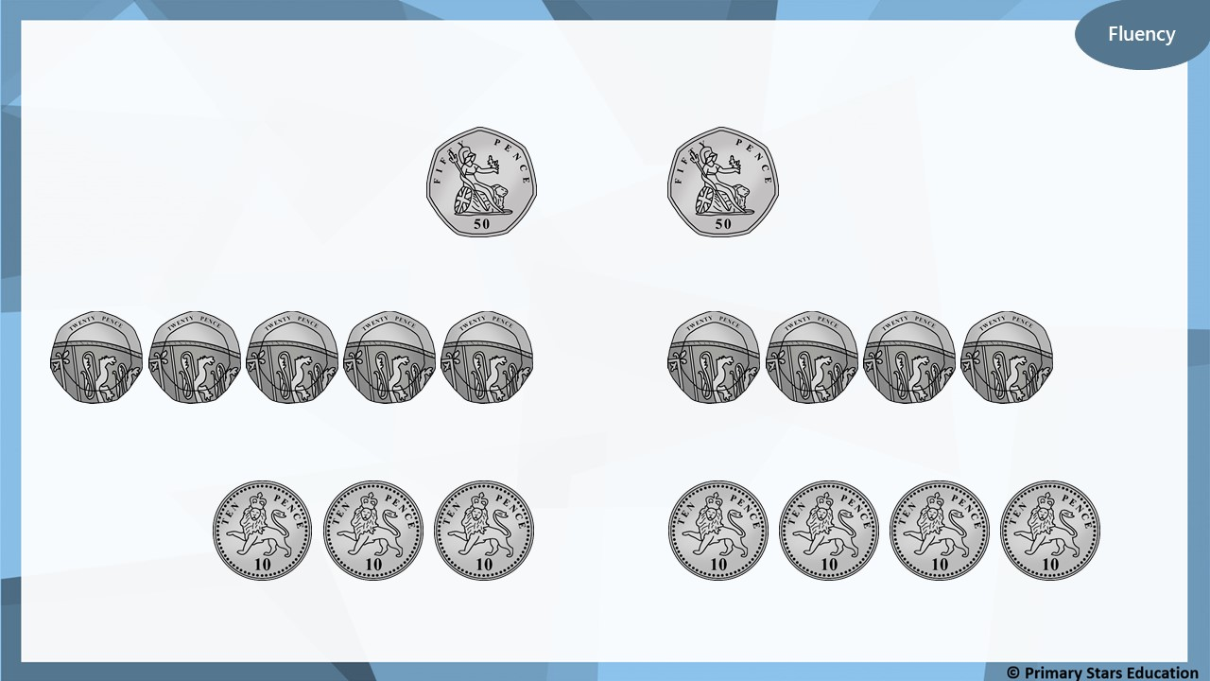
Use <, > or = to compare the money.
=
>
<

Slide 15
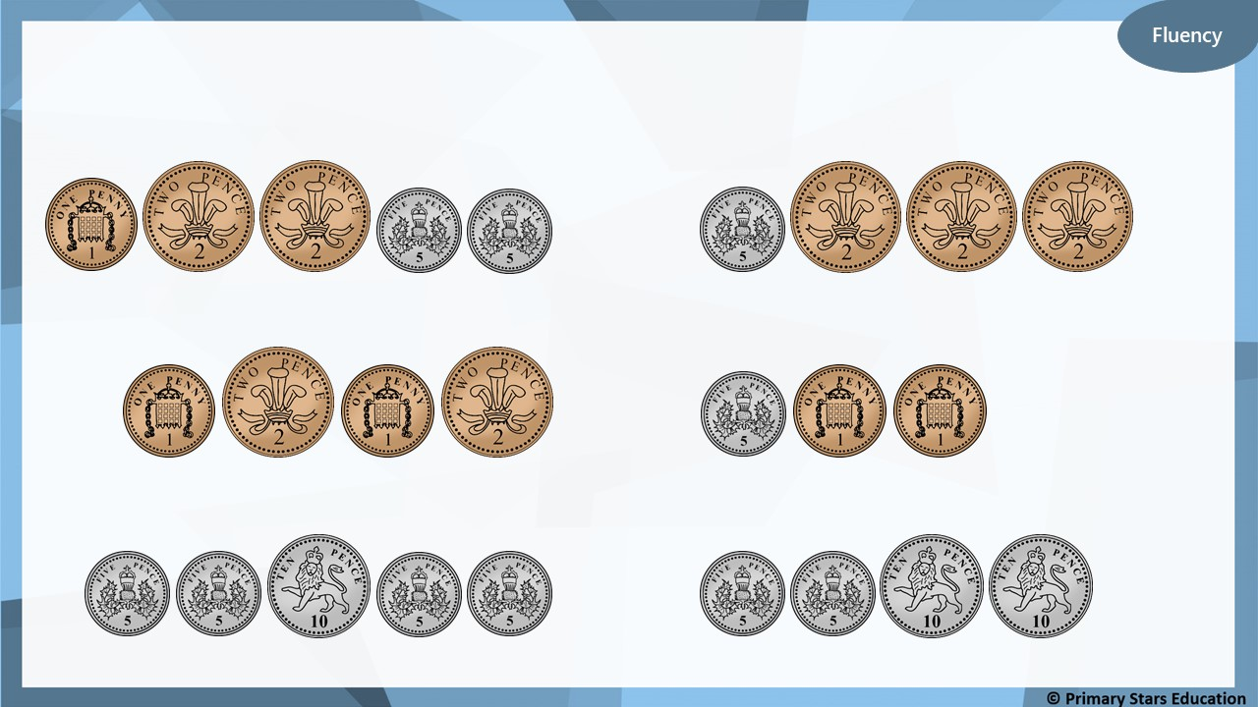
Use <, > or = to compare the money.
>
<
=

Slide 16
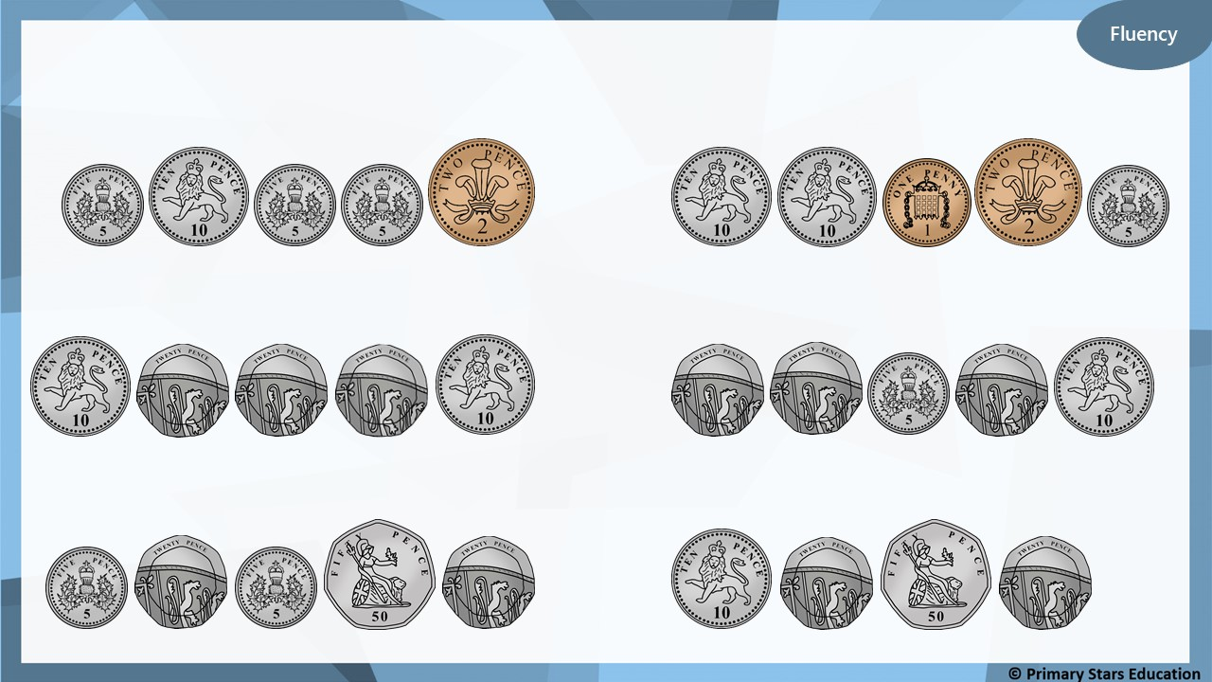
Use <, > or = to compare the money.
<
>
=

Slide 17
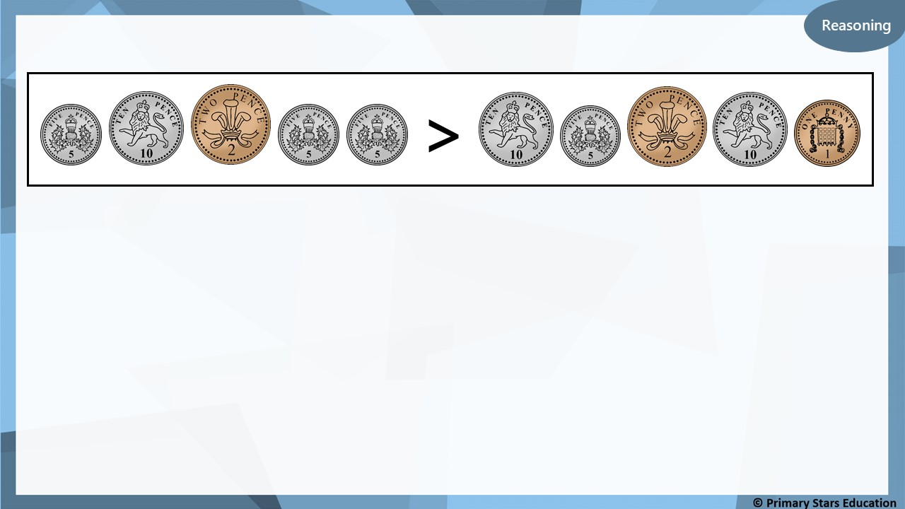
Is the statement above true or false? Explain how you know.
False. The left side shows 27p and the right side shows 28p.
27p is less than 28p so the sign should be less than (<).

Slide 18
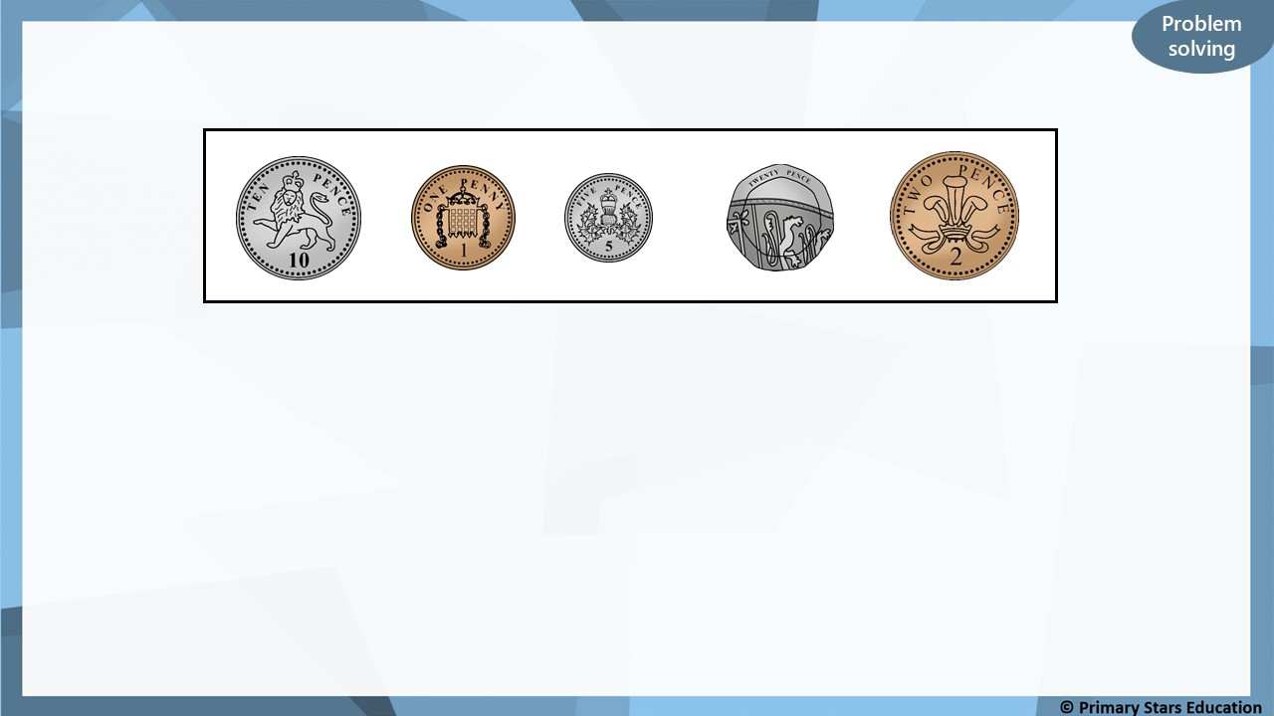
Kat selects four of these coins, using them only once.
18p
What is the lowest total Kat could make? __________
37p
What is the greatest total Kat could make? __________
38p
What total would all the coins make? __________
Notes:
Send y2 to table

Slide 19
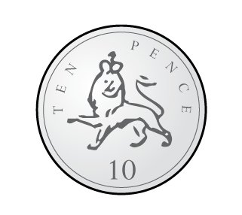

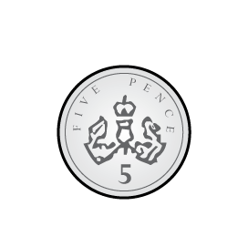

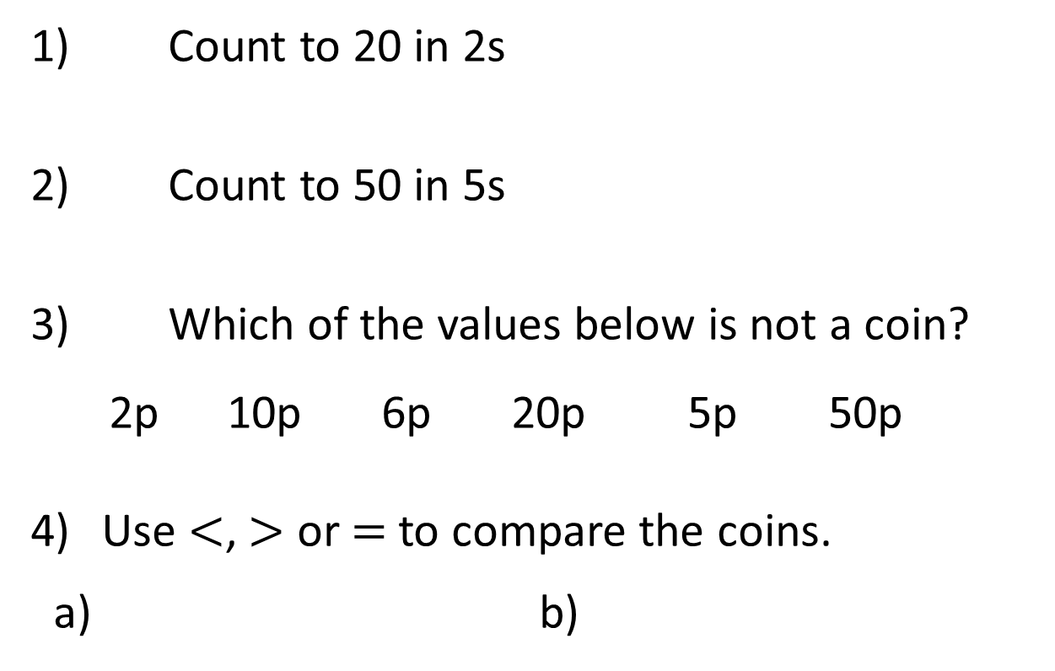
1) Count to 20 in 2s
2) Count to 50 in 5s
3) Which of the values below is not a coin?
2p 10p 6p 20p 5p 50p
Use $<$, $>$ or $=$ to compare the coins.
a) b)
Notes:
Keep Y3 for the next couple slides

Slide 20
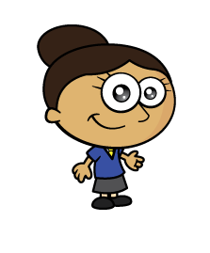

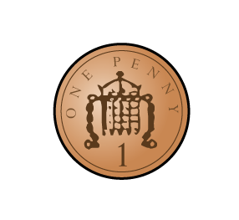
Dora has used pennies to represent the value of different coins.
Which coins has she represented?
Have a think

Slide 21
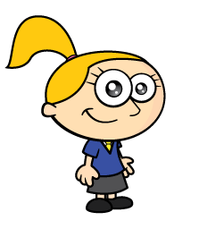
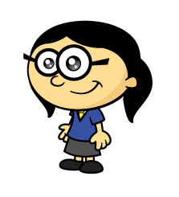
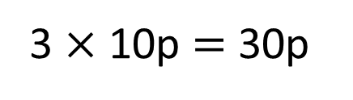
How much money is there?
30p
5
10
15
20
25
30
10p
10p
10p
3 $×$ 10p $=$ 30p
I will count in 5s
I will make 10s

Slide 22
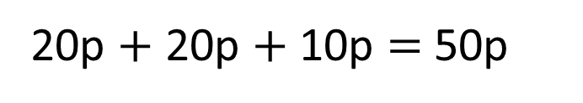

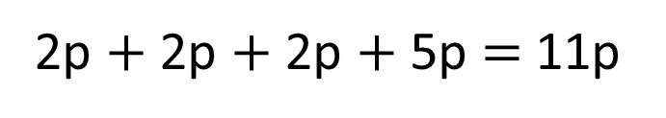
How much money is there?
61p
2p $+$ 2p $+$ 2p $+$ 5p $=$ 11p
20p $+$ 20p $+$ 10p $=$ 50p
50p $+$ 11p $=$ 61p
Have a think

Slide 23
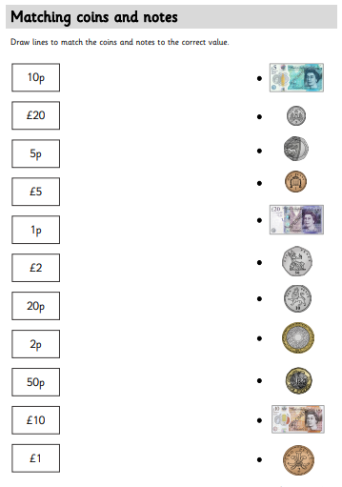
Activity one:
To refresh our memory on recognising coins, complete this worksheet.
You need to match the value to the correct note or coin.
Once you have had this checked you can move onto your next worksheet.

Slide 24
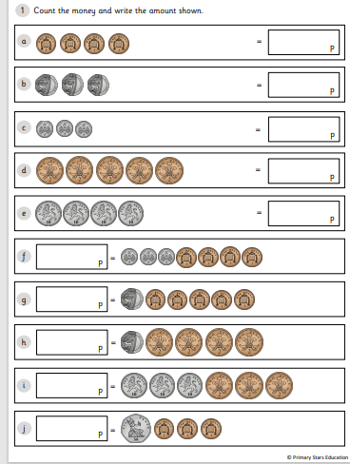
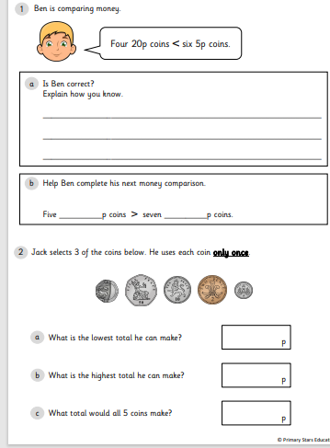
Activity two:
Complete the worksheet, you have two sheets to complete. The first sheet is counting the coins to find the value.
The second sheet is looking at problem solving questions.

